Slide 1

Knowledge Sharing
in Public Administration Sector
Cooperation Program on Public Administration
Woong Joe Ko
Director of International Cooperation for Good Governance
Ministry of the Interior and Safety, Republic of Korea
Notes:
Good morning, everyone. (또는 현지어 인사)
Thank you for attending this meeting.
(도와준 사람,thanks for organizing this meeting.
It is a great pleasure to meet the representative of (나라이름), which is our partner country.
I am Kwon-Mo Kang, Alex, and DeputyDirector of the Ministry of the Interior and Safety, Republic of Korea.
(나라에 대한 코멘트)
We kicked off our visiting program since 2016, havingsent delegations to 9 nations such as Czech Republic, Chile, Costa Rice, Cambodia, and Indonesia.
After visiting these countries, plenty of follow-up projects such as consultation, dispatch of experts, training programs are preceded.
From time to time, we send our delegates to the international conference to be held in our partner countries when requested.
(협력단을 제안하게 된 계기 설명)
Basically, we organize the detailed program, under the agreement with our partner country.
As you can see in the 1st draft on the table, we chose available topics, based on the survey which I sent last September.
I couldn’t include every topic which your side proposed due to the circumstance of each related organizations.
Some organizations had a previous schedule on the day of our visits, even though they look forward to cooperating (국가이름)
Before we discuss the items to organize the cooperation program, I would like to introduce Korea’s cooperation program on public administration.

Slide 2

Knowledge Sharing
on Public Administration Sector
Contents
1. Overview
2. Major Activities
3. Past Performances
4. Key Follow-ups

Slide 3
01. Overview

Slide 4
Overview
Purpose
Promote mutual benefits by sharing knowledge and experience in public policy and services
e.g.
Civil registration, Open Data, E-Government, training and education, etc.
Discuss and search for opportunities for developing cooperation activities and projects
Forms of Cooperation
A multi-departmental Korean delegation dispatched to the partner country
Co-host a public service forum, ministerial meeting, study visits, signing MOUs, etc
Notes:
The main purpose of this program is to share knowledge and experience on various fields of public administration.
The Korean government has sent delegates consisting of government officials from relevant governmentagencies for a short period of time in order to cooperate withcountries around the world on various areas of public administration.
Through this program, we have shared our experiences on various areas of public administration, promoting win-win development as well as facilitating high-level cooperation for long-lasting partnership.
Civil registration, Open Data, E-Government, public security, public health care are the areas that the Korean Government have shared with partner countries.
Furthermore, we will constantly make efforts for achieving sustainable development in the world.

Slide 5
Overview
Procedure
Agreement on cooperation program
Confirmation on the subjects/items
Consult the areas of cooperation
Consider the needs of partner country
Discuss contents and logistics
Delegation dispatched and event held
Cooperation Forum, Ministerial Meeting, Signing of MOU, etc.
Conduct follow-up activities
Training program, consulting, full-scale projects, etc.
Notes:
We have already consulted the areas to cooperate. Let’s skip this page.

Slide 6
02. Major Activities
Notes:
Now, I am going to introduce the key components implementedby our program.

Slide 7
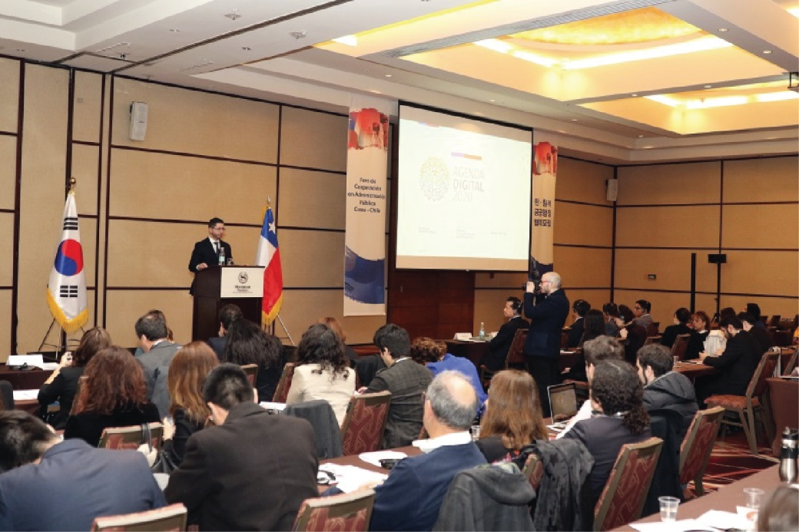
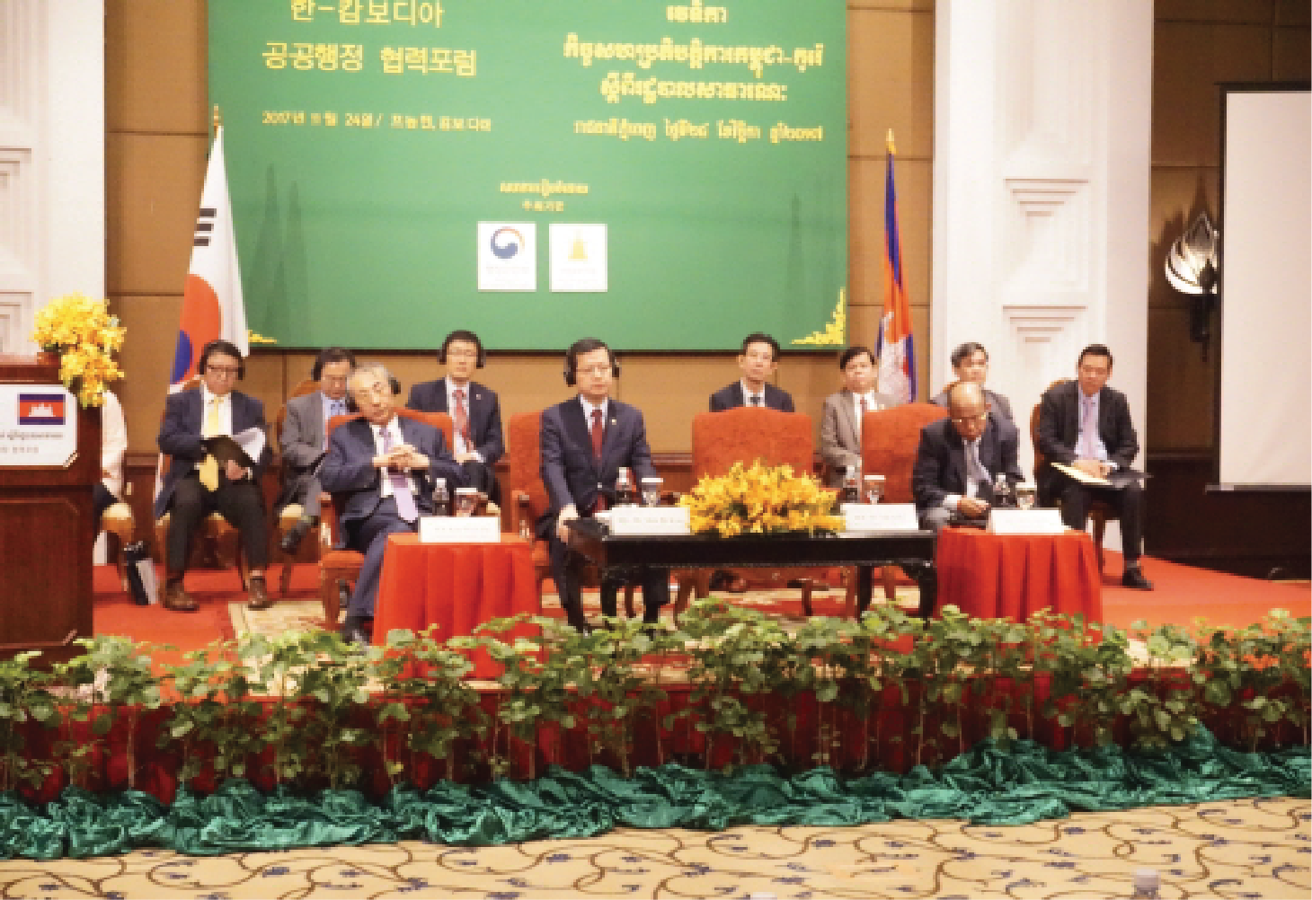
Major Activities – Cooperation Forum
Intergovernmental forum where public officials from ministries and public institutions participate and share development experiences
Korea-Chile Cooperation Forum
Korea-Cambodia Cooperation Forum
Notes:
First,one-day Forum!
We’ve held cooperationforum on public administration with our partner countries, attended by relevant ministries with selected topics.Relevant organizations from two countries will give 15-20 min presentations to introduce their policies.
Through this forum, two countries could share experiences on wide-ranging of public administration, such as e-Government, Open data, civil registration and etc.
The forums have been meaningful in that the occasions have helped countries briefly understand policies of each other.

Slide 8
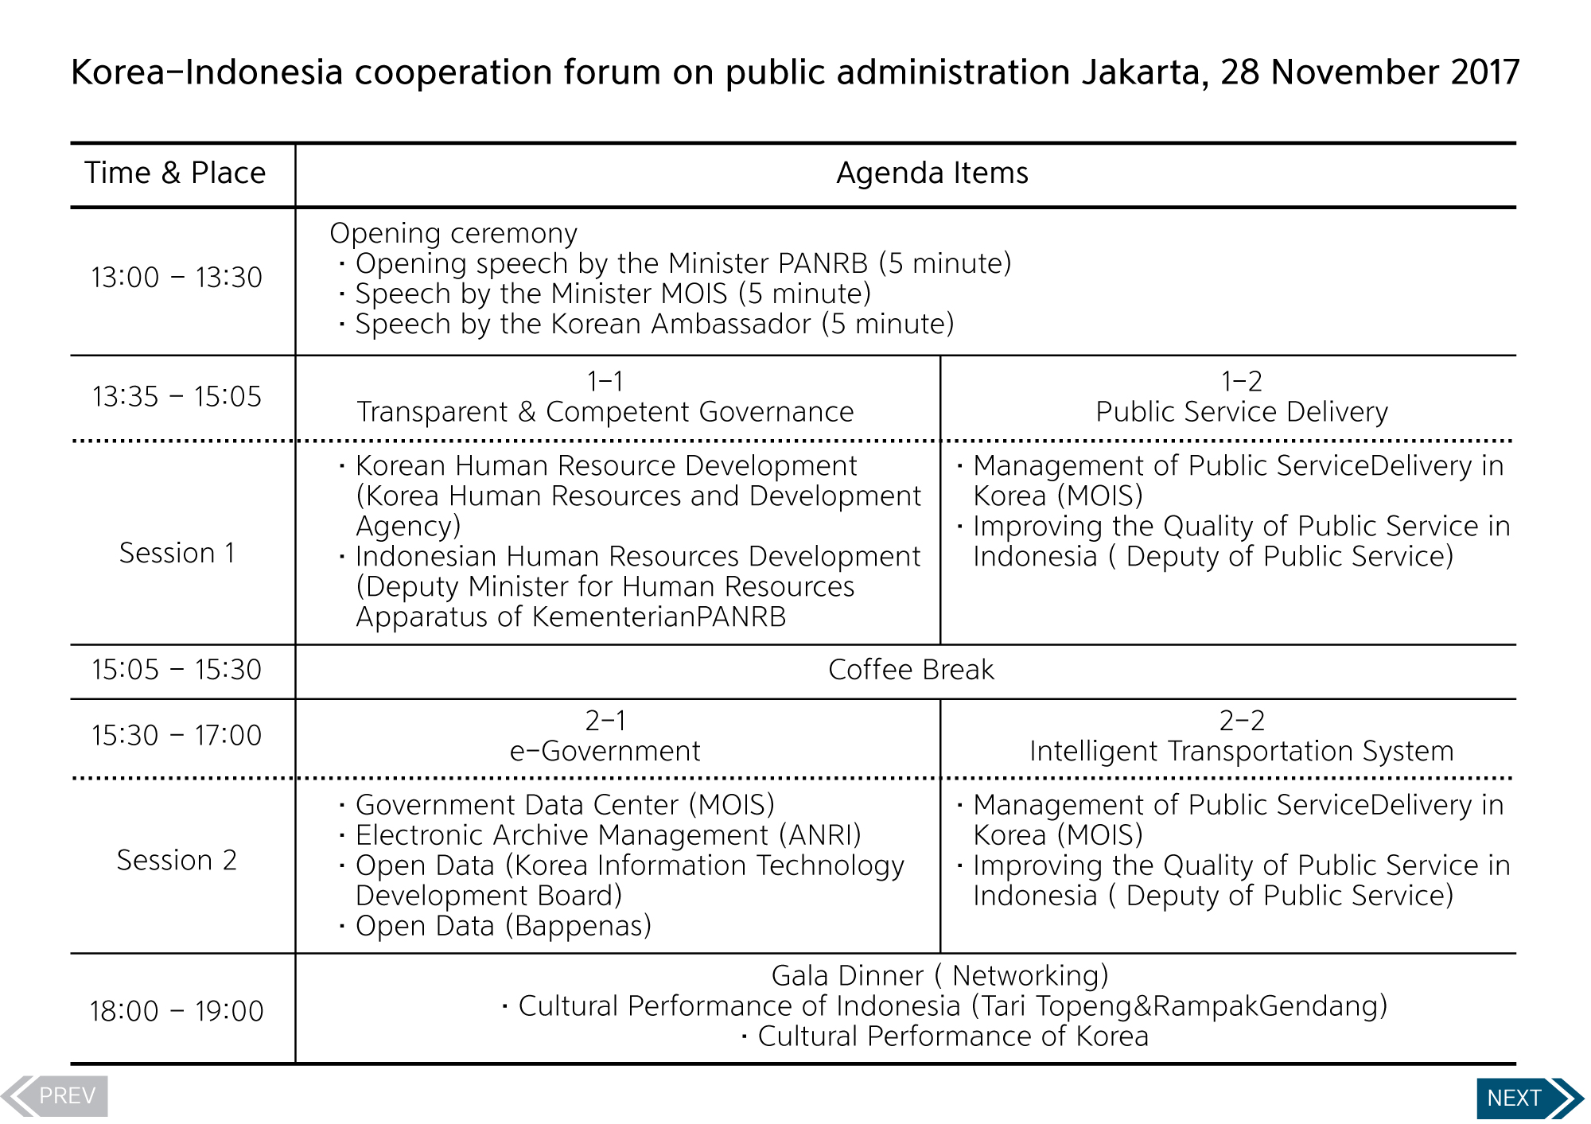
Notes:
This is one of the examples, which was the time table for the Korea-Chile Cooperation Forum held in July last year.
Not only the MOIS, but also other government agencies such as Seoul Metropolitan City and Korea Customs Services joined the forum and shared various issues like Intelligent Transport System and e-customs service.

Slide 9
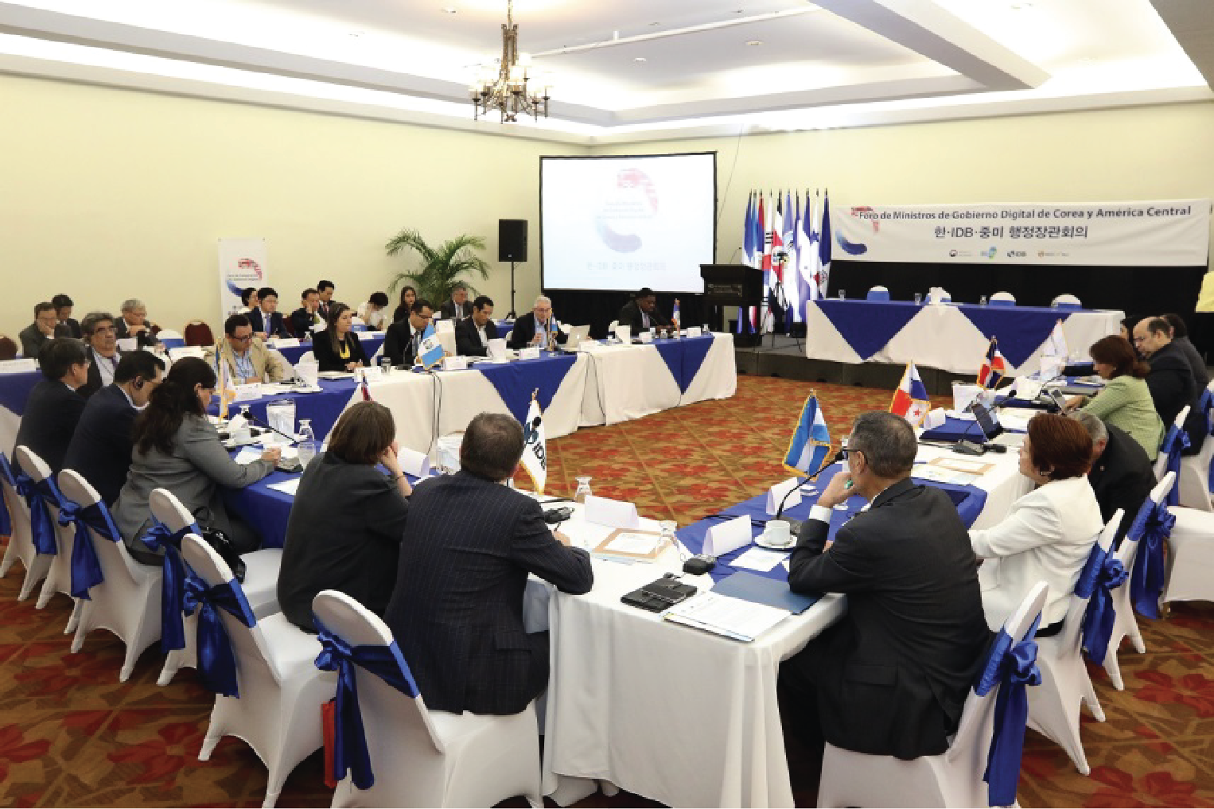
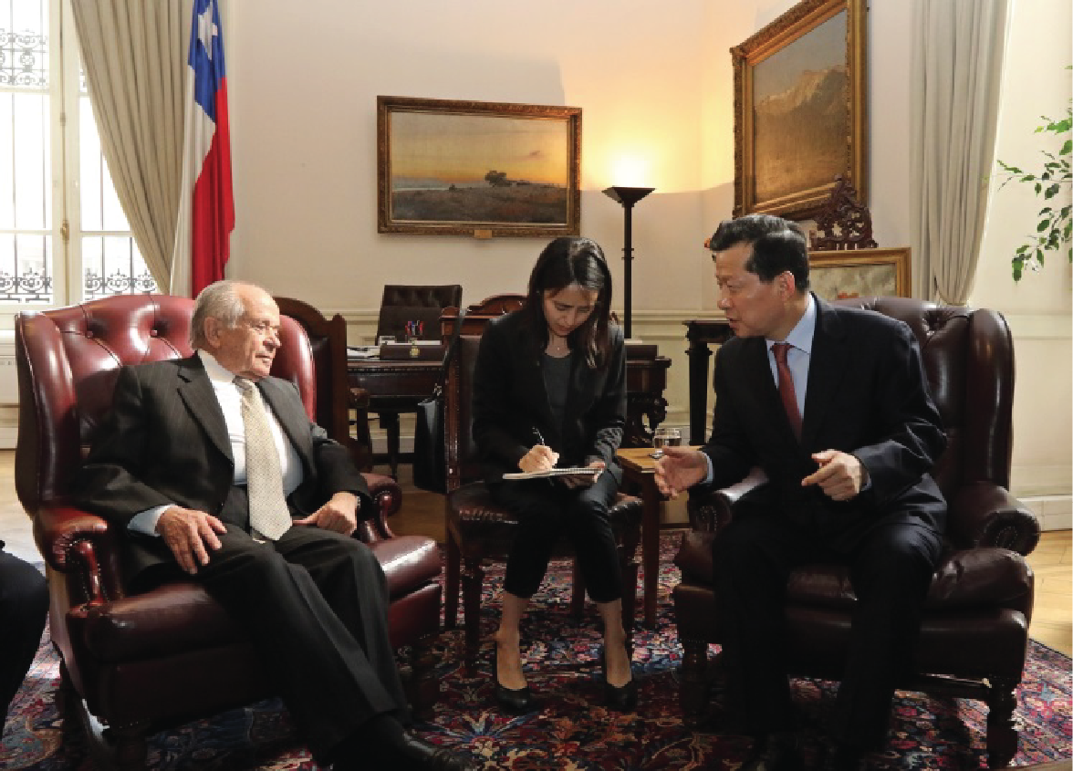
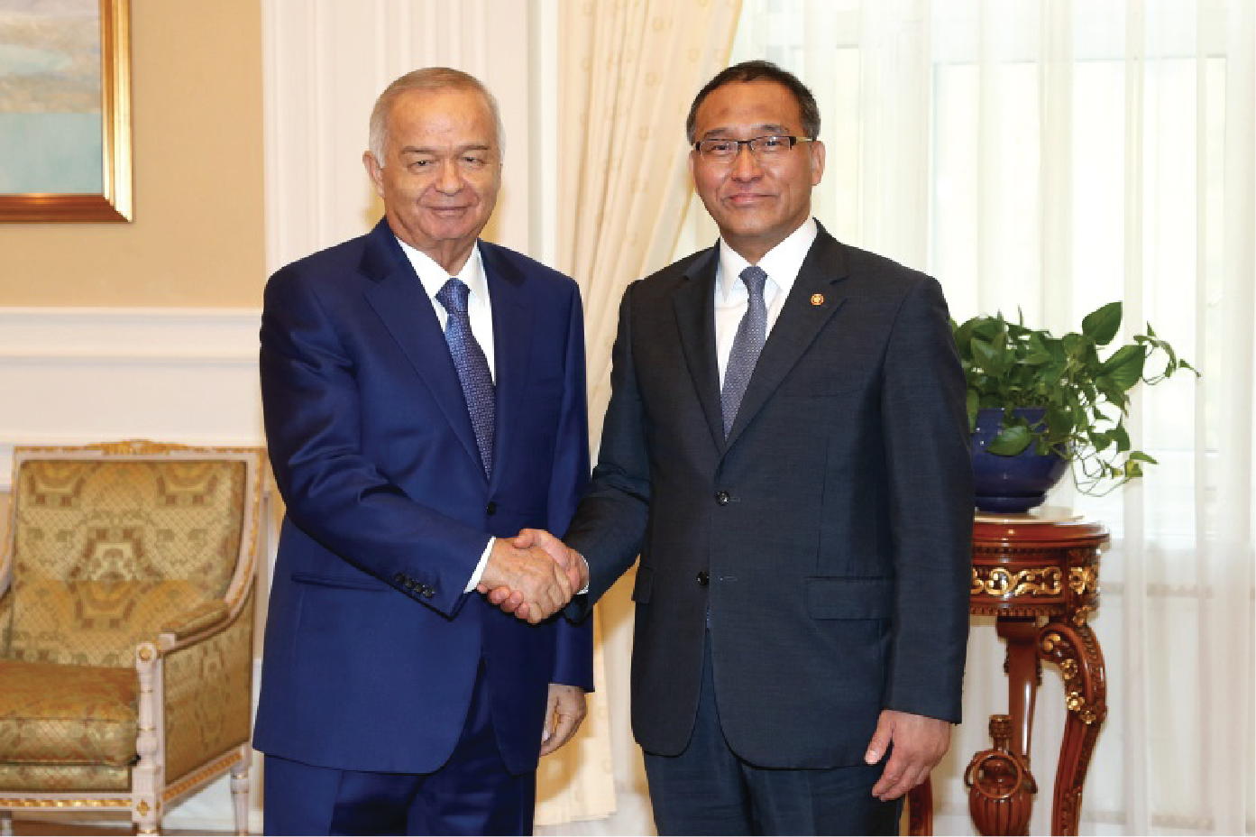
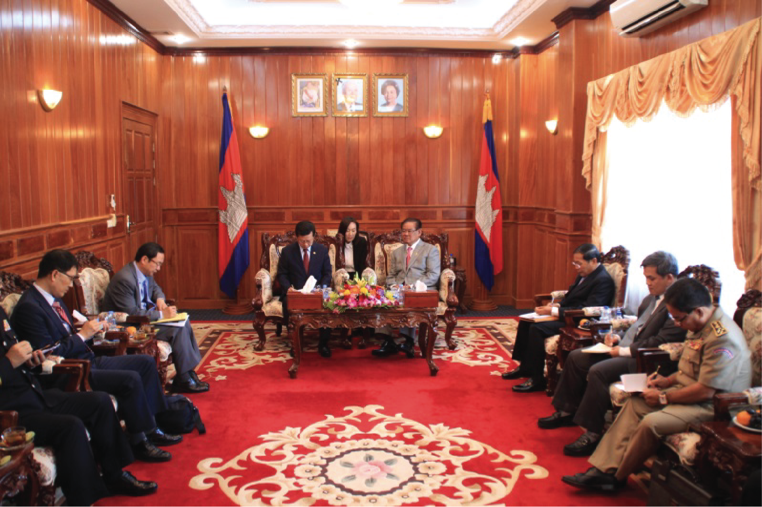
Major Activities - Ministerial Meeting
Review and exchange ideas and thoughts to initiate cooperation activities
1. Multilateral Ministerial Meeting
2. Bilateral Ministerial meeting
3. Signing of MOU
Korea – IDB – Central
America Ministerial meeting
(July 2017, Costa Rica)
e.g
Korea-IDB-Central America Ministerial Forum
Courtesy Call on the late Uzbek President Karimov
Courtesy Call on President of the Senate in Chile
Bilateral Meeting of Ministers of the Interior of Cambodia and Korea
Notes:
In addition to cooperation forum, we promoted high-level cooperation such as multilateral, ministerial meeting, bilateral meeting and MOU conclusion in parallel.
The photos in this slide show the examples of high-level cooperation activities performed between Korea and partner countries in recent years.
High-level cooperation gives momentum to carry out cooperation activities in specific areas, and it is also very importance in terms of making cooperation sustainable in the future.
In occasion, the president of a visiting country warmly welcomes the Korean delegation in the past, and after a courtesy call, specific cooperation activities were initiated right away.

Slide 10
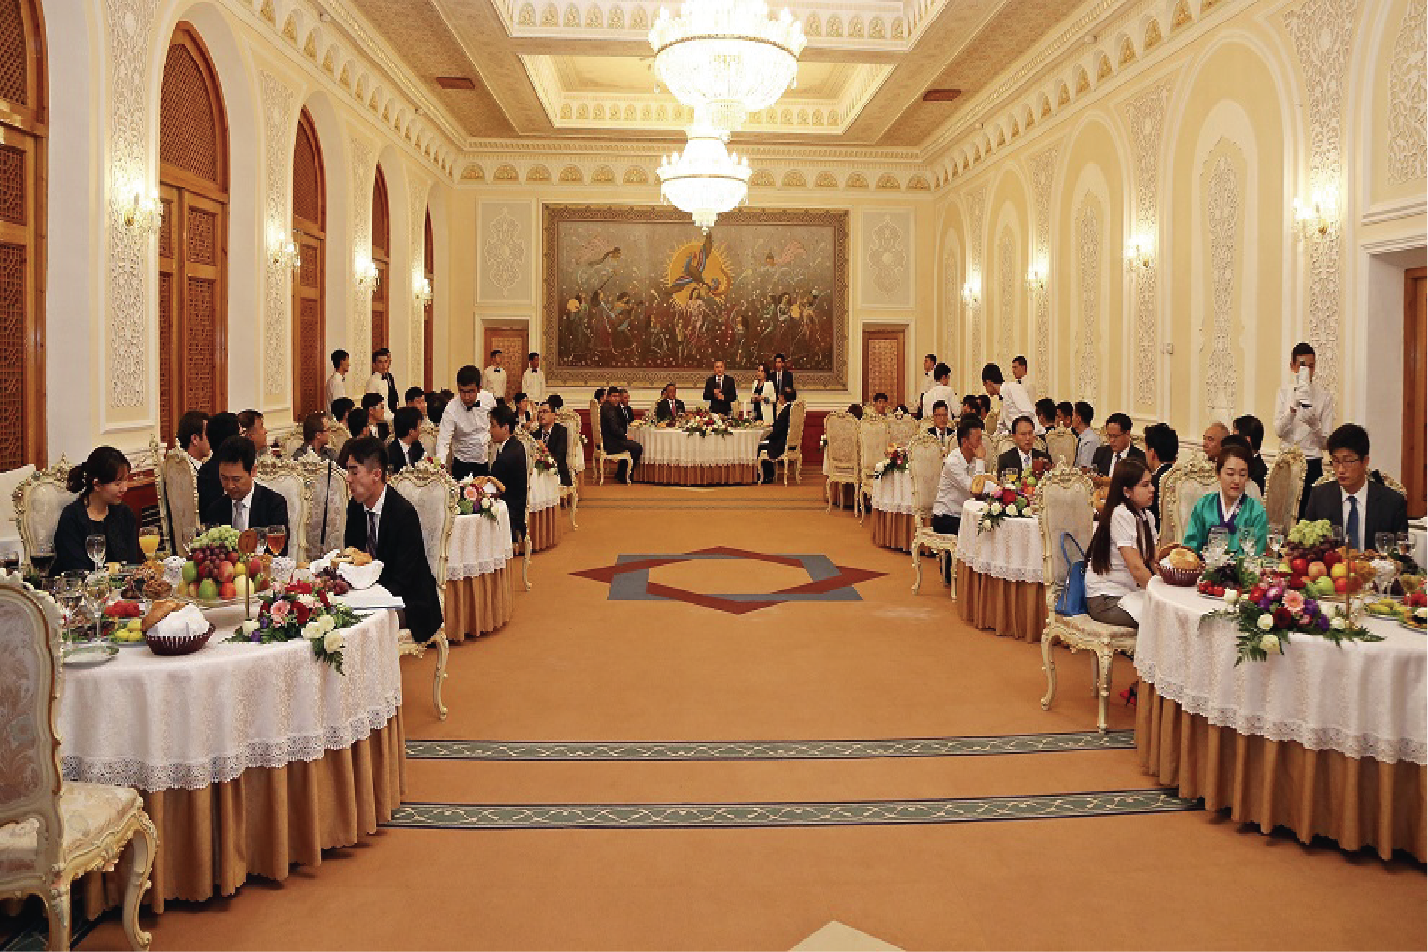
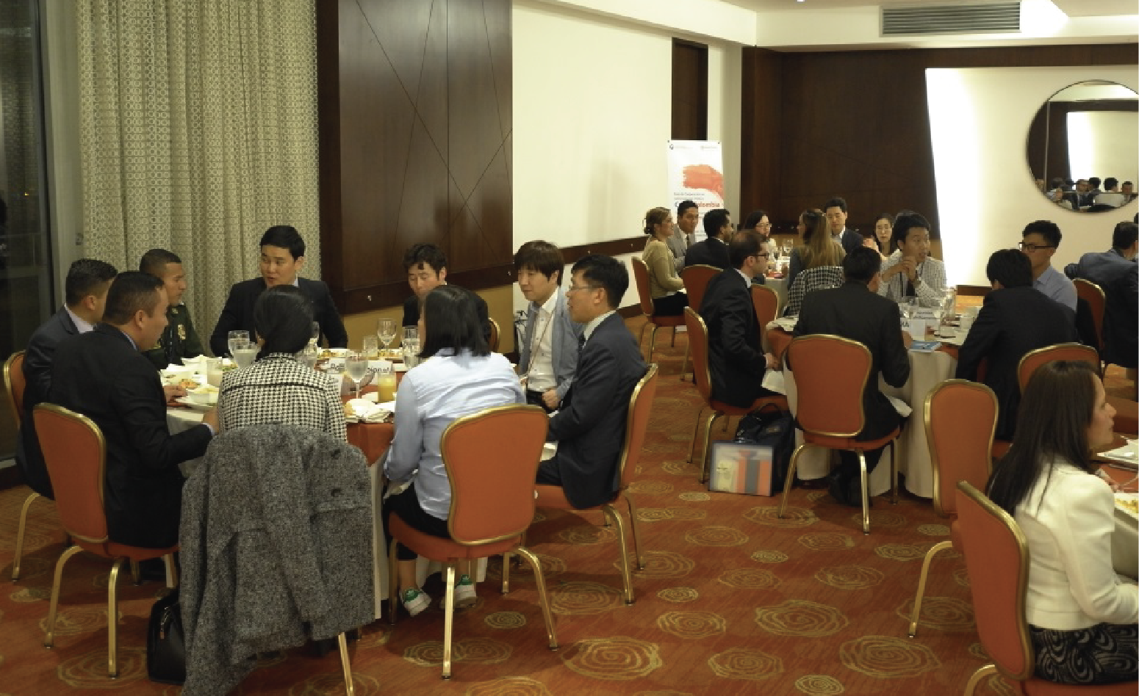
Major Activities – Networking Events
Networking and expertise sharing opportunieies
Korea-Uzbekistan Networking Dinner
Korea-Colombia Networking Dinner
Notes:
Luncheon or dinner is provided with an aim to build friendship and network with each other during forums.

Slide 11
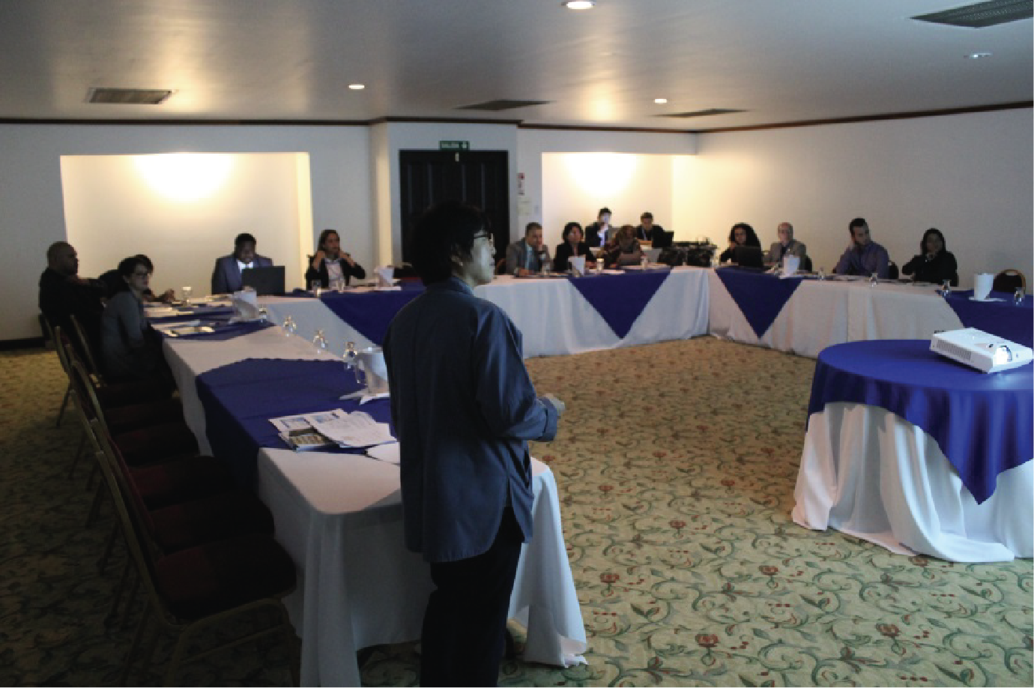
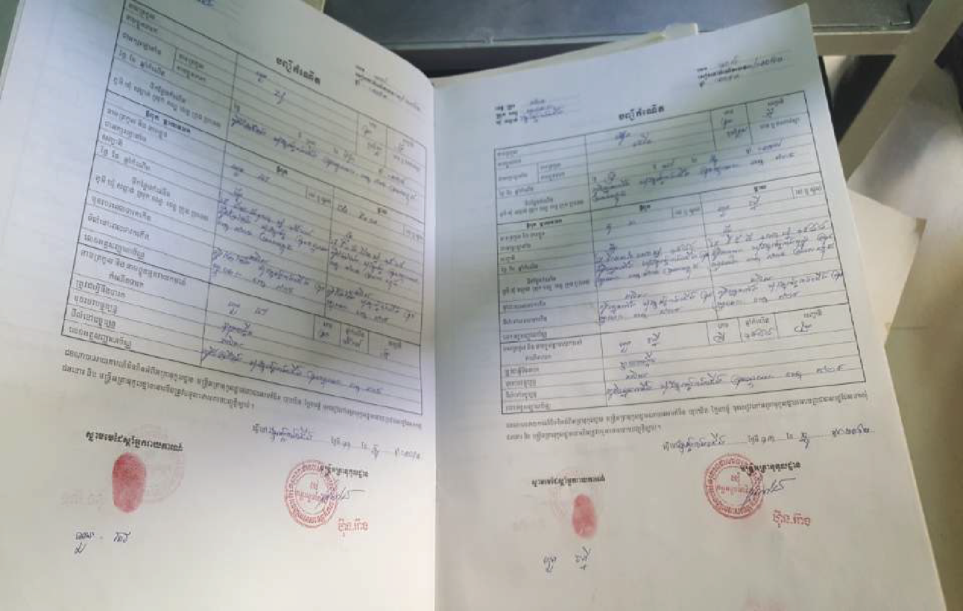
Major Activities – Working-level Activities
In-depth workshop on issues discussed at the forum and on-site visits
In-depth Workshop on National Archive with 8 Central American Countries
On-Site Visit – Image of Cambodia’s National ID Card Application Form
Notes:
Moreover, working-level cooperation normally is arranged to deepen the discussion in the forum. 15-20 min presentation isdefinitely not enough to understand how the policies promoted, what difficulties we had been faced, and how we can solve the problems. To exchange know-how and give some inspiration for these issues,respective organizations of two countries normally hold in-depth workshop. For example, experts of cyber security in Korea have a meeting with the experts of cyber security in your country, with visiting government complex of DICT. In other cases, some of counterpart organizations provided on-site visit for Korean delegations to seek the cooperation projects.You can see the image of Cambodia’s national ID card application form in this slide. Our delegation could recognize how ID cards in Cambodia are manufactured,and thennew installment of e-civil registration system is needed to be commenced in the country. To be honest,Working-level cooperation ismuch more important as high-level cooperation in order to create new joint projects in some specific areas.

Slide 12
03. Past Programs

Slide 13
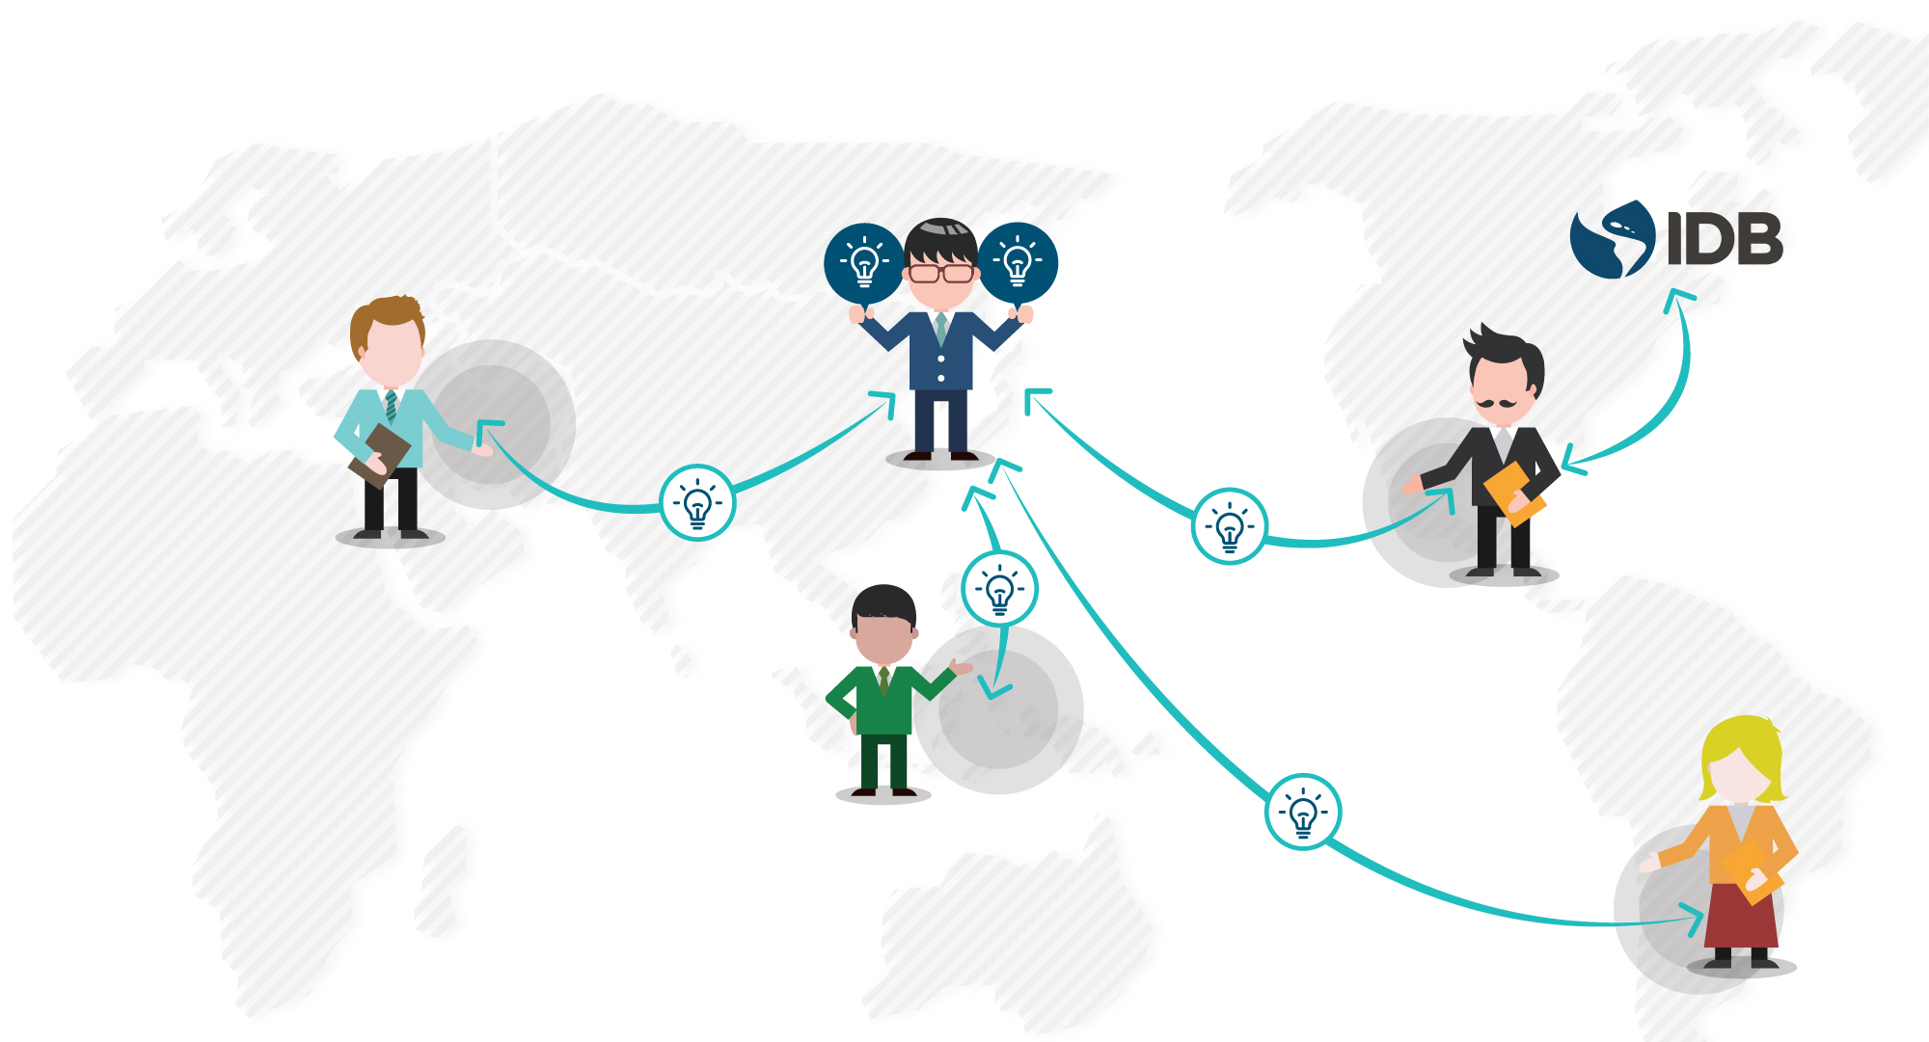

Past Programs
Europe
Czech Republic
Serbia
Portugal
Central
America
Central
Asia
Costa Rica
Mexico
Uzbekistan
Azerbaijan
South-East
Asia
South
America
Indonesia
Cambodia
Chile
Colombia
Notes:
As I have already mentioned, the Korean government has sent delegations to 9 countries over the past two years and shared know-hows on achieving innovation in various fields of public administration.
This map shows where the past countries which Korean delegations had visited for the last couple of year.
Next, I will introduce you which activities were done for each visit.
In last July, our delegations visited Czech Republic to deal with 9 topics, including e-Government, cyber security, e-procurement, and public safety.

Slide 14

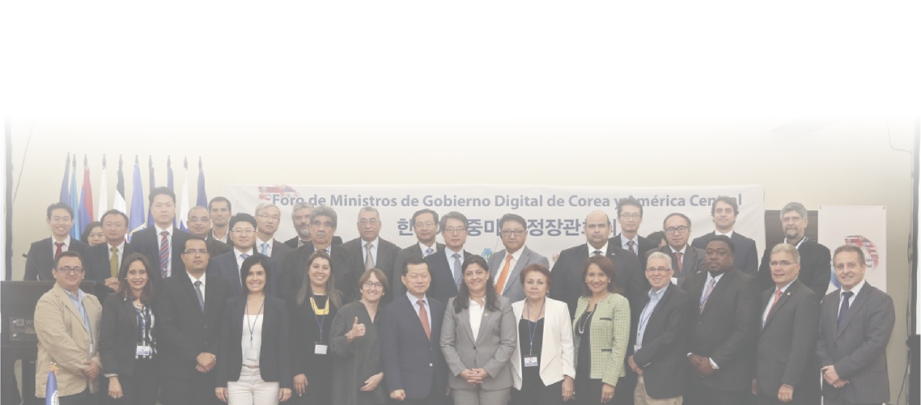
Central America and Chile
Date : July 26 –August 1, 2017
Participating Ministries and Agencies from Korea
- Ministry of the Interior and Safety (Legal Framework for digital government, National Archive, civil registration, public service delivery, national disaster management, data analytics for public service)
- Korea Custom Service (e-Custom system)
- Seoul Metropolitan Government (Intelligent Transport System)
- Ministry of Government Legislation (Legal information system)
Notes:
In July 2017, Korean delegates visited Costa Rica and Chile to share our experiences in various areas of public administration.
As you can see in the slide, 4 government organizations participated as the delegates to implement government-to-government cooperation.
Through the last visit, the Korean government could make progress on cooperation in various areas such as civil registration and natural disaster management as well as high-level cooperation.

Slide 15
Central America and Chile
Activities
- Korea-IDB-Central America Ministerial Meeting
(Participated countries) Belize, Costa Rica, Dominican Republic, El Salvador, Guatemala, Honduras, Nicaragua, Panama
- Korea-Central America / Korea-Chile Cooperation Forum on Public Administration
- Joint declaration between Korea and 8 Central American Nations for Public Administration
- Signing MOU between Korea and Costa Rica on Cooperation in e-Government

Slide 16

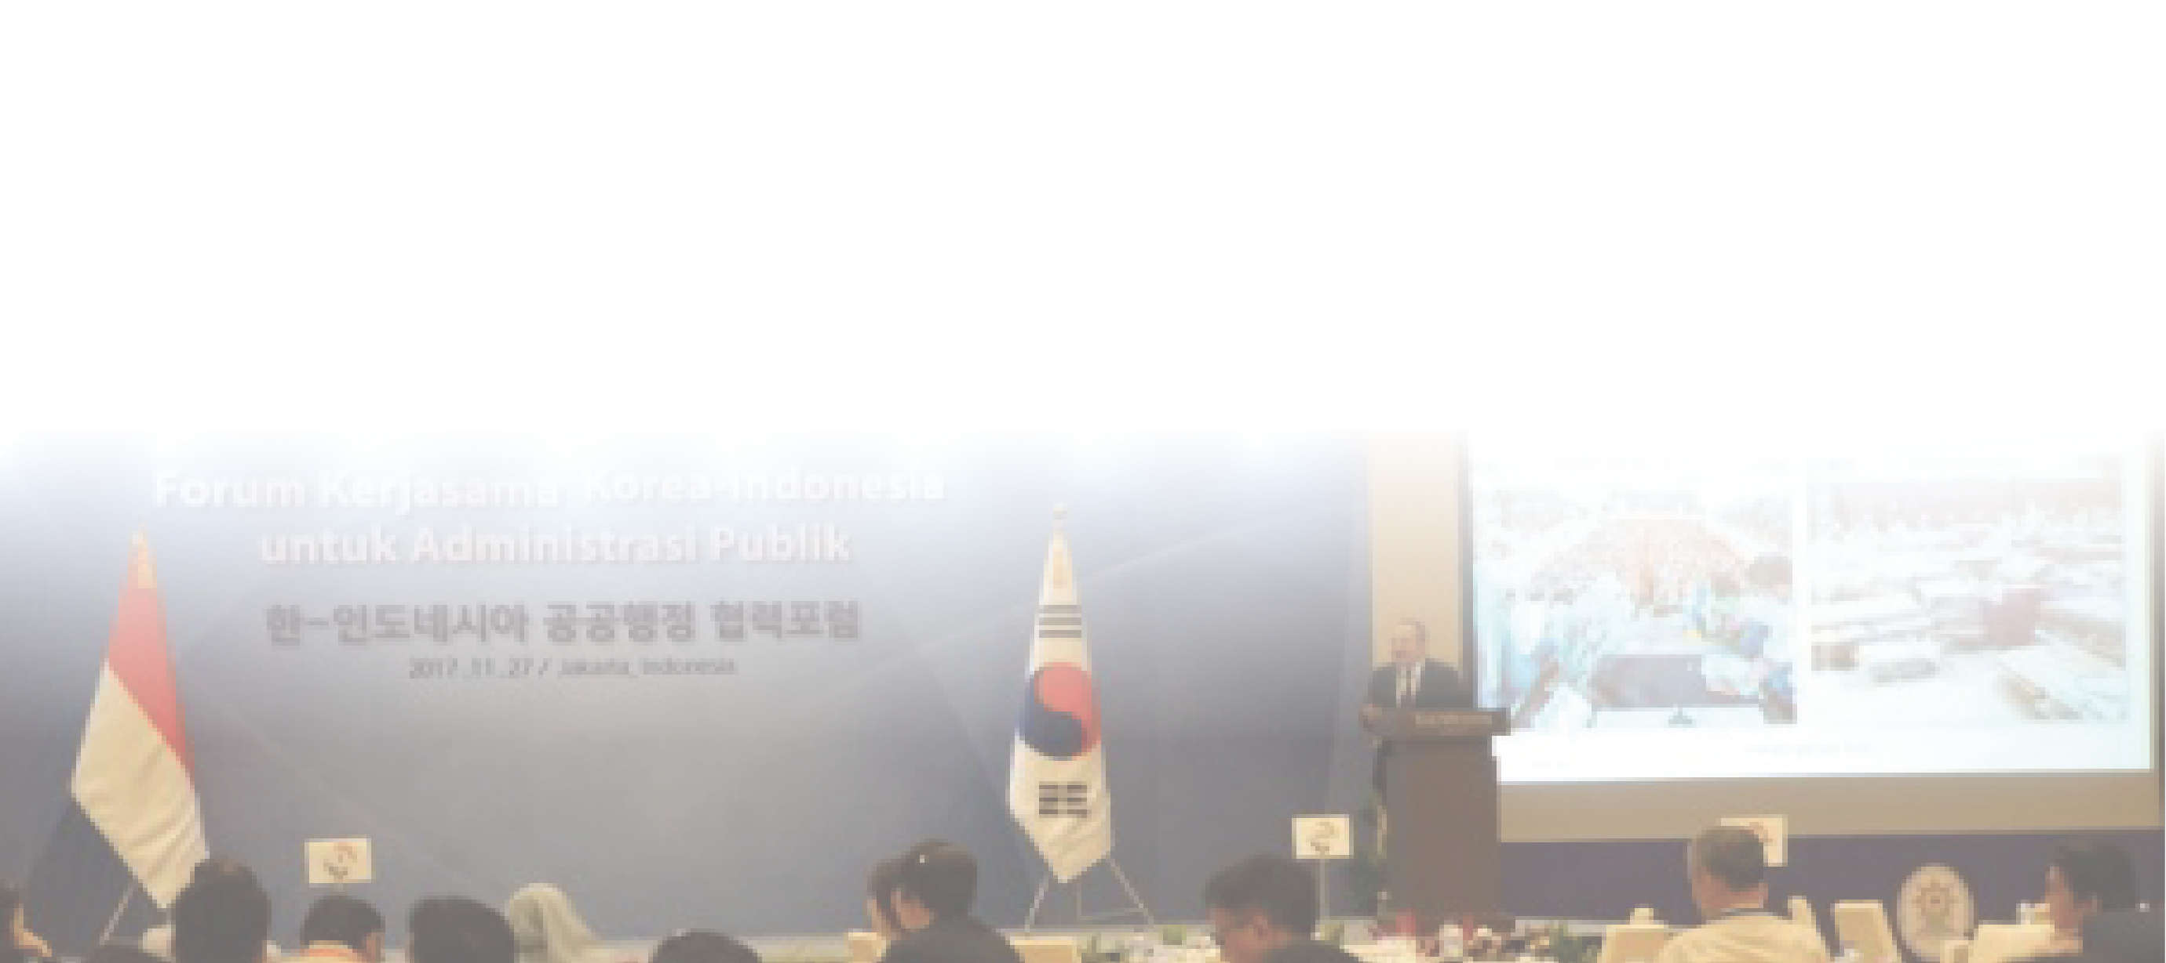
Indonesia and Cambodia
Date : November 23-28, 2017
Participating Ministries and Agencies from Korea
- Ministry of the Interior and Safety (Civil registration, NID, public service delivery, government data center, national disaster management, capacity building of local government, Open Data, national archive)
- Ministry of Personnel Management (Personnel management)
- Ministry of Land, Infrastructure and Transport (Intelligent Transport System)
- National Police Agency (Public Safety)
- Seoul Metropolitan Government (Public transportation system)
Notes:
In last November, the Korean delegates consisting of 5 government organizations visited Indonesia and Cambodia.
Korea and Cambodia signed an MOU for Cooperation on Public Administration to strengthen the bilateral relation as well.
Recently, Korea and Cambodia are going to commence capacity building program for local government officials in this November.

Slide 17
Indonesia and Cambodia
Activities
- Korea-Indonesia, Korea-Cambodia Cooperation Forum on Public Administration
- Signing MOU between Korea and Cambodia on Cooperation in Public Administration
- Bilateral meeting with Minister of Interior in Cambodia

Slide 18

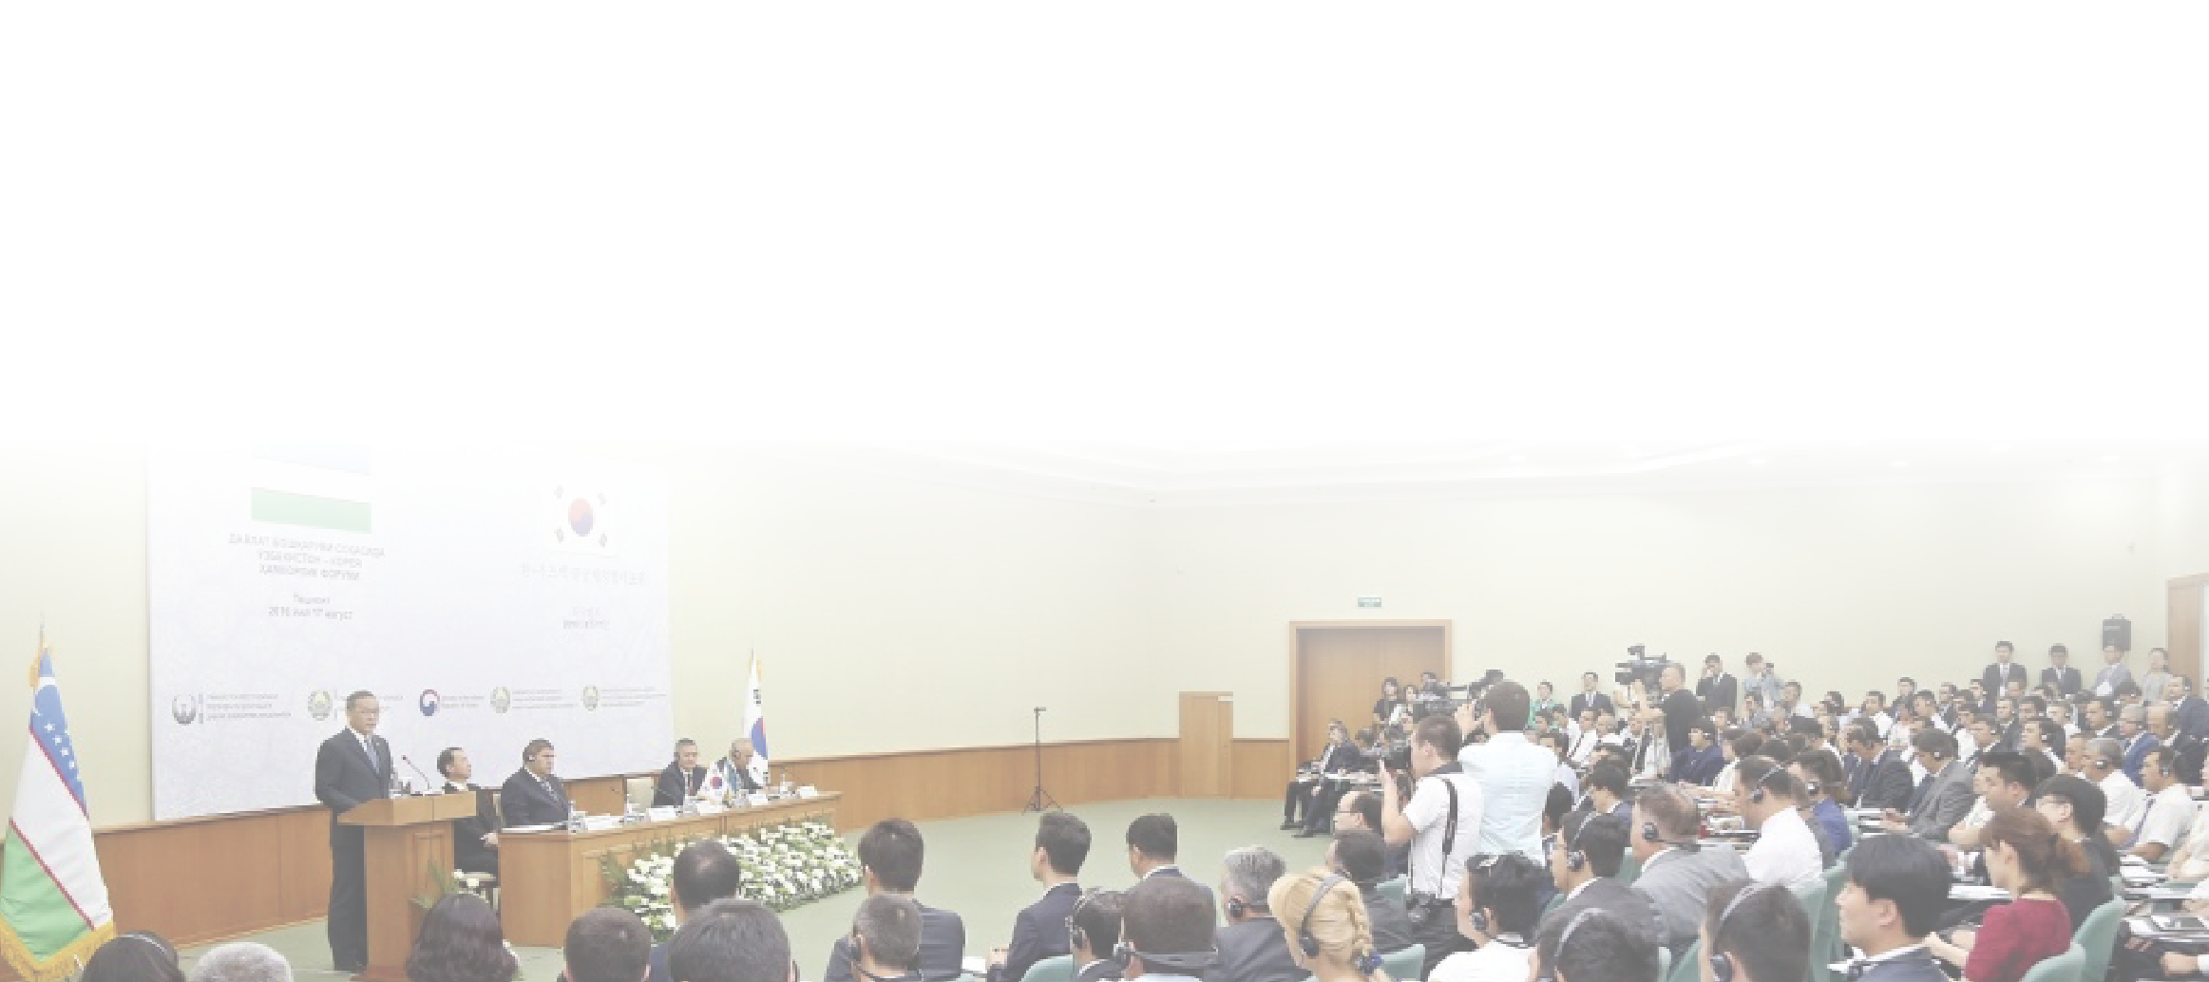
Uzbekistan and Azerbaijan
Date : August 16-20, 2016
Participating Ministries and Agencies from Korea
- Ministry of the Interior and Safety (Government Data Center, sharing of administrative information, National Archive)
- Ministry of Personnel Management (Capacity building for government official)
- Ministry of Justice (Information system of criminal justice service)
- Korea Post (Postal logistics system)
- Korean Intellectual property office (Intellectual property system)
- Ministry of Health and Welfare (Maternal and child health care)
- Ministry of Government Legislation (Legal information system)
Notes:
In August 2016, the delegations composed of 7 government organization visited Uzbekistan and Azerbaijan.
Especially, the late Uzbekistan president Karimov warmly welcomed the delegation and allowed a courtesy call by the head of delegation, who was the Minister of the Interior and Safety.
Through the meeting, Korea and Uzbekistan further enhanced bilateral cooperation in many fields.
You know? Our previous minister was the last person who paid a visit to the late president Karmiov.

Slide 19
Uzbekistan and Azerbaijan
Activities
- Korea-Uzbekistan, Korea-Azerbaijan Cooperation Forum on Public Administration
- Courtesy call on the late Uzbekistan president and Azerbaijan Prime Minister
- Signing MOU between Korea and Azerbaijan on Cooperation in e-Government

Slide 20
04. Key Follow-ups
Notes:
Our program was followed by so many follow-up activities.

Slide 21
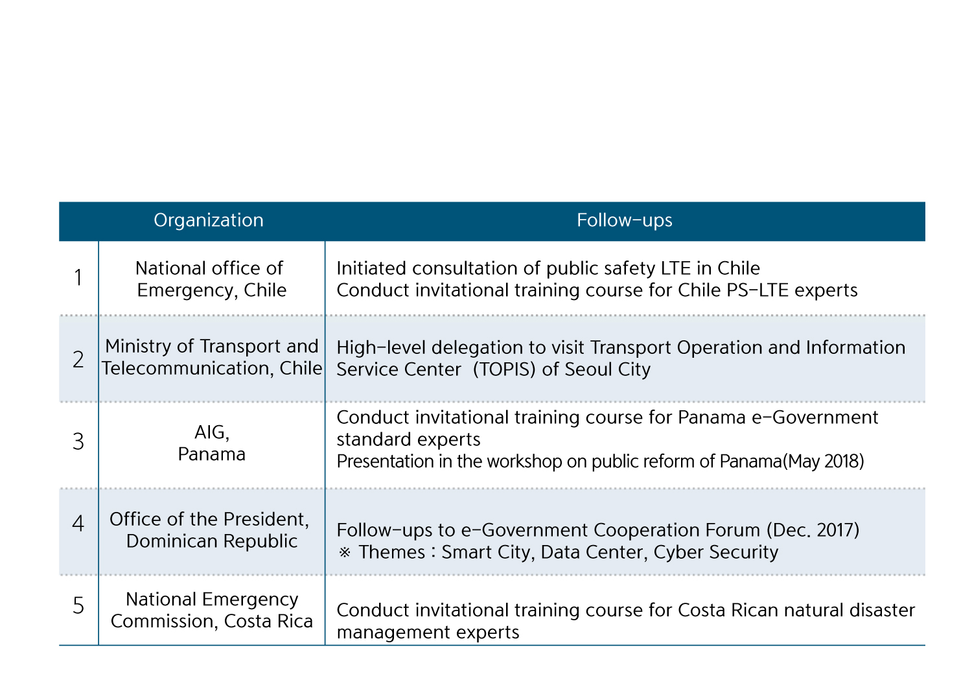

Key Follow-ups
1) Central America and Chile
Notes:
First of all, Korea and Chile are closely working together to construct the Public Safety LTE by mutual consultation. And, the Korean government finished an invitational training program for disaster safety management experts in Costa Rica in March.

Slide 22

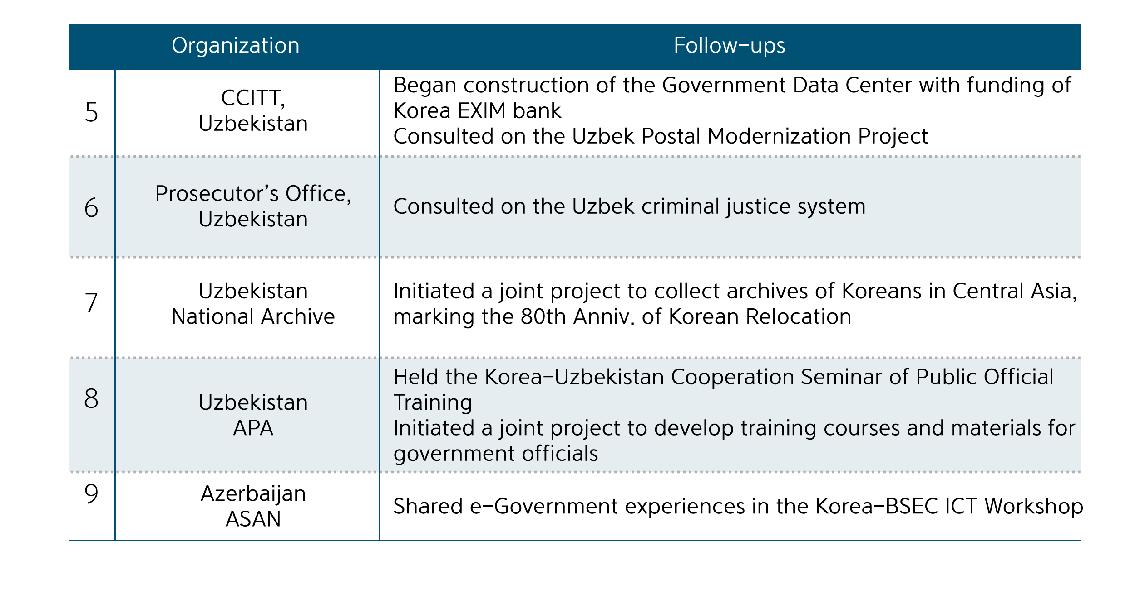
Key Follow-Ups
2) Uzbekistan and Azerbaijan
Notes:
Based on the last visit to Uzbekistan and Azerbaijan, the Korean government is undertaking follow-up activities in the area of national archive, criminal justice system and Data Center.
In specific, Korea and Uzbekistan agreed to construct the Uzbekistan Government Data Center, with the loan provided by Korea.
You can refer to other follow-ups with this file.

Slide 23

Notes:
As you are aware, the Koreangovernment will send the delegation to (나라이름) in December.
We believe that our visit will add momentum to strengthening good relationship between Korea and (나라이름).
This is end of my short presentation.
Let’s move on to the next discussion.
I would like to describe the respectivetopicsto be deal with during our delegations’ visit.

Slide 24
