Slide 1



Making It Happen:
Providing knowledge and tools to assist implementation of the SDGs
Riccardo Mesiano
Environment and Development Division
ESCAP

Slide 2
A one-stop, partnership-based online gateway to knowledge products and services

Slide 3
Addressing the Needs of Member States
A preliminary assessment of stakeholders' needs in relation to the products and functions offered by the SDG Help Desk was initiated in July 2017:
Mapping stakeholders
Needs assessment
Regional Expert Consultation
Hands-on and networking
VNR focal points, SDG focal points, particularly from countries with special needs (LDCs, LLDCs and SIDS)
Identifying gaps in capacity for implementation of the SDGs, learning needs within the national context, and expectations for the SDG Help Desk
Scoping on the SDG Help Desk, seek feedback on proposed concept, user interface and functionalities
Live test during SDG Week 2017 including hands-on and networking sessions to present final concept

Slide 4

How does it work?

Slide 5
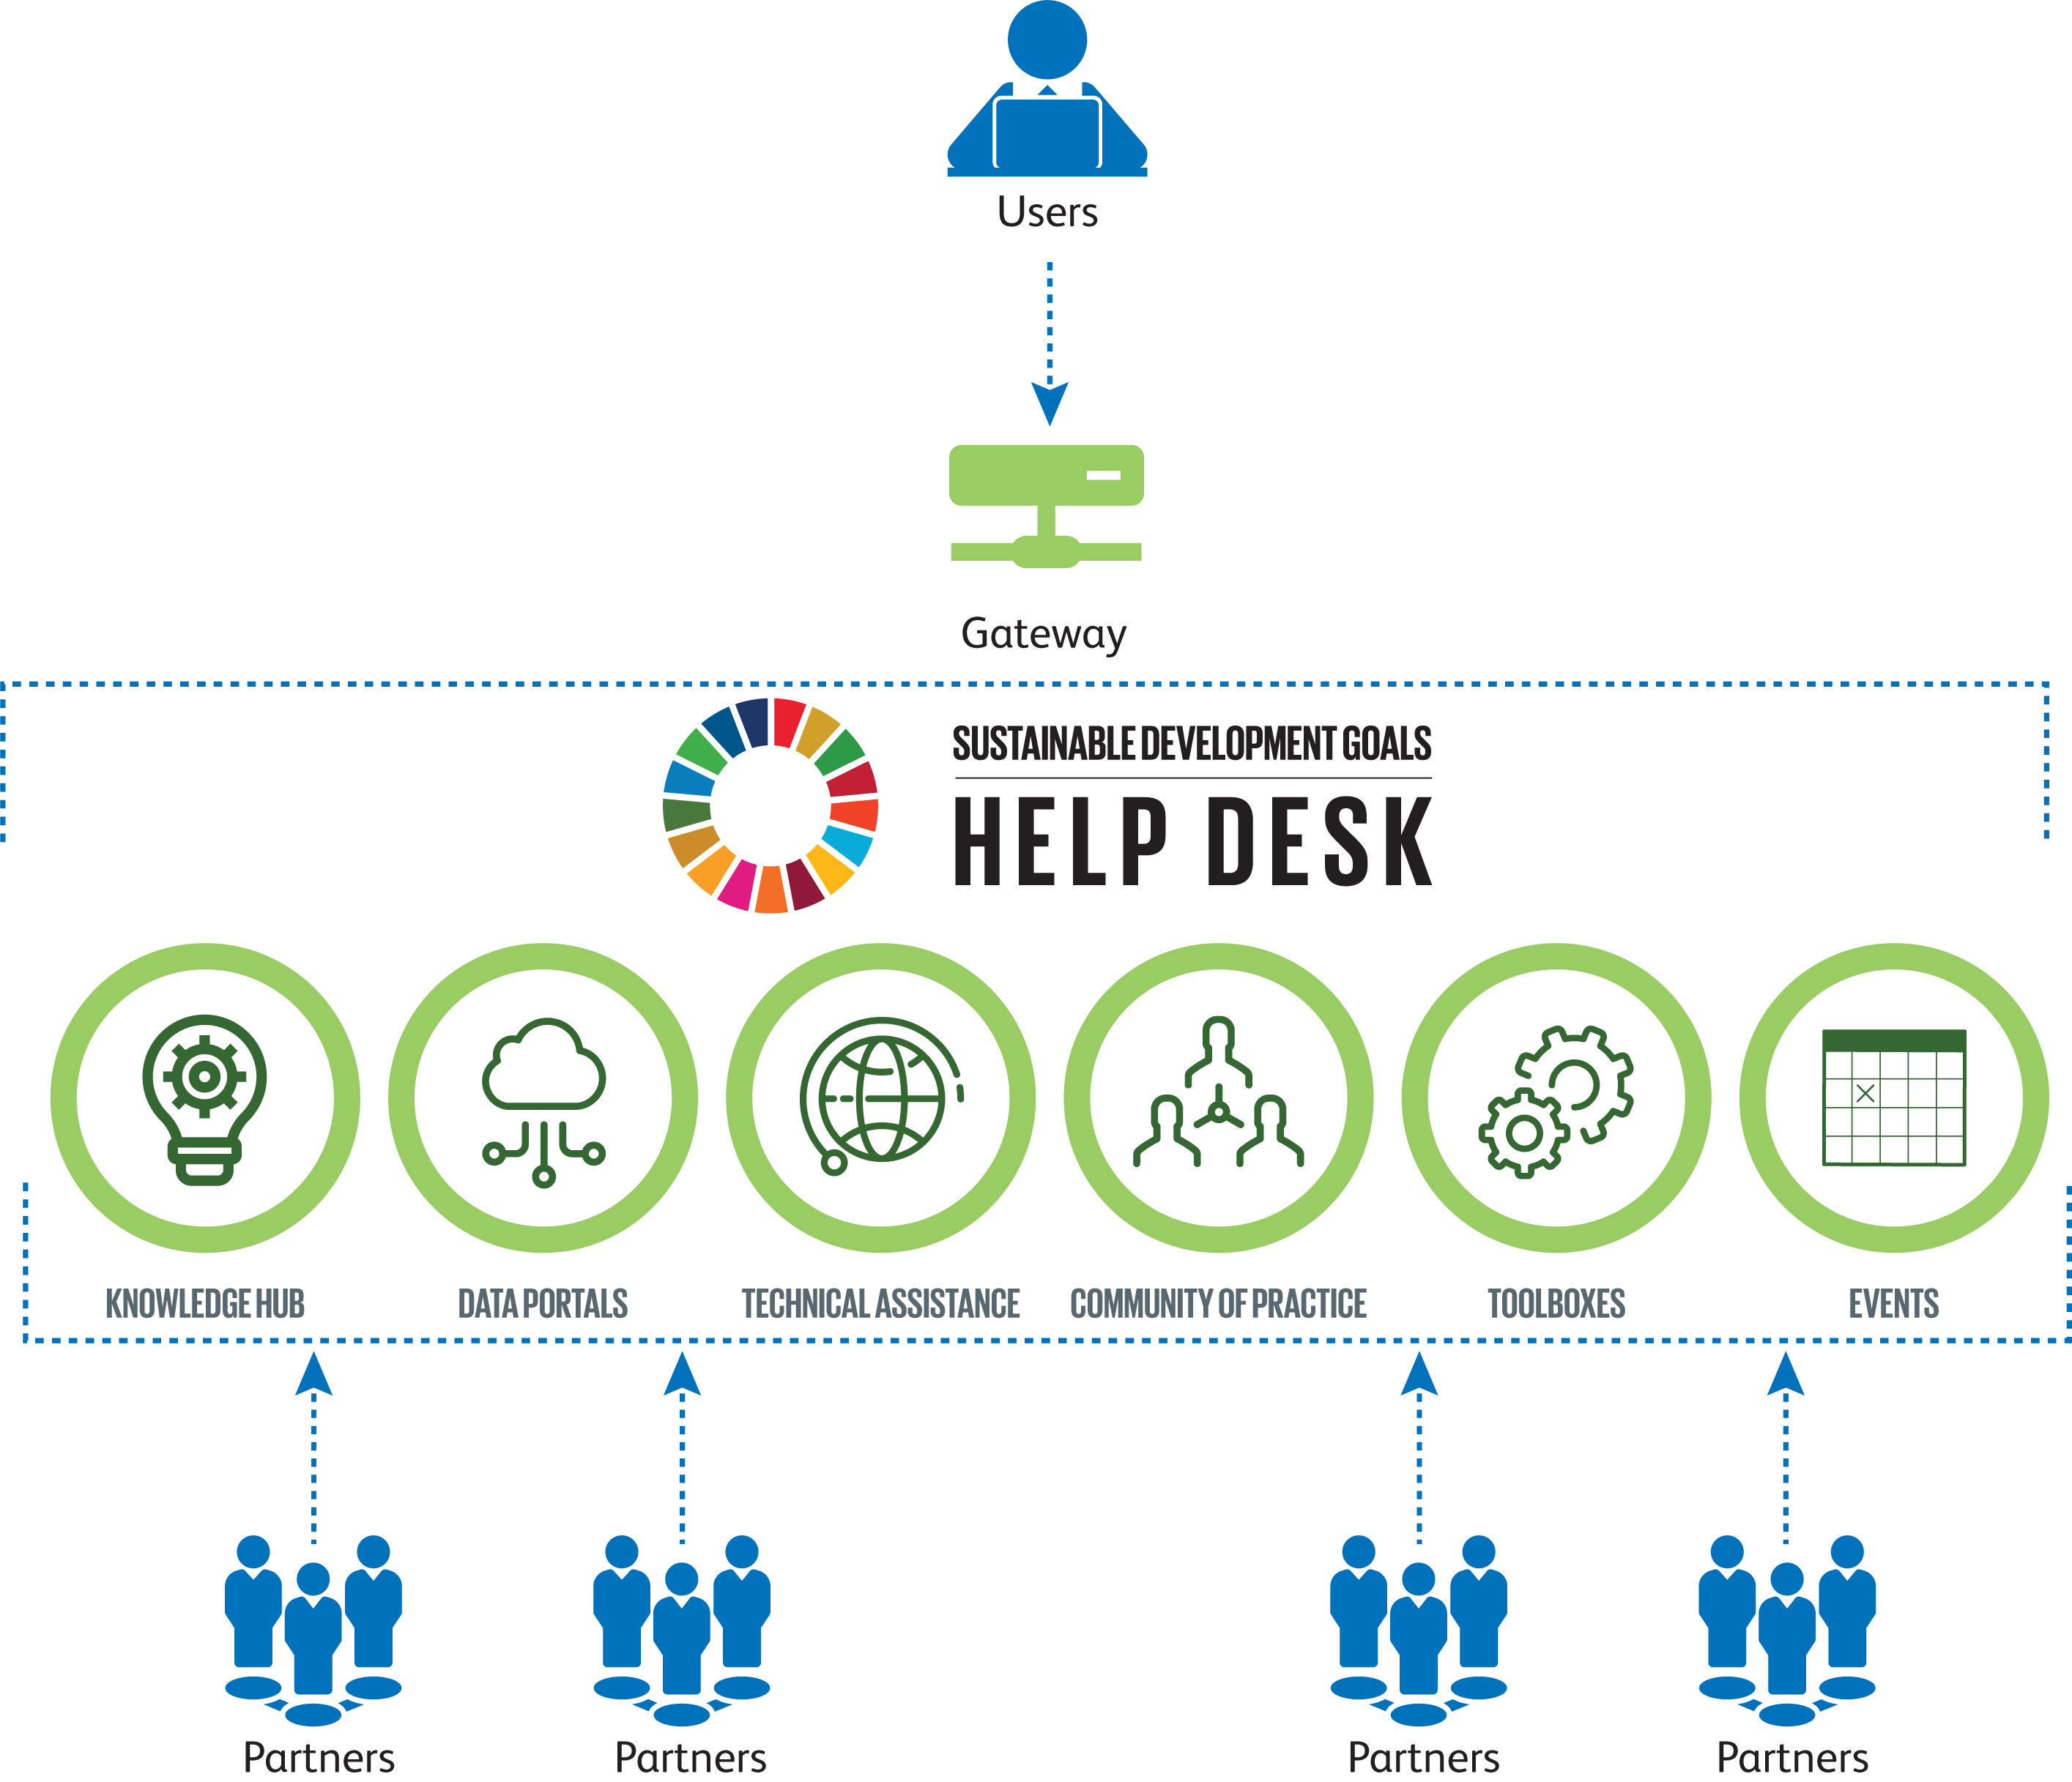

Slide 6
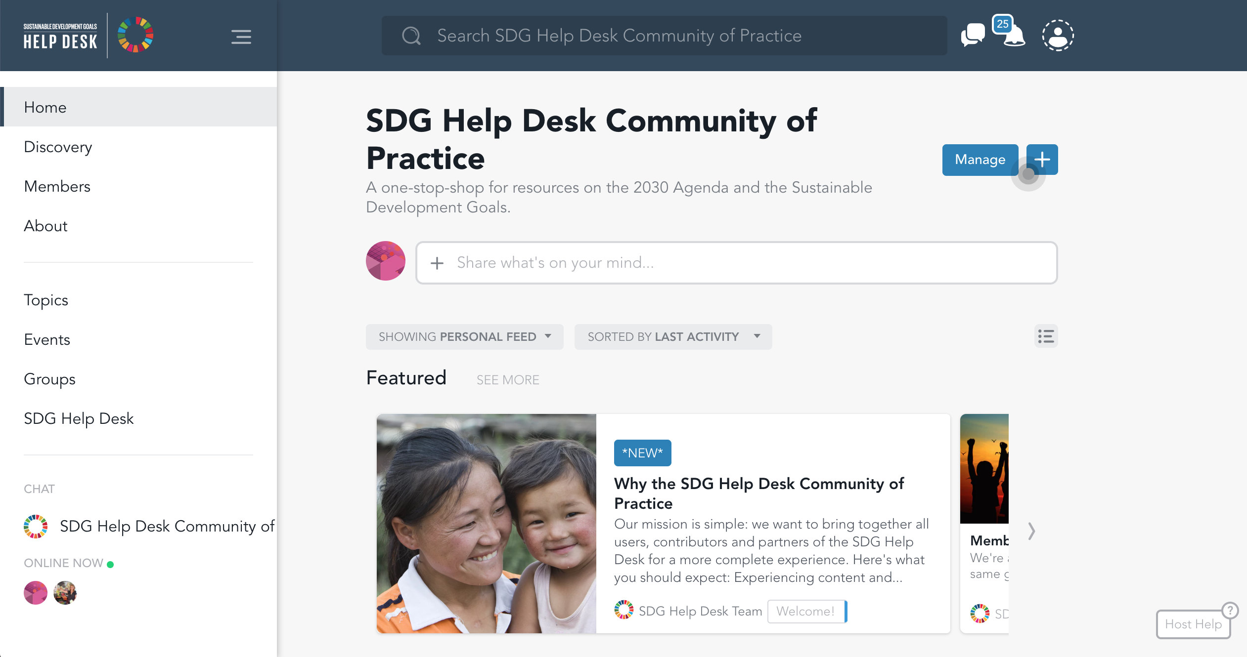
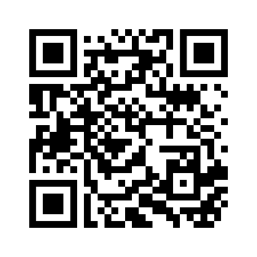
Community of Practice
Discussion Forum
Snap this link
to sign up!
https://bit.ly/2ATqwVe
Notes:
Currently at 219 members

Slide 7
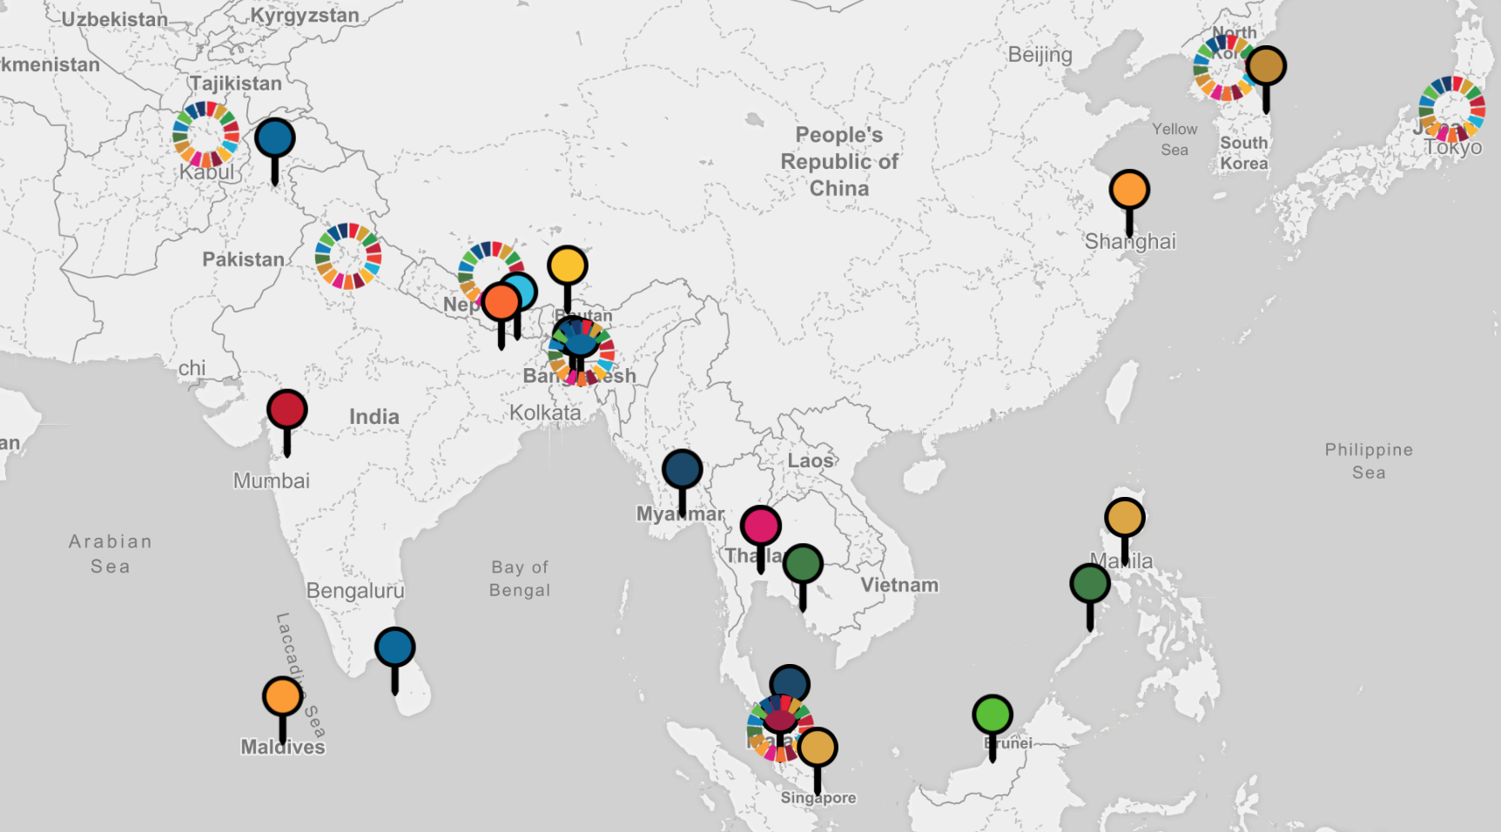
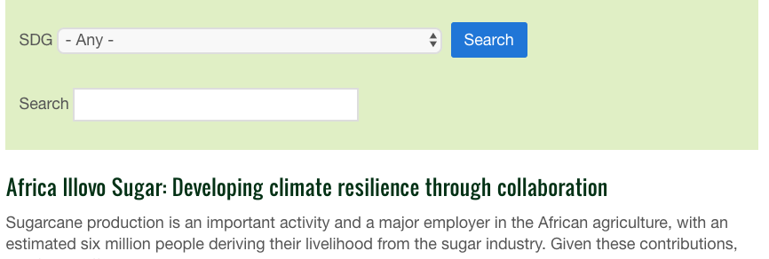
Technical Assistance
Best Practices
See how the SDGs are
being engaged worldwide.
Share your Best Practices
to be featured in our
collection.

Slide 8


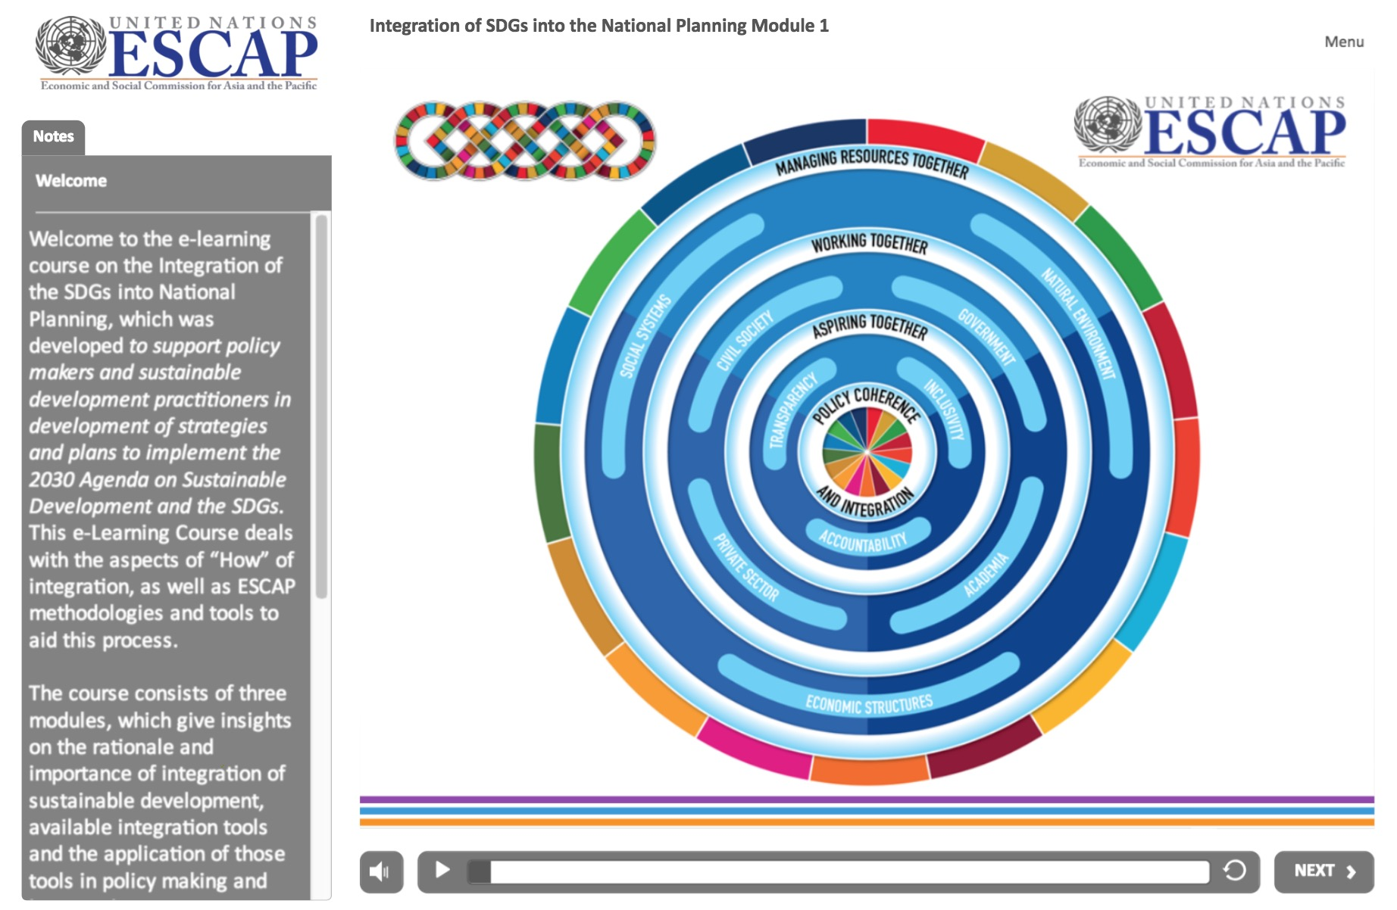
E-Learning
Course
Integration of the SDGs Into
National Planning
“
Support policymakers and sustainable development practitioners in developing strategies and plans to implement the 2030 Agenda
”
Gain knowledge of the tools to apply concepts of integration into the policymaking and implementation
Understand the essence of the integration of the three dimensions of the sustainable development
Apply system thinking framework to SDG integration analysis to support the 2030 Agenda
Have an overview of regional, national, local level system thinking applications in the Asia and the Pacific countries

Slide 9
as a partner and knowledge producer!
JOIN US
escap-sdghelpdesk@un.org

Slide 10

Thank you!
Ms. Katinka Weinberger
Chief, Environment and Development Division, ESCAP
weinberger@un.org

