Slide 1

Transformational Leadership and Transforming Public Servants’ Mindsets for the Sustainable Development Goals
Learning Conference: Holistic Approaches for Implementing the 2030 Agenda
in the Asia-Pacific Region
23-24 January 2019, Shanghai, China
Adriana Alberti
Chief, Capacity Development Unit
Division for Public Institutions and Digital Government (DPIDG)
United Nations Department of Economic and Social Affairs (UN DESA)

Slide 2

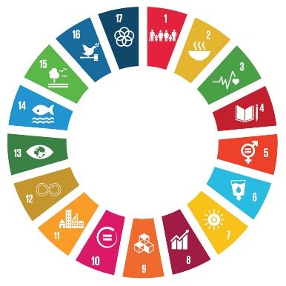
Goal 16 commits to promoting effective, accountable and inclusive institutions - critical to realize the SDGs
People’s vision of the future is crystallized in institutions and translated into concrete programmes of action.
1
2
In the absence of effective, accountable and inclusive institutions, none of the SDGs will be realized.
3
But what does it take to make institutions effective or strong?

Slide 3

Key Challenge of Promoting Effective Institutions: Changing Public Servants’ Mindsets
Changing the formal rules of institutions does not always produce desired results. Institutions are not only constituted by formal rules but also by underlying values and belief systems.
Norms and Rules
Values and
Behaviours

Slide 4

Key Challenge of Promoting Effective Institutions: Changing Public Servants’ Mindsets
So, it is important to design or redesign the formal rules of institutional architectures.
But it is even more important to transform mindsets.
To achieve the SDGs and the principle of leave no one behind, public servants must change their beliefs, attitudes and behaviors to align them with the new and/or revisited institutions being set up.

Slide 5
New capacities needed to implement the SDGs
Inclusive institutions and integrated approaches – strengthening whole-of-government approaches and mechanisms that support inclusive and integrated policies and public service delivery.
Policy coherence – strengthening national analytical and quantitative capacities to conduct cross-sectoral analyses and identify policy options that help achieve national goals.
Social inclusion – providing visibility to disadvantaged groups to give them a voice in national policymaking and implementation.
Evidence-based policy – modernizing statistical systems to increase national production and access to quality and disaggregated data for policy formulation
Means of implementation – strengthening capacities of national systems to mobilize resources for sustainable development.
Notes:
Institutions and government organizations will require adequate skills and capacities to plan and implement policies, adopt whole of Government approaches, collect and use statistics and project the impact of policies.
Governments need to rethink how they design their policies and make decisions, how they operate and deliver services, engage people, mobilize resources, as well as monitor and evaluate their programmes and plans. Effective, accountable and inclusive public institutions are essential to achieve each and every sustainable development goal.
National and local capacities are needed to design and implement holistic, integrated, and coherent and risk informed policies and institutional frameworks that support people’s aspirations, strengthening central-local government interactions and capacities. Decision-making at all levels needs to include all stakeholders’ voices and perspectives to ensure that no one is left behind and foster inclusive societies. Addressing these complex challenges calls for whole-of-society approaches and partnerships.

Slide 6

Global Initiative on “Transformational Leadership and Transforming Public Servants’ Mindsets for the Sustainable Development Goals” together with Schools of Public Administration
The main objectives of the Global Initiative for Schools of Public Administration are:
To inspire public sector leaders and public servants to mainstream the principles of the 2030 Agenda and to include the SDGs in their public sector performance strategies, plans and programs;
To inspire Institutes responsible for training public servants to include in their training both the principles and the Goals of the sustainable development agenda; and
To contribute to the development of the competencies required by public sector leaders and public servants for the achievement of SDGs through the development of revised and/or new curricula.

Slide 7
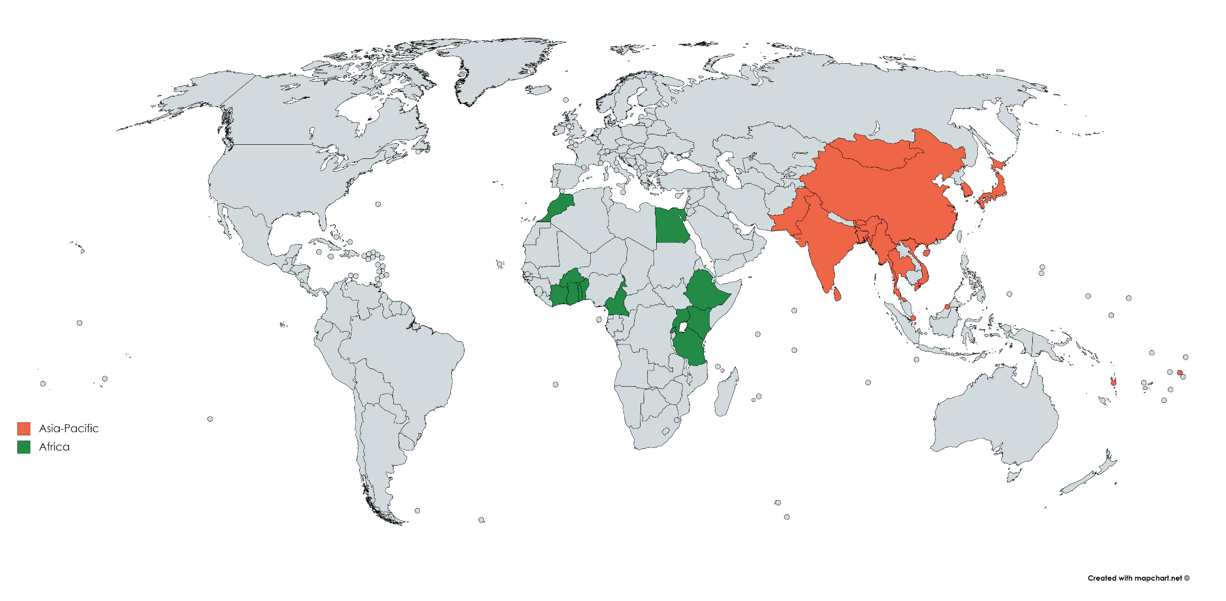
Global Initiative on “Transformational Leadership and Transforming Public Servants’ Mindsets for the Sustainable Development Goals” together with Schools of Public Administration
Task Forces across the Regions
Working with CLAD

Slide 8
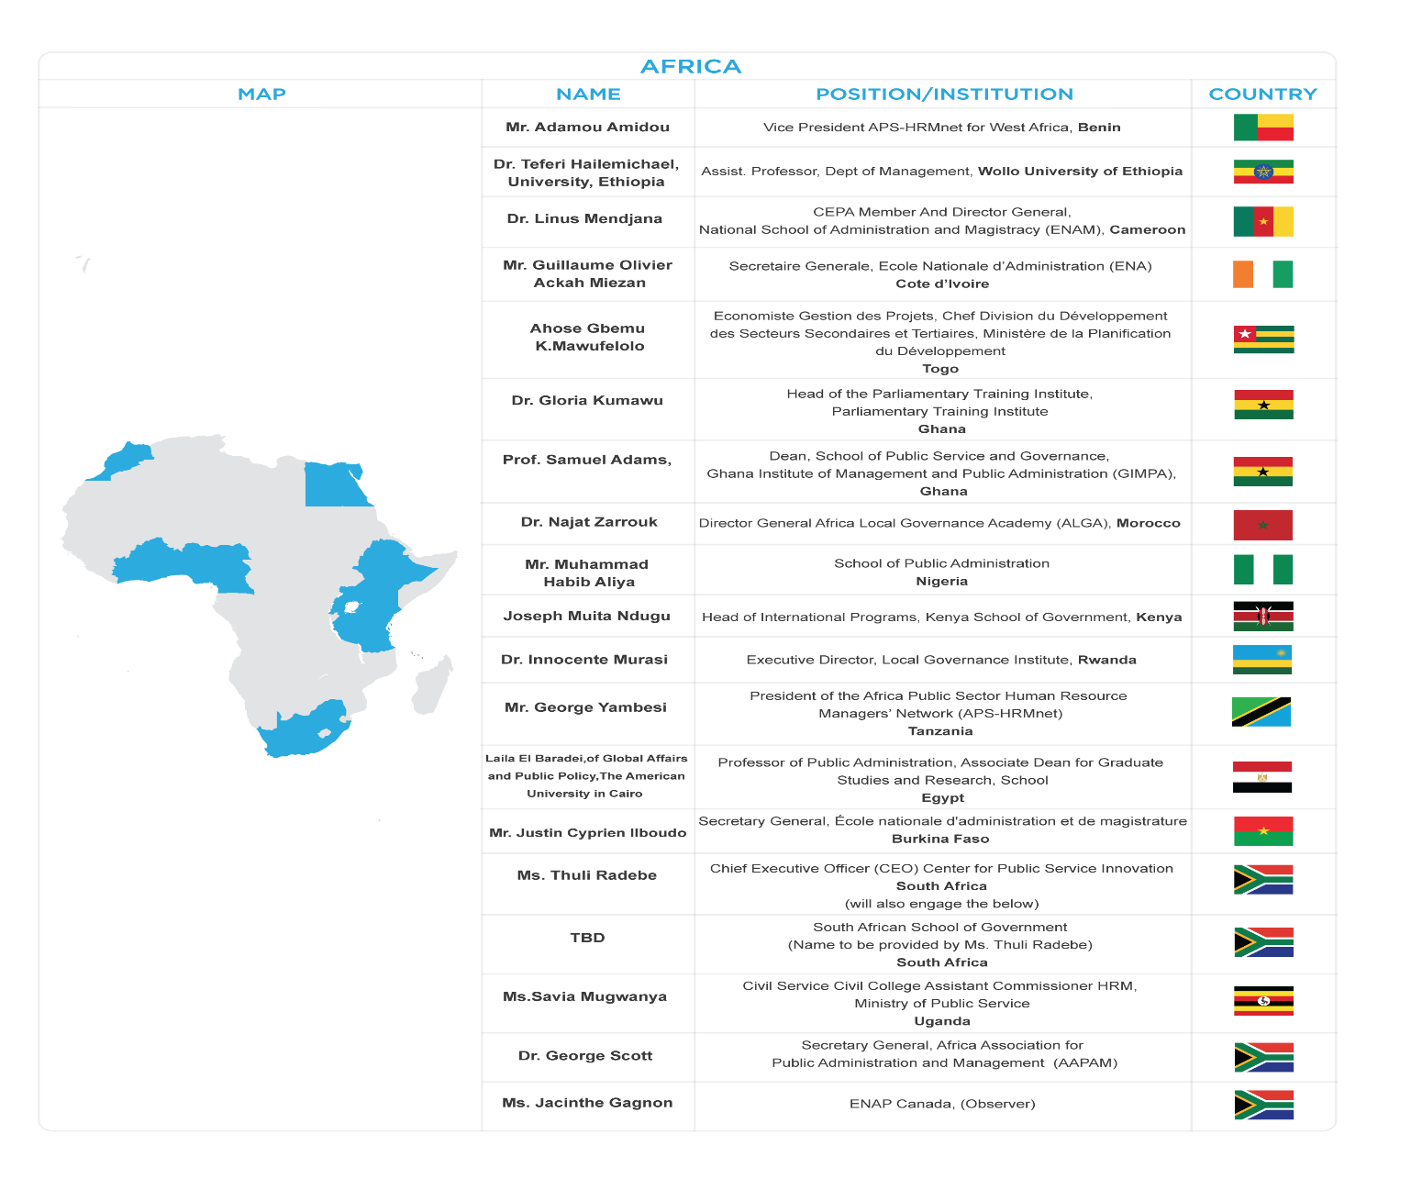
Task Force in the Africa Region

Slide 9
What has been done so far?
Task Force in the Africa Region
UNDESA/DPIDG organized an Expert Group Meeting (EGM) titled “Equipping Public Servants with Competencies and a New Mindset to Effectively Use Innovations for the Implementation of Sustainable Development Goals (SDGs)” from 27-31 August 2018, in Kampala, Uganda.
The meeting was carried out in conjunction with the 5th Conference of APS-HRMnet on “Human Capital: Sustainable Future for Africa – Agenda 2030 and 2063” – resource management in public sector institutions in Africa” with the aim to promote integrity and professional standards in the practice of human resource management in public sector institutions in Africa.
This meeting served as a backdrop for the initiative “Working with public administration schools and institutes to mobilize and equip public servants for implementing the 2030 Agenda for Sustainable Development and achievement of the SDGs” and provide UNDESA with an opportunity to raise awareness to adapt and better align academic curricula for implementation of the SDGs.
An online training course on “Transformational leadership capacities in Africa’s public-sector institutions to implement the 2030 Agenda and achieve the SDGs” was presented.

Slide 10
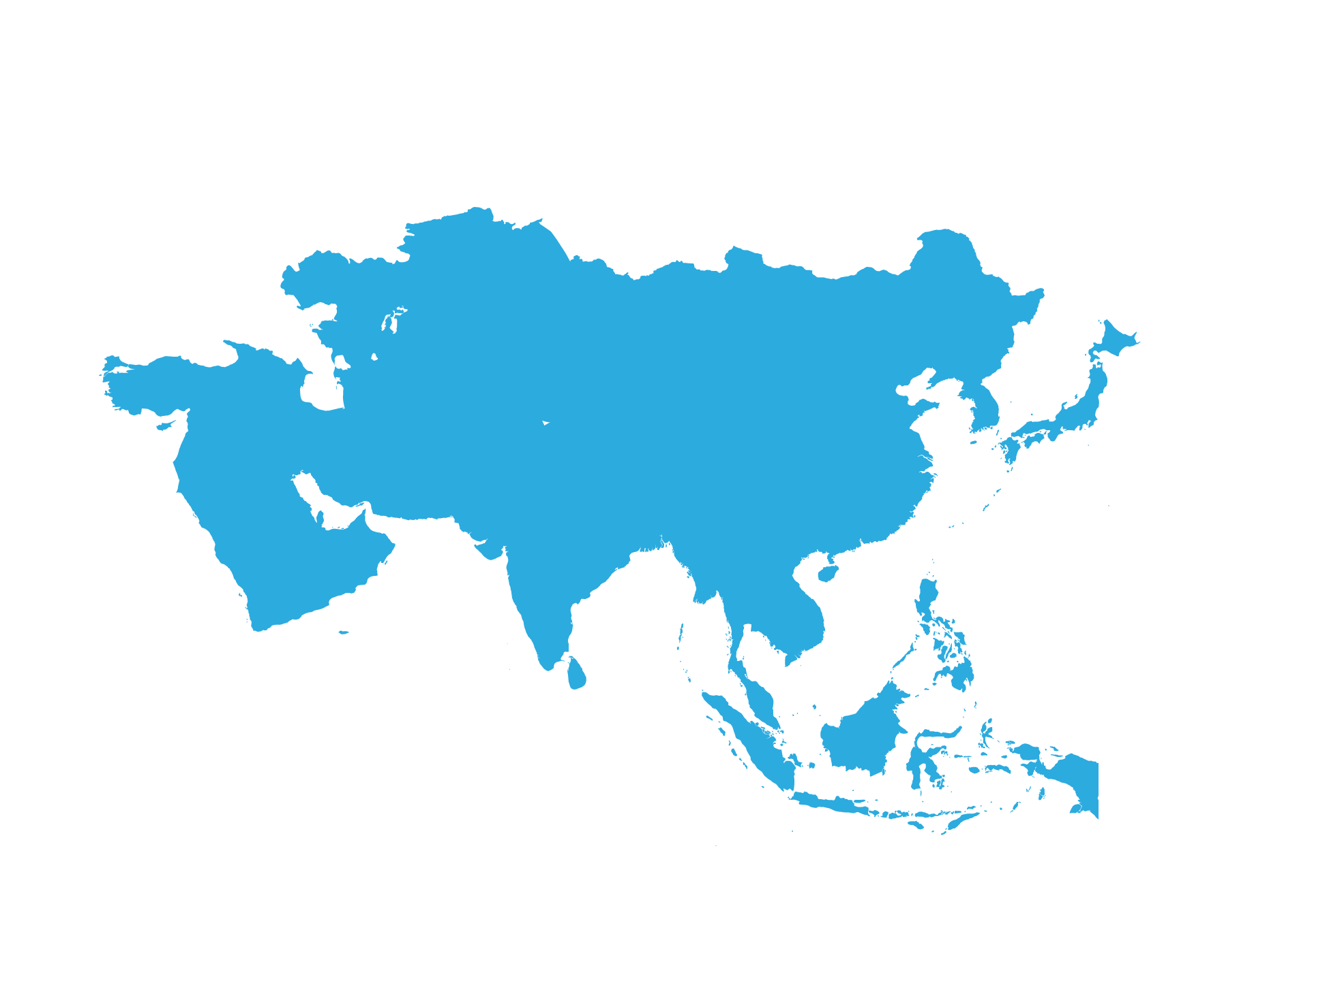
Task Force in the Asia and the Pacific Region
Asia
Mr. Alex Brillantes | President, Asian Association for Public Administration; abbrillantes@up.edu.pha; abbrillantes@gmail.com AAPA
Md. Aslam Alam | Rector, Bangladesh Public Administration Training Centre, Bangladesh; m.aslam.alam@gmail.com ashraf77.du@gmail.com Bangladesh
Mr. Dasho Karma Tshiteem, | Chairman, Royal Civil Service Commission; ktshiteem@rcsc.gov.bt; CC: Ms. Pelden Lhamu (phlamu@rcsc.gov.bt) Bhutan
Mr. Sarkhad Zulfikar, | Director/Rector, National Academy of Governance; zulfikar@naog.gov.mn Mongolia
Mr. Iqbal Mohammed | Director General, National School of Public Policy; nspprector@gmail.com, imchohan@hotmail.com Pakistan
Ms. Pham Thi Quynh Hoa, | Director, National Academy of Public Administration; hoanapa@yahoo.com Viet Nam
Ms. Maria Fe Villamejor Mendoza | Dean, National College of Public Administration and Governance, fevmendo@yahoo.com; mvmendoza@upd.edu.ph Philippines
Ms. Mariyam Nazima Ibrahim | Senior Human Capital Management Executive, Civil Service Commission; nazima@csc.gov.mv Maldives
Mr. Narayan Gopal Malego | Senior Director of Studies, National Administrative Staff College; zulfikar@naog.gov.mn Nepal
Mr. Jeffrey Fereti Faitua, | Coordination Officer, Public Service Commission; oliki@psc.gov.ws; twarren@psc.gov.ws; jfaitua@psc.gov.ws Samoa
In 2019, Task Forces of schools of public administration will be set up in the Arab Region and in Central Asia

Slide 11
Outcomes
Competency Framework for the SDGs
Curriculum on governance for the implementation of the SDGs, highlighting the implications of the SDGs for public servants and public administration, including but not limited to SDG 16.
New curricula, revised curricula and/or guidance to adjust curricula to reflect the SDGs and their principles.

Slide 12
Competency Framework for SDGs
Principles of the 2030 Agenda
Transformative
Integrative
Leave no one behind
Universal
Values
Mindsets
Competencies

Slide 13
Mindsets and related key competencies for SDG implementation
Transformative |  | Integrative
Mindset | Competency | Mindset | Competency
Proactive | Forward thinking Management of change | Holistic | System/integrative
Critical/analytical thinking | Strategic Problem-solving | Strategic for long term vision | Prioritizing
Innovative | Creativity Design-thinking Digital Skills | Evidence based | Information literacy
Open/Empowering (self and others) | Life-long learning Adaptive | Professional | Professionalism
Results oriented | Result based management Individual targets setting

Slide 14
Mindsets and related key competencies for SDG implementation
Leave no one behind |  | Universal/Partnership
Mindset | Competency | Mindset | Competency
Inclusive | Open to diversity | Global collective responsibility | Collaboration/Cooperation/Coordination
Empathic/Caring/Wellbeing for vulnerable/disadvantaged groups | Emotional Intelligence | Accountability to present and future generation
Responsive to the needs of the vulnerable groups | Non-discriminatory Service oriented

Slide 15
Possible Elements for a Curriculum on Governance for the SDGs
Governance Framework: Planning, Implementation, Monitoring and Review of the SDGs
From MDGs to SDGs:
Key Principals and Strategies
Building National/Local Capacities
Public accountability for SDG implementation, review and monitoring
Transformational Leadership
Policy Integration, including forecasting and SD modelling tools
Mobilizing resources for SDG implementation
Organizing Institutions for SDG Implementation at all levels
Engaging people and raising awareness of the SDGs
Building Partnerships
Integrated Approaches to Sustainable Development Planning
Innovation and ICT for Public Service Delivery
Review and Follow-Up of the SDGs, including indicators framework

Slide 16
Global initiative on capacity building in support of Goal 16, with a focus on effective, accountable and inclusive institutions
Policy coherence + Coordination
Transparency Accountability
Transforming Mindsets
Innovation and public service delivery
Institutional Coordination
Appropriate digital and technological options
Accountability for people-centric services
Engagement of civil
society + private sector

Slide 17
Thank you
alberti@un.org
http://publicadministration.un.org

