Slide 1

Learning solutions and global platform to support holistic implementation of the 2030 Agenda
A tactical, problem-solving tool to strengthen governance of data ecosystems for SDGs
Strategic Implementation of the 2030 Agenda Unit
Shanghai, 24 January 2019

Slide 2
A tactical, problem-solving tool to strengthen governance of data ecosystems for SDGs
Overview of learning solutions in support of the holistic implementation of the 2030 Agenda

Slide 3

Strategic areas for learning support
Strategic areas
Learning solutions
Learning toolkits
Workshops
Online courses
Learning conferences
Training programmes
Integrated policies
Data
Stakeholders
Innovation
Advisory services
Applied research
Institutional development

Slide 4
A tactical, problem-solving tool to strengthen governance of data ecosystems for SDGs
SDG Mainstreaming Highlights:
Policy cycle, integrated approaches and SDGs

Slide 5
















Toolkit: Policy Cycle, Integrated Approaches and the SDGs
This new series of learning toolkits being developed by UNITAR aims to support more harmonized approaches towards incorporating the SDGs across the national policy cycle: from integrated planning to aligned budgeting frameworks and M&E systems, reviews and reporting. They also highlight knowledge products from across the UN family and other partners.

Slide 6





Core sustainability competences for policy-makers
Systems thinking
Ability to collectively analize complex systems across different domains and different scales
Ability to:
Undertake integrated policy analysis, and
Undertake integrated planning and decision-making
Anticipatory
Ability to collectively analize, evaluate and craft rich “pictures” of the future
Ability to:
Anticipate changes,
Envision future,
Provide a forward-looking orientation,
Plan based on evidence and good understanding of statistical data and evaluation results
Build in resilience
Normative
Strategic
Interpersonal
Ability to:
Mainstream equity-focused approaches across policies, budgeting, monitoring and evaluation
Interpret evidence through equity lens
Apply human rights-based approach
Ability to collectively map, specify, apply, reconcile, and negotiate sustainability values, principles, goals
Ability to collectively design and implement interventions, transitions, and transformative governance strategies
Ability to:
Apply results-based approaches to work
Promote effectiveness
Ensure efficiency
Interpret data
Take decisions based on evidence
Ensure timely course corrections
Ability to motivate, enable and facilitate collaborative and participatory approaches
Ability to:
Inspire change in mindsets
Promote inclusive decision-making and review of progress
Foster transparency
Promote internal and external collaborations
Leverage partnerships

Slide 7
A tactical, problem-solving tool to strengthen governance of data ecosystems for SDGs
SDG Mainstreaming Highlights:
National briefing package

Slide 8
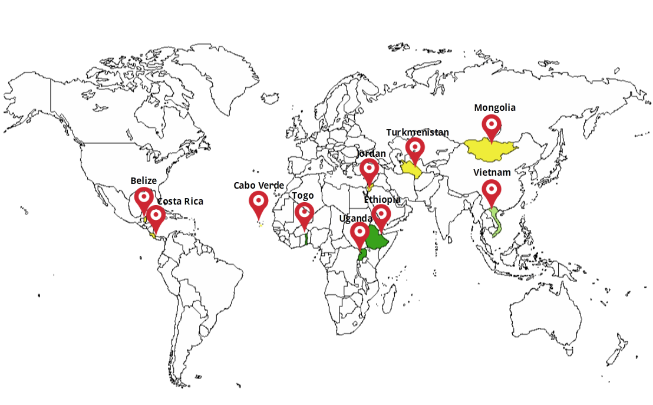
UNITAR – UNDG introductory toolkit: National “Preparing for Action” briefing package
5 MODULES:
Module 1. Post-2015 process
Module 2. Transition from the MDGs and key principles of the 2030 Agenda
Module 3. SDGs and integration
Module 4. Means of implementation
Module 5. Follow-up, review and monitoring on SDGs
Module 6. Evaluation for SDGs
Pilot countries

Slide 9











UNITAR – UNDG introductory toolkit: National “Preparing for Action” briefing package
What is a toolkit?
Toolkit
Set of PPTs, exercises and manuals available online to national facilitators
National workshop
Roadmap!
National Government/Coordinating Ministry

Slide 10
A tactical, problem-solving tool to strengthen governance of data ecosystems for SDGs
Other SDG Highlights:
UN SDG:Learn, StaTact and LEiP

Slide 11

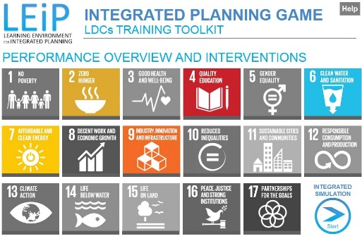




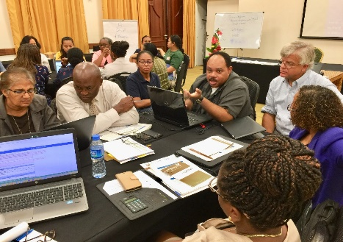
Highlights
Gateway for learning solutions for organizations and individuals:
Government decision-makers
Academia and CSOs
Private sector
UN staff
Citizens
UN SDG:Learn
1
Partnership
Platform
Programme
3
UNITAR-Millennium Institute game for policy-makers based on iSDG model
UNITAR – UNSD short-term action-planning tool for NSOs and NSSs to strengthen data use in SDG policies
2
Notes:
LEiP – Learning Environment for integrated Planning
NSOs and NSSs – National Statistical Offices and National Statistical Systems

Slide 12
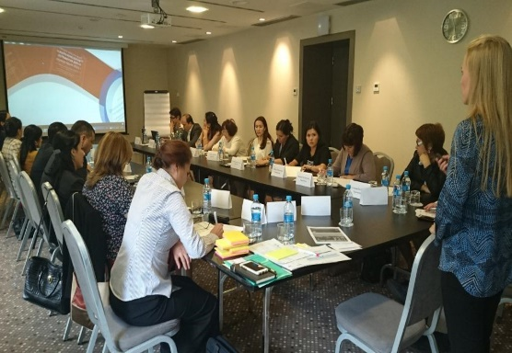
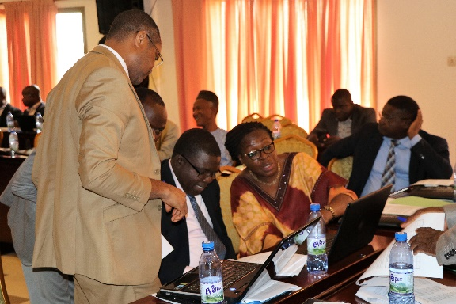
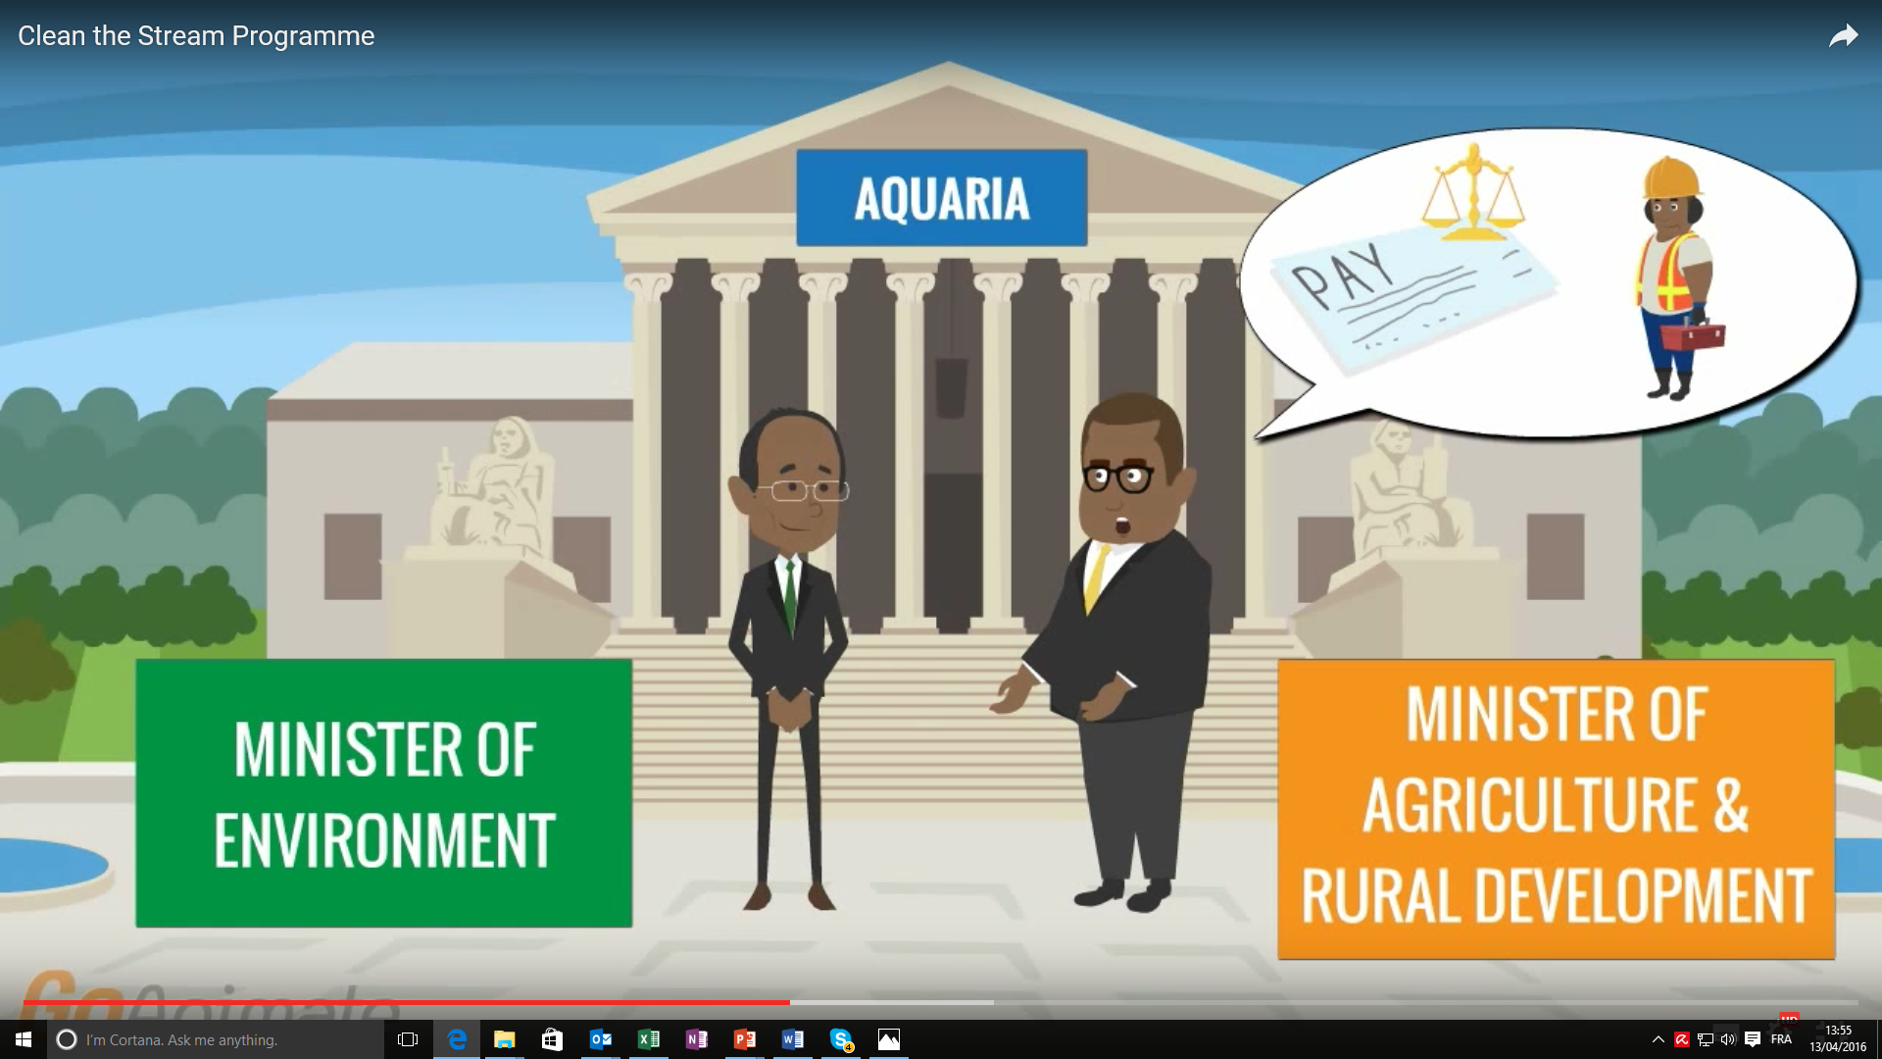
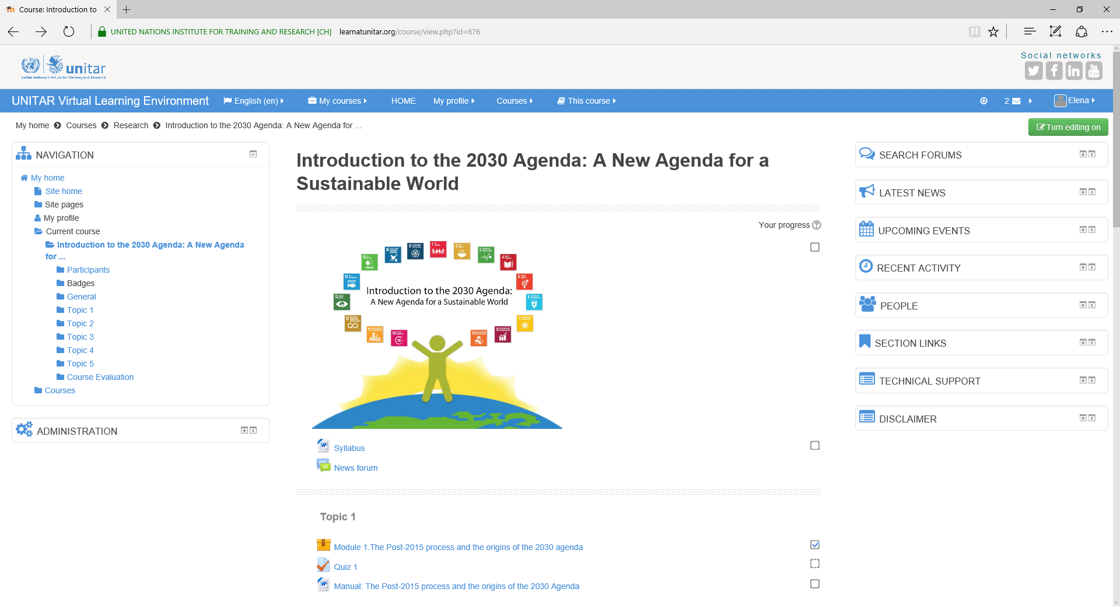

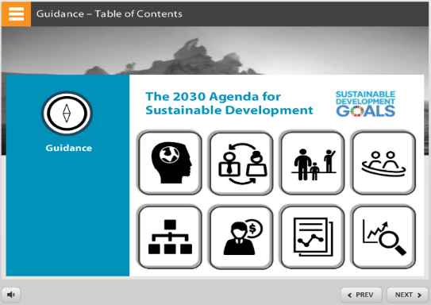
Training and learning offer
Face-to-face courses
Training of Trainers
Microlearning
MOOC: Introduction to 2030 Agenda
UNITAR – UNDESA e-course: Stakeholder engagement
E-tutorial: Mainstreaming 2030 Agenda

Slide 13
Links and contact details
Web-page:
http://unitar.org/a2030
Contact:
a2030@unitar.org

