Slide 1


Best-practice sharing on effective national Monitoring & Evaluation systems: Vanuatu 2030 and the SDGs
Monitoring & Evaluation Unit, Department of Strategic Policy, Planning and Aid Coordination (DSPPAC), Office of the Prime Minister and the Vanuatu National Statistics Office, Vanuatu Government

Slide 2
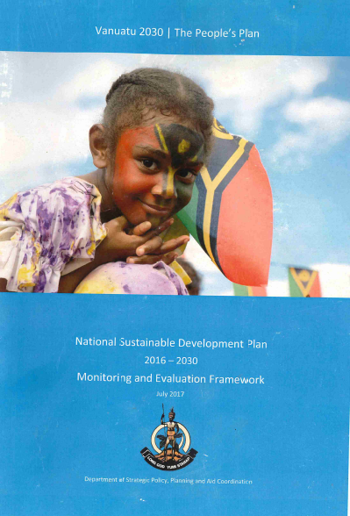
Vanuatu 2030: The People’s Plan (NSDP) A framework for action
The goals represent the priorities expressed through the consultations and have been grouped under the three pillars
Under each of the goals are policy objectives, which specify the interventions and the outcomes to be focused on to achieve the goals
Each policy objective is to have a corresponding target and indicators to enable monitoring and reporting on progress
The national targets and indicators will also inform how we contextualise and monitor the global Sustainable Development Goals, which came into force in 2016 to replace the Millennium Development Goals (MDGs)
Notes:
Will talk more about implementation at the end of the presentation

Slide 3
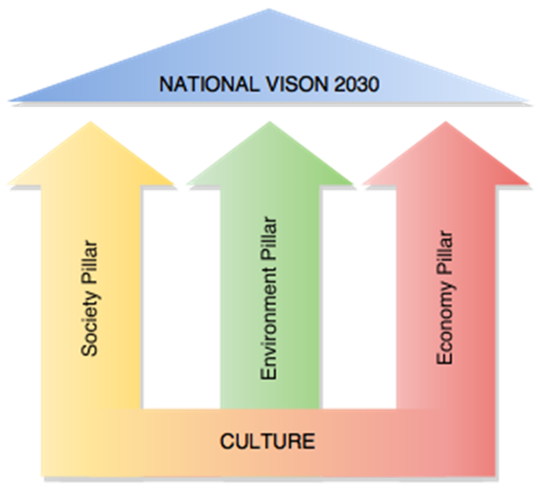
An Integrated Approach: Balancing the 3 pillars of development
Our culture, traditional knowledge and Christian principles are the foundation of the plan, which focuses on improving the wellbeing of our people (society); protecting and enhancing our place (environment); and maximising opportunities for shared prosperity (economy).

Slide 4
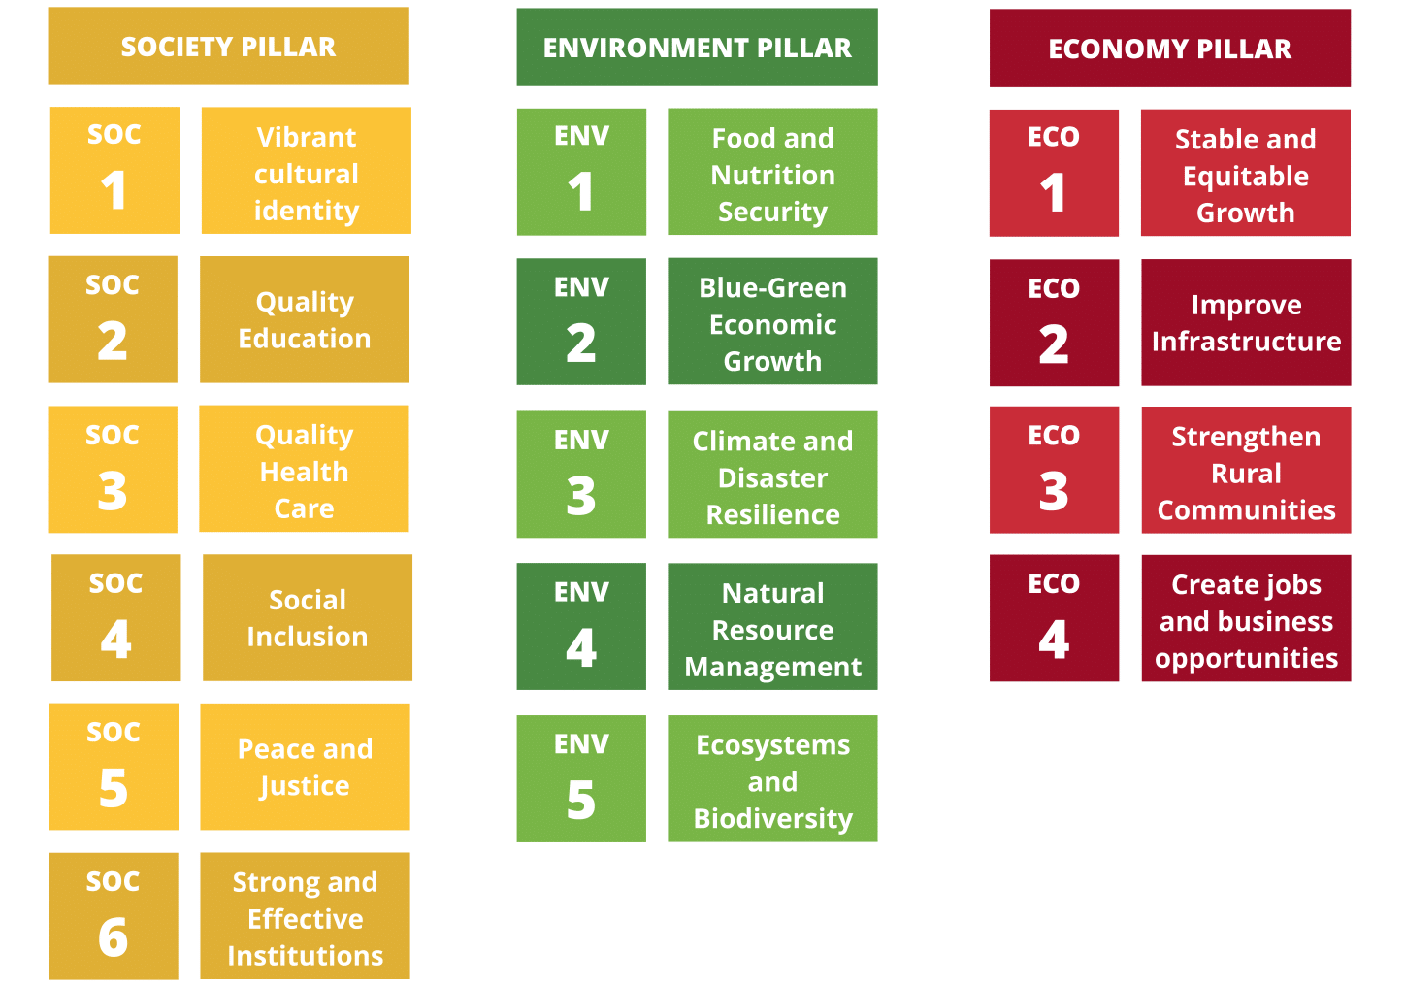

Slide 5


15 Goals and 98 Policy Objectives
3 Pillars → 15 Goals → 98 Policy Objectives → 196 Indicators & 205 Targets → 17 SDGs and 122 SDG indicators (includes Regional Core Indicators)
17 SDG Goals and the 122 SDG Targets and Indicators have also been analysed and linked to the NSDP Policy Objectives through an ‘integrated and localisation’ process
Integrated reporting framework for both NSDP and SDGs in the Annual Development Report (ADR)
Reporting Mechanisms →National Planning Framework and National M&E Policy
Tools - NSDP Baseline Survey and the NSDP Indicators Database

Slide 6
ADR Matrix & Report Template
SOCIETY GOAL 3: A healthy population that enjoys a high quality of physical, mental, spiritual and social well-being
PO | Monitoring |  |  |  | Evaluation
NSDP Policy Objectives | Indicators What are we Monitoring |  | Baseline | Target Where do we want/need to be | Status NSDP Indicator and SDGs | Measurement | Summary Analysis (Validation)
SOC 3.1: Ensure that the population of Vanuatu has equitable access to affordable, quality health care through the fair distribution of facilities that are suitably resourced and equipped | SOC 3.1.1 Number of skilled health professionals to 10,000 population | Baseline: 2014 - Doctors = 1 per 10,000; Nurses = 12.3 per 10,000; Midwives = 1.4 per 10,000 population [Source: HRIS2, MoH] 2015 - Doctors = 1.1 per 10,000 population; Nurses = 12.2 per 10,000 population; Midwifes = 1.3 per 10,000 population [Source: HRIS2, MoH] |  | 2020-Vanuatu has a density of 24 HWs per 10,000 population 2025-Vanuatu has a density of 31 HWs per 10,000 population 2030-Vanuatu has a density of 38 HWs per 10,000 population SDG 3.c 3.c.1 (Tier 1) | 2017: 17.27 health workers per 10,000 population (HRMIS) | 2 - Less than 50% progress from 14.6 in 2015 to 17.27 in 2017 (50% marker is 19.3 per 10,000 population) | Based on Human Resource Information Systems as of 31st December 2017. NOTE: Prior to GoV retirement of age group 55+ which will have effect on 2018 reporting. Based on population as a Dec 2017

Slide 7
Implementation
15 years collaborative partnership between government, businesses, civil society and development partners – modalities such as annual recurrent budget, ODA, GCF, EDF, etc.
→ Prioritising and cyclical review will be important for meeting development aspirations
→ GoV has a CSO desk at Internal Affairs ministry to facilitate activities through VANGO and other CSOs and INGOs also have MOU arrangements with ministries, departments, etc.
NSDP provides overarching framework for all national, provincial and local government policies, strategies, priorities and development programmes to be aligned with through National Planning Framework (NPF)
New Medium-Term national plan will follow; linked to medium-term policy priorities and Medium-Term Expenditure Framework (MTEF) with a new one in review
National Monitoring & Evaluation Policy (MEP) guidance on government related M&E activities and processes
Annual follow up and review and reporting will take place under the Annual Development Report (ADR)
The NSDP guides how we tailor the implementation and reporting on the SDGs and framework for Pacific regionalism to minimise reporting burdens and duplication of efforts

Slide 8
National Planning Framework
The aim is to improving government-wide planning and ability to translate the national goals in the NSDP in to programmed activities and long-term development outcomes
This will also involve producing key documents to guide and inform the work of DSPPAC and ministry planners throughout government
The National Planning Framework (NPF) should:
Align all levels of planning in Vanuatu in line with the NSDP
Align with the National M&E Policy so that planning, monitoring and reporting effectively achieved
Provide a platform for aligning budgeting with planning at the sector level

Slide 9
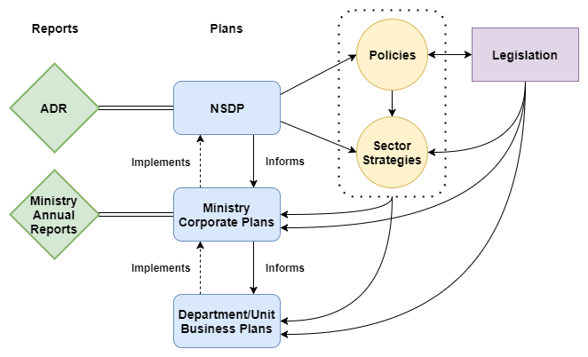
GoV Planning Flow Chart
Notes:
Some ministries combine Policy and Sector Strategies into one document

Slide 10
National Monitoring & Evaluation Policy
Stresses importance of M&E within the broader Government management
Designed to address 4 critical areas that must be clarified for effective Government wide M&E:
1. Principles of the M&E Policy
2. Defining GoV M&E terms
2. Roles, responsibilities and mandates across government regarding M&E and reporting
4. Capacity building activities necessary for effective M&E

Slide 11
NSDP and SDGs Indicators Database
Improved process for centralised storage of national data used in ADR and UNVR reporting (and other reporting too)
Includes proxy indicators for possible multiple use
Institutionalised approach for regular updating by Vanuatu Statistical System (VSS) producers
Reliability assurance from primary sources, administrative data
Maintained and housed by Vanuatu National Statistics Office (VNSO)
Main users national planning office and ministries
Activity Outputs
Indicator database tool and manual for use
Identified indicators and gaps for inclusion in NSDP Baseline Survey

Slide 12
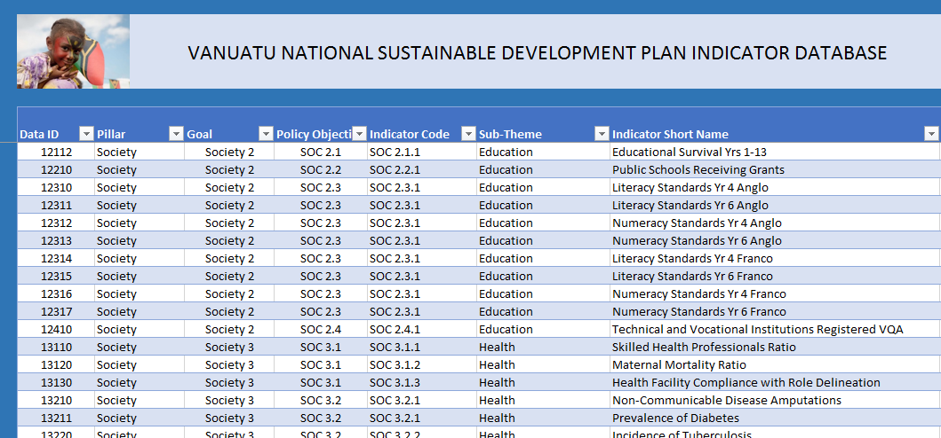
NSDP/SDGs Indicators Database

Slide 13
Pillars | All Indicators | Indicators with data | Percentage of Available
1 | 77 | 53 | 69%
2 | 62 | 13 | 21%
3 | 57 | 30 | 53%
Total | 196 | 96 | 49%

Slide 14
NSDP Baseline Survey Jan 2018- Jan 2019
Rebasing of the National Accounts, CPI, and an expanded Household Income and Expenditure Survey with a focus on NSDP indicators as per the Indicators Database activities 2018-19
Also includes relevant SDG indicators
Vanuatu National Statistics Office (VNSO) and DSPPAC (National Planning Office) joint activity
VNSO has a list of all data providers which we modified for national annual reporting
Same list will include other key stakeholders including CSOs, donor partners, and agencies that collect key data

Slide 15
Vanuatu Draft VNR Work Plan
No. | Activity | Description | Responsibility | Deadlines*
1 | NSDP/SDG Indicator Database | Check how many SDG indicators are in the database with information and provide a status update | VNSO | December 2018
2 | SDGs Indicator gaps | Identify SDG indicator provider gaps – check with VSS listing and identity who is responsible for this missing information and provide to DSPPAC | VNSO | January 2019
3 | What is going to go in our report? Report skeleton and 17 goal areas skeleton to be prepared before the stakeholder engagement starts | Divide the SDG indicators we have via the 17 SDG goal areas | M&E Unit VNSO | November 2018 – February 2019
4 | Stakeholder mapping for data gaps and for consultations | Identify information provider gaps and organise consultations/discussions | M&E Unit VNSO | January – March 2019
5 | Stakeholder consultations | Provide a list – content, objectives, etc. |  | January – March 2019

Slide 16
Feedback after July 2019 to everyone and anyone on results and HOW this should be used and in true M&E style: review, revise, and go forth for another go
6 | VNR Technical group
7 | Technical assistance to VNSO and DSAPPAC – identify what and when, who |  |  | Ongoing
8 | Deadlines for reports | Report formats and deadlines | UNDESA, PIFS, UNESCAP, DSPPAC, VNSO | TBC at Dec workshop
9 | Report presentation | Report formats and deadlines | PMO, UN, VNSO, etc. | July 2019
10 | Report feedback – how, what, when |  |  | TBD
11 | Planning for next VNR, recommendations, etc. |  |  | TBD

Slide 18
Challenges
Data Limitations
Data specifications
Data formats
Institutional Coordination
Proper coordination in terms of working groups from key stakeholders
Final Report Write up and Format/s
What to use, analysis, inclusion
Limited capacity
For both VNSO and the key stakeholders
Understanding data specification, formats, and methodology
Funding
Crucial part and one of the main constrains to policy implementation

Slide 19
Question for the Participants
Report content and analysis
How do you know enough is enough and how do you make sure the important stuff gets in?

Slide 20
TANKIU TUMAS
THANK YOU

