Slide 1


Effective Monitoring and Evaluation of Progress on the SDGs Monitoring SDGs : the perspective of Armstat
Ðì SA
Learning Conference: Implementing the 2030 Agenda in the Asia-Pacific region
23-24 January, Shanghai, People’s Republic of China
Anahit Safyan, PhD
Member, State Council on Statistics, Focal Point for SDGs
Statistical Committee of the Republic of Armenia (Armstat)

Slide 2

National Coordination Mechanisms
Ðì SA
National Council on Sustainable Development of Armenia,
Prime-Minister of RA
Interagency Commission coordinating the Sustainable Development Process in Armenia, Deputy Chief of Government Staff
Working groups to Interagency Commission
Road Map to Nationalize
the 2030 Agenda for
Sustainable Development
in Armenia

Slide 3

Working groups to Interagency Commission
Ðì SA
Armstat
Social
Armstat
Economic
Armstat
Environmental
Armstat
Ministry of Labour and Social affaires
Goals 4, 5, 10, 16, 17
Ministry of Health
Ministry of Justice
UN Agencies + International Organizations + Civil Society NGOs (41)
Goals 6, 13, 14, 15, 17
Ministry of Economic Development and Investments
Ministry of Nature Protection
Ministry of Territorial Administration and Development
Ministry of International Economic Integration and Reforms
Legal and Democratic Equality
UN Agencies + International Organizations + Civil Society NGOs (53)
UN Agencies + International
UN Agencies + International Organizations + Civil Society NGOs (58)
Goals 7, 8, 9, 11, 12, 17
NGOs (39)
Organizations + Civil Society
Goals 1, 2, 3, 17

Slide 4
Overall level of SDG integration
Ðì SA
The Rapid Integrated Assessment
involved a broad set of sector specific policy/strategy documents:
Armenia Development Strategy (ADS) 2014-2025
48 sector specific strategy documents, concepts, action plans, relevant laws and regulatory documents.
covered all SDG targets and indicators. 108 SDG targets have been prioritized out of 169.
The main strategic document - ADS 2014-2025 - reflects on 64 SDG targets (about 40% of SDG targets).
Prioritization of SDG Targets
Overall, the SDG principles and approaches are well reflected in Armenia’s national strategic documents. There is a high level of integration of the SDG targets (about 70%) into ADS 2014-2025 and sector specific strategies.

Slide 5
Gap Analysis
Ðì SA

Slide 6
Data availability 78% available data, of which
Ðì SA

Slide 7
Road Map on Statistics for SDGs
Ðì SA
establishing mechanisms for national collaboration
assessing the readiness of Armenia to report on global SDG indicators
developing national and sub-national indicators
reporting of SDG indicators
capacity building
+
+
✔
✔
communicating statistics for SDGs
✔
in progress
✔

Slide 8

Capacity building
Ðì SA
Donors support to strengthen a statistical capacity, including capacity of administrative registers
UNDP
UNFPA
UNICEF
UNFAO
IOM
UNFPA - National Reporting Platform (NRP)
UNECE - National workshop on statistics for SDGs in Armenia – preparing a road map with key stakeholders, 12 October 2017
and Experts mission on SDGs, 14-15 November 2018
Share of countries experiences and new approaches
Cooperation with developed countries
knowledge

Slide 9

Communicating statistics for SDGs
Ðì SA
http://www.armstat.am/en/?nid=655
First step
published table with the SDGs indicators in Excel format at Armstat website, including all available data, with time series from 2015 onwards, and definitions of indicators and data sources
Second step
developed web-based NRP for SDGs indicators

Slide 10

National Reporting Platform (NPR)
Ðì SA
NRP is a tool for disseminating and reporting national statistics for the global SDG indicators that provide the framework for monitoring progress towards SDGs
NPR
comparable, timely, transparent and publicly accessible
user-friendly

Slide 11

NRP characteristics
Ðì SA
To conform with the UN Fundamental Principles of Official Statistics, the Platform
is managed by Armstat
features official statistics and metadata
according to standard methodology
allows for feedback from data users
This platform was developed by Armstat
with the support of the UNFPA Armenia
Country Office

Slide 12
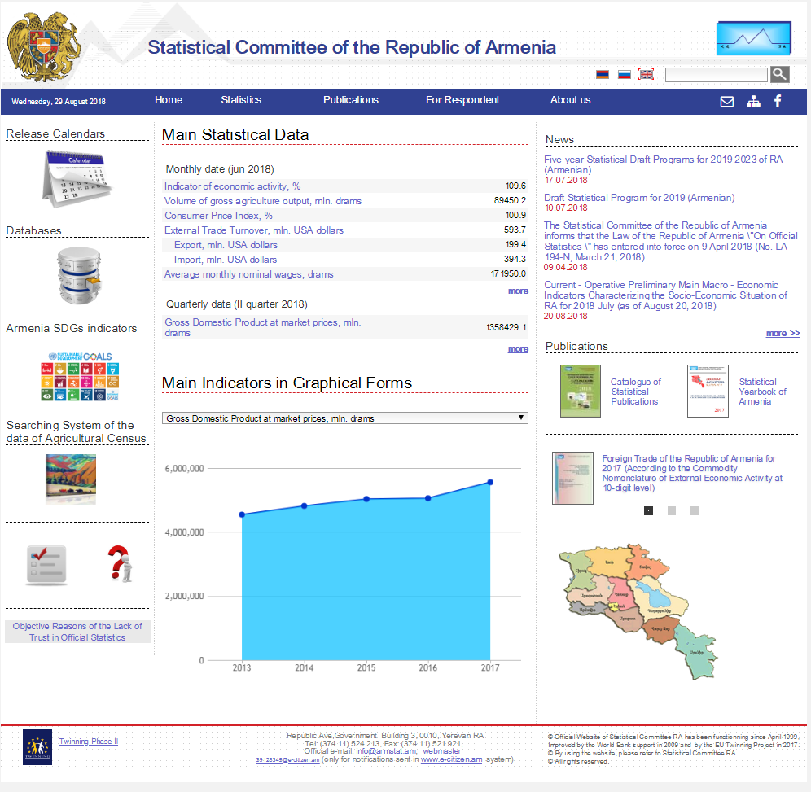

Slide 14
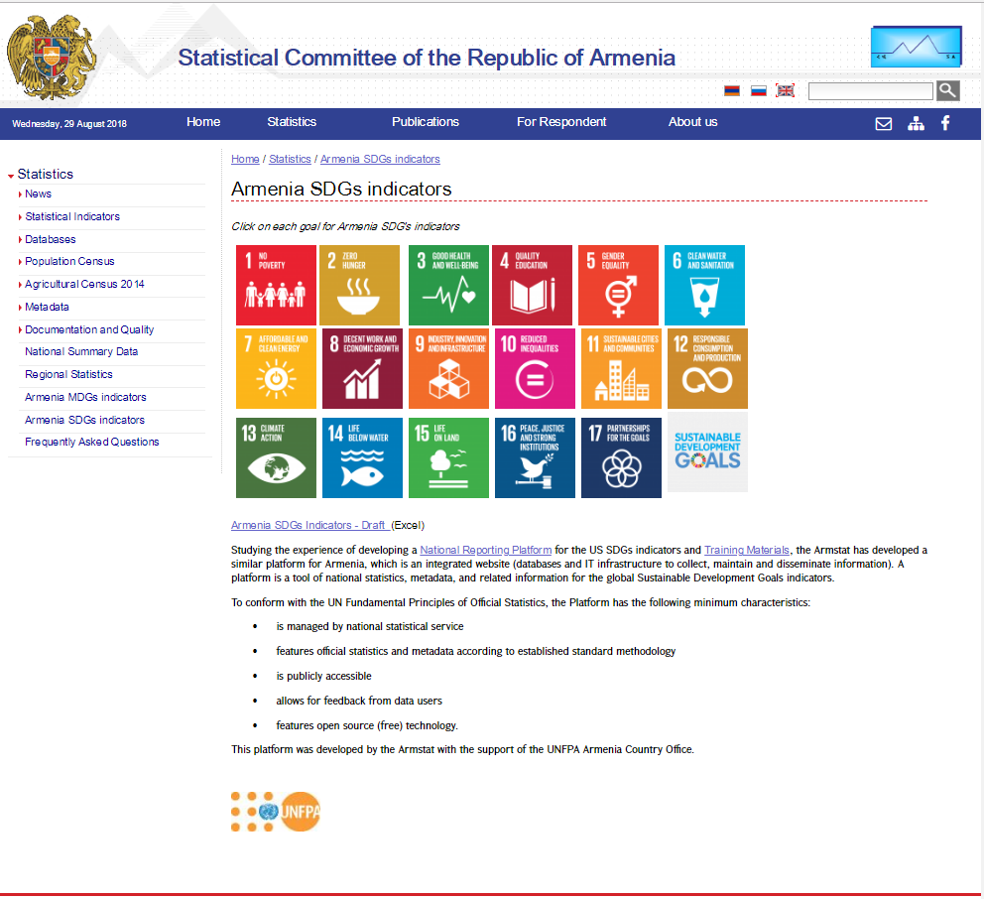

Slide 17
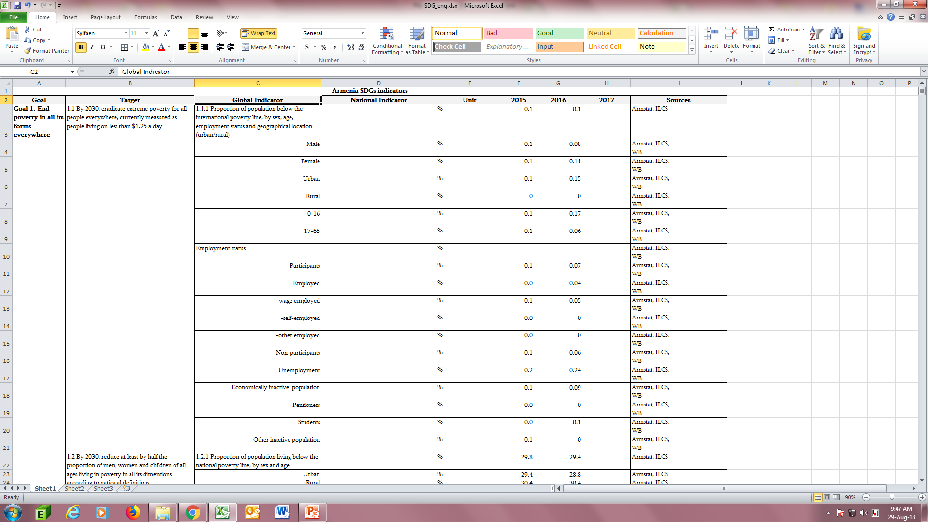

Slide 19
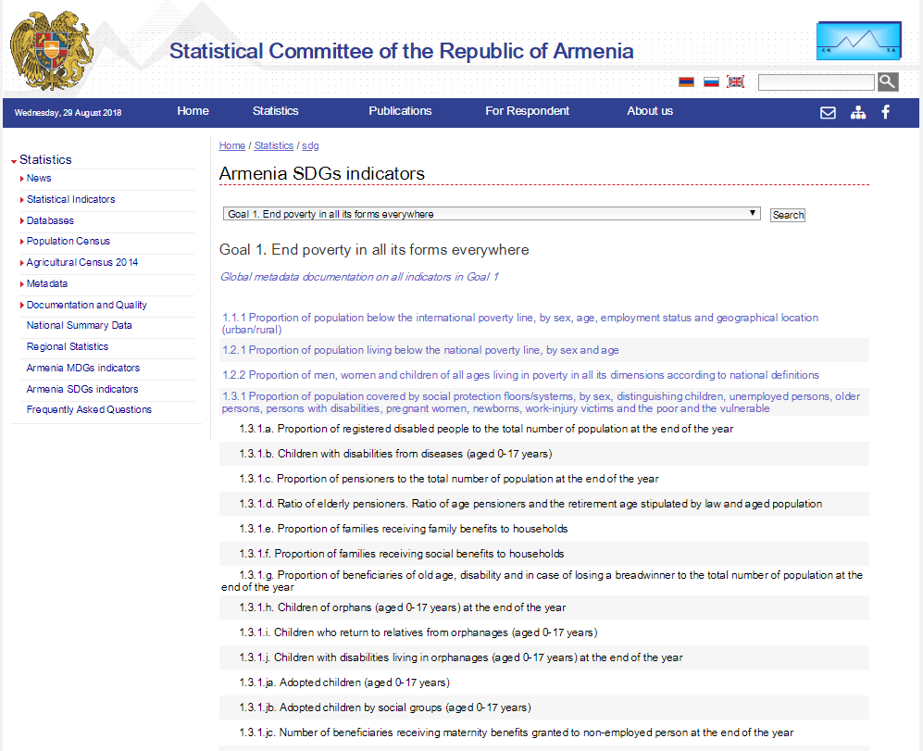

Slide 20
National Indicators

Slide 22
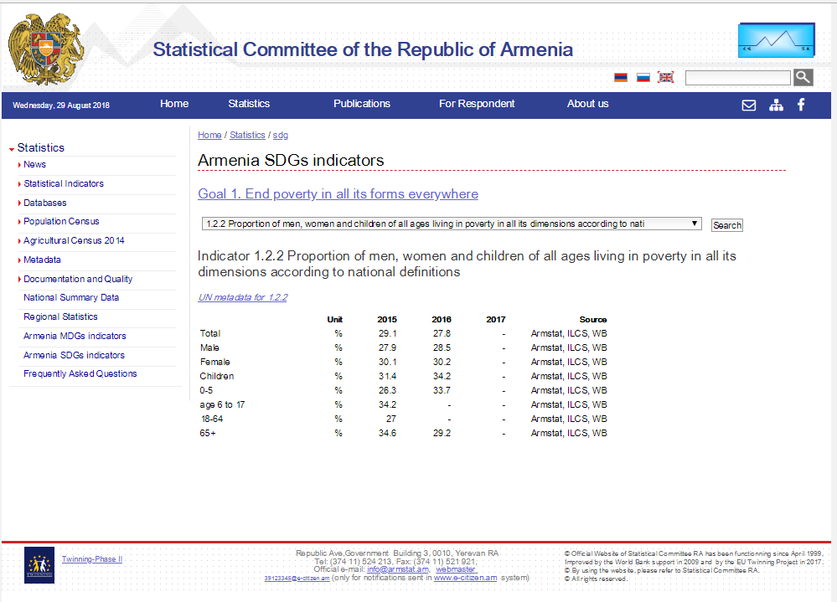

Slide 24

Challenges
Ðì SA
Improving NPR (IT resources, site functionality, visualization, data structure, data security, data flow and on-line access by administrative registers)
Expert support on database creation
Training (server administration and
database creation)
Lack of:
methodology, data and data sources,
level of disaggregation
quality of administrative registers
institutional infrastructure and
statistical capacity

Slide 25
Coordination of capacity building
Ðì SA
Task Force on SDGs, 27 April 2018
UN Agencies
Armenia National SDG Innovation Lab
Armstat
Meetings in UN to discuss:
challenges and further steps aimed at
strengthening statistical capacity, 1 June 2018
SDGs Statistics and Monitoring: The latest
best practices from Europe. The current situation
in Armenia. Way forward, UNECE experts,
15 November 2018

Slide 26

Donors support
Ðì SA
UNFPA and IOM expressed their commitment to support Armstat to improve the NRP:
UNFPA (purchased server),
IOM (mission by Data Scientist, Center for Open Data Enterprise, (CODE)) on database creation), 21-27 January 2019, Yerevan
Objective:
- data imports, platform setup
basic training

Slide 27

Capacity building needs
Ðì SA
Strengthening statistical capacity in respect to methodological support, pilot surveys
Training on methodologies, compilation and production of indicators, data disaggregation, conducting new surveys or introducing new modules in existing surveys
Strengthening capacity of administrative registers
Use of administrative registers and non-traditional sources: Big data, geospatial information
Institutional infrastructure.

Slide 28
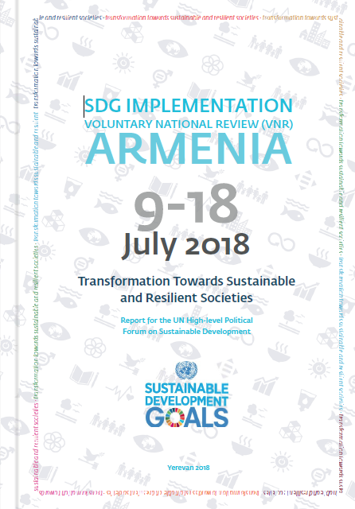

Slide 29
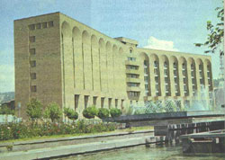
Thank you
STATISTICAL COMMITTE REPUBLIC OF ARMENIA (Armstat)
3 Government House, Republic ave., Yerevan 0010, Republic of Armenia
Telephone: (37411) 524 213 Fax: (37411) 521 921 E-mail: info@armstat.am
Internet: http://www.armstat.am; www.armstat.info; www.armdevinfo.am, www.armstatbank.am

