Slide 1
Challenges in Tracking the progress of SDG implementation – The 2018 SDG report
Learning Conference on
“Implementing the 2030 Agenda for Sustainable Development”
Shanghai, China
Division for Public Institutions and Digital Government (DPIDG)
United Nations Department of Economic and Social Affairs (UN DESA)

Slide 2
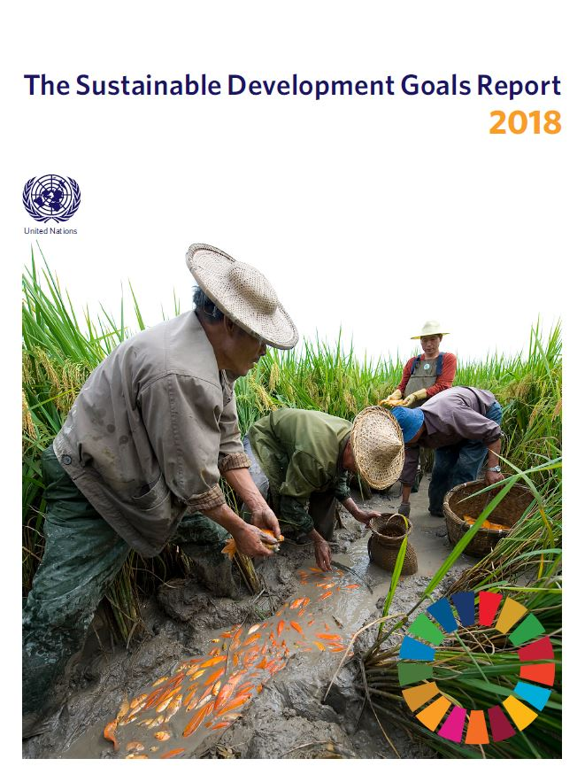
Progress toward implementation of the 2030 Agenda
“With just 12 years left to the 2030 deadline, we must inject a sense of urgency. … This ambitious Agenda necessitates profound change that goes beyond business as usual”– Secretary-General António Guterres
Overview of all 17 Goals, in-depth focus on Goals under review at the HLPF and analysis of interlinkages between Goals using data currently available to highlight the most significant gaps and challenges.
Despite inspiring success stories in several areas, overall, progress is uneven. We must step up efforts to ensure that all nations are on track to reach the SDGs, with no one left behind.
Where there is progress, it is often too slow to meet the deadline (e.g. maternal mortality reduction). And in too many cases we are losing ground (e.g. biodiversity loss, GHG emissions).
Photo: ©FAO
Notes:
The report of the Secretary-General, the “Sustainable Development Goals Report 2018” was launched on 20 June 2018 in advance of the High-Level Political Forum. The report includes an overview of all 17 Goals, in-depth focus on the Goals that were under review at the HLPF and analysis of interlinkages between Goals using data currently available to highlight the most significant gaps and challenges.
For info:
2018 HLPF theme: Transitioning towards more sustainable and resilient societies
2018 HLPF Goals under review: Goals 6 (Water), 7 (Energy), 11 (Cities), 12 (Sustainable consumption and production), 15 (Forests) and 17 (Means of implementation).
The report presents data and analysis on the SDGs in a user-friendly format, with charts, infographics and analysis on selected indicators for which data are already available. The report is built upon official data provided by Member States and is the result of a collaboration of the entire UN System.

Slide 3
Interlinked nature of the SDGs

Slide 4

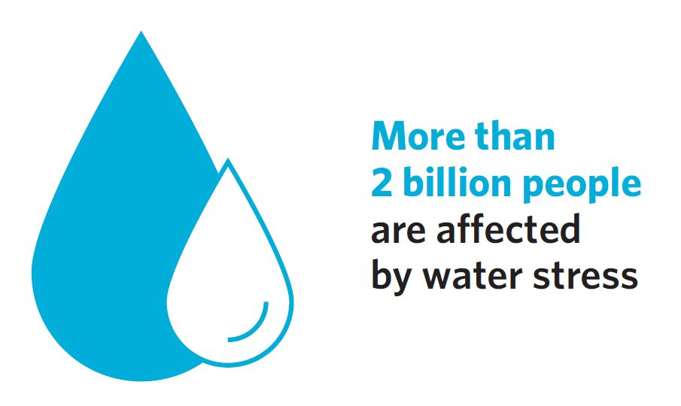
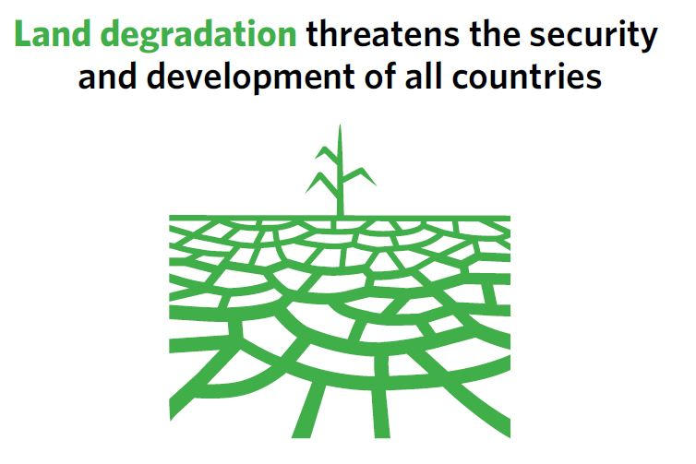
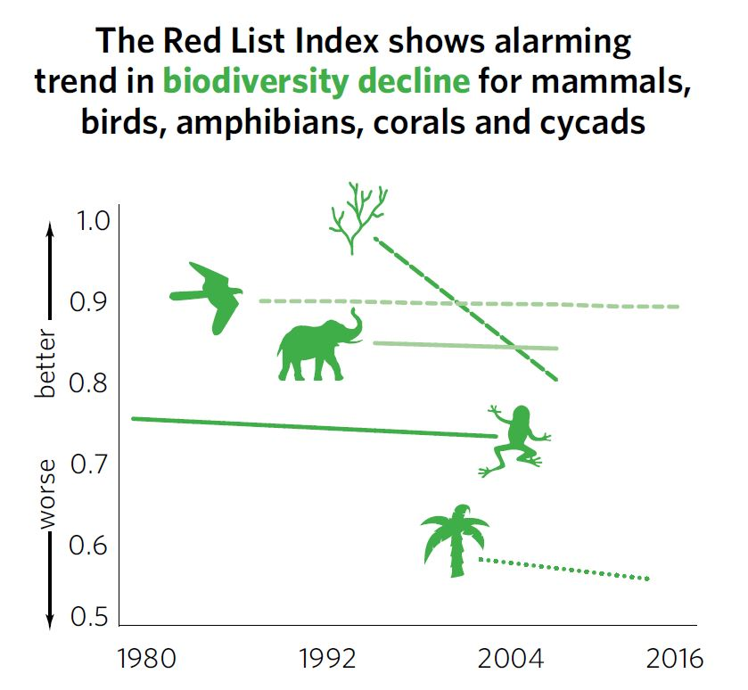
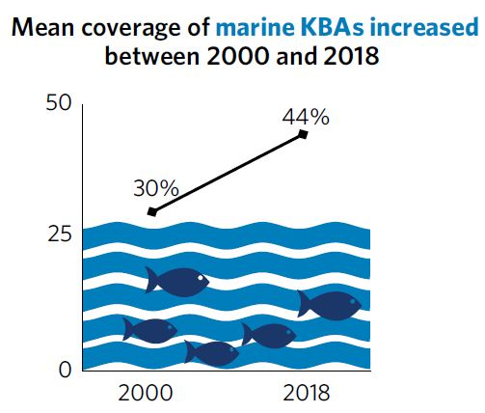
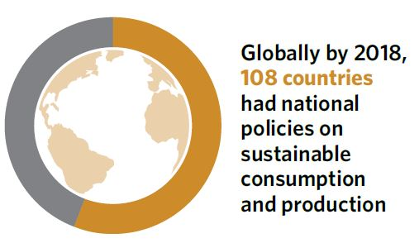
Transitioning toward sustainable and resilient societies hinges on responsible management of finite resources
Notes:
Three years after the adoption of the 2030 Agenda, countries are taking bold actions to achieve the ambitious vision of this transformative plan. Transitioning towards more sustainable and resilient societies also requires an integrated approach that recognizes that these challenges—and their solutions—are interrelated.
Land- and water-based ecosystems and the rich biodiversity they support provide food, clean water and air, and raw materials that fuel economic growth. They provide natural sites for human settlements and mitigate climate change. However, population growth, agricultural intensification, urbanization and industrial production are creating competition for natural resources, including land and water. Overuse is contributing to their rapid depletion and consequent environmental degradation.

Slide 5
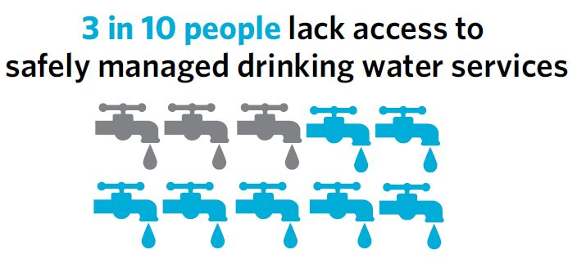
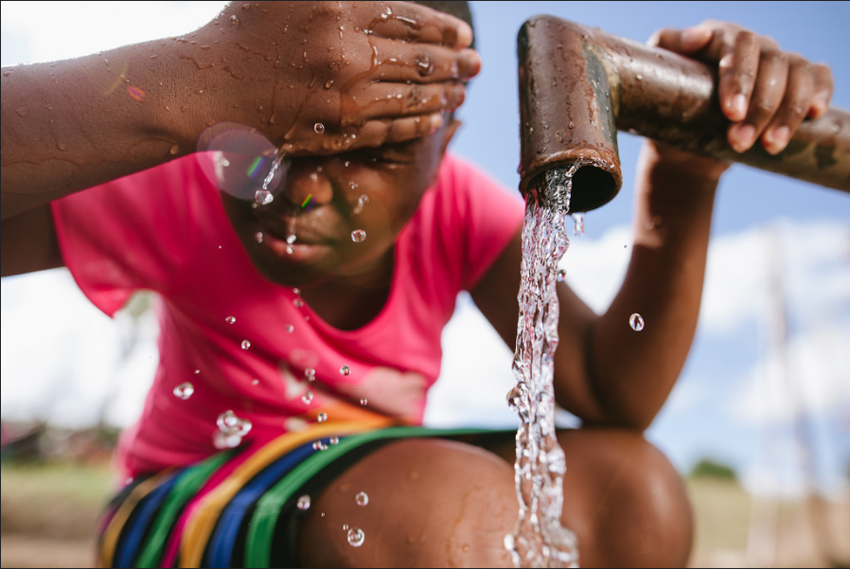
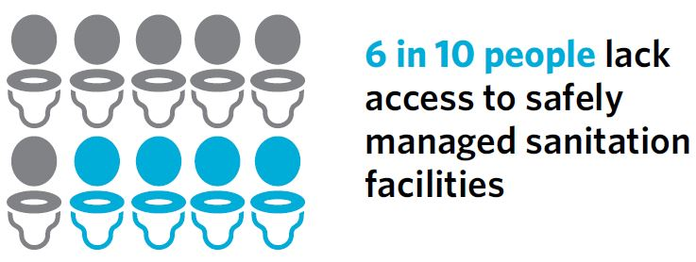
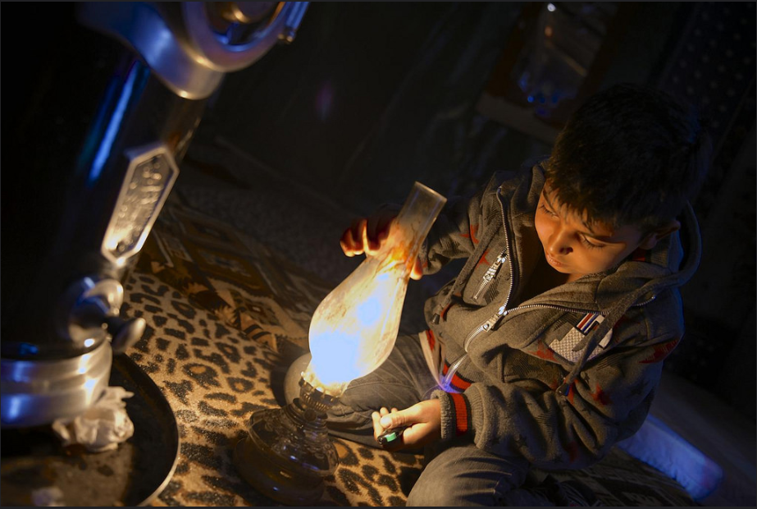
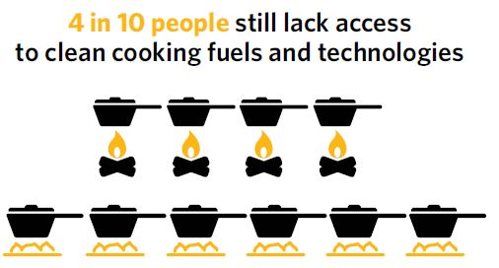
Access to basic services is not only a fundamental human right, but also a stepping stone to sustainable development
Photo: ©WMO/Luke Romick
Photo: ©UNICEF/Shehzad Noorani
Notes:
Every citizen has the right to safe drinking water, adequate sanitation, electricity or other forms of energy, safe transport, waste collection, education and health care. Provision of these basic services goes hand-in-hand with economic growth, social inclusion, poverty reduction and equality.
Globally, significant strides have been made in improving the quality of and access to basic services, while making them more inclusive. However, in many countries, the poor and most vulnerable have been left behind.

Slide 6
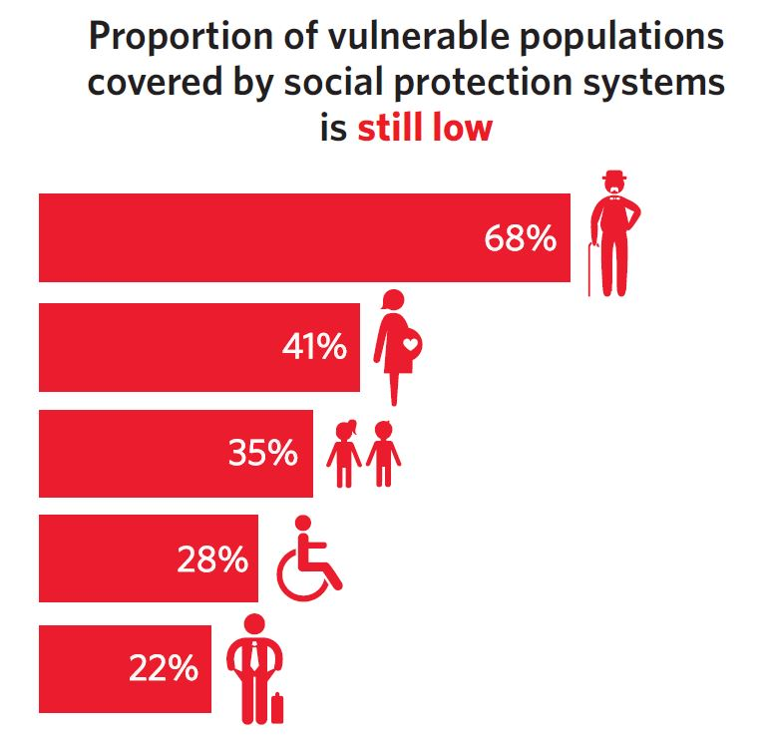
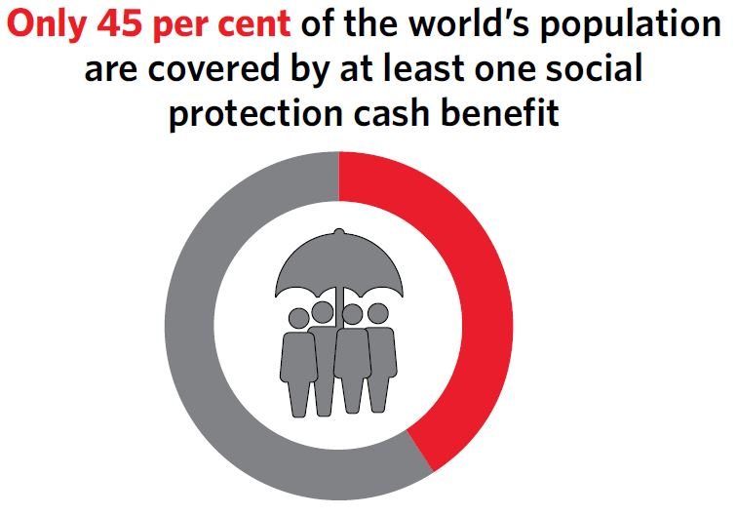
Social protection systems provide a safety net
for the vulnerable
Notes:
Challenges to sustainability and resilience manifest themselves differently for different population groups. Social protection systems can have a levelling effect. They help prevent and reduce poverty and inequality at every stage of people’s lives and make societies more inclusive and stable.
Despite significant progress in many parts of the world in extending social protection, the human right to social security is not yet a reality for most people. Based on 2016 estimates, only 45 per cent of the world’s population were effectively covered by at least one social protection cash benefit, leaving 4 billion people behind.

Slide 7
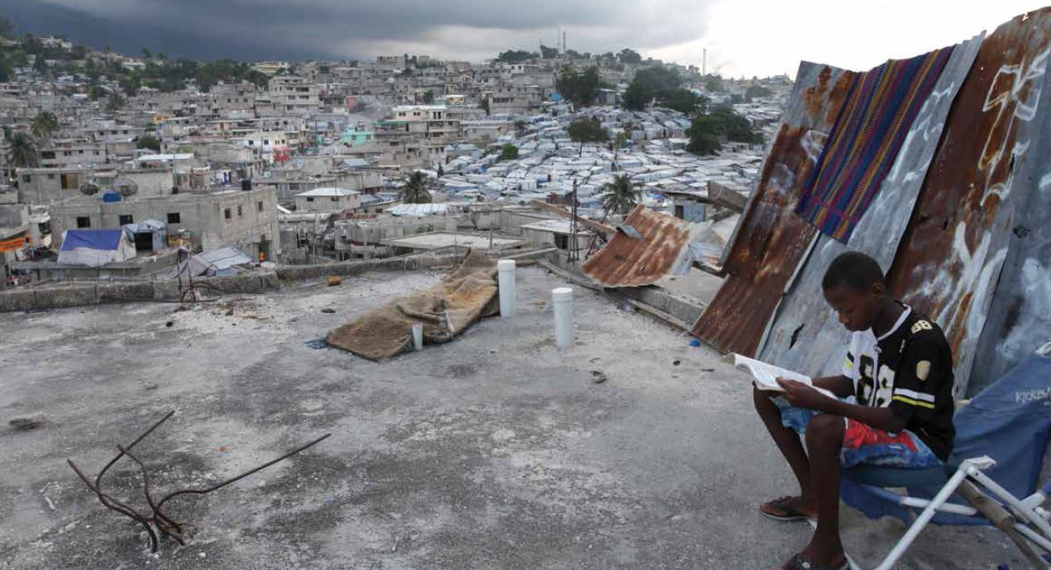
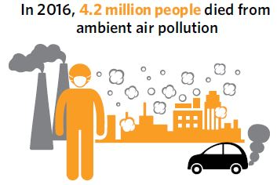
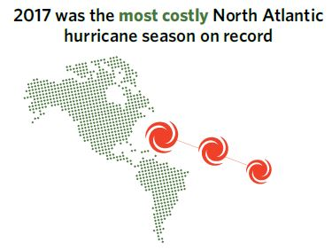
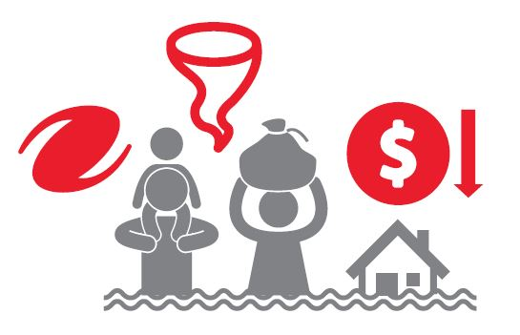
The path to resilient cities must address growing social, economic and environmental challenges
More than half the world’s population live in urban areas, projected to rise to 60% by 2030.
Mounting problems are plaguing cities:
Photo: ©The World Bank/Dominic Chavez
In the Caribbean, more than half the population live within 1.5 kilometers of the sea
Notes:
Since 2008, more than half the world’s population has lived in urban areas, a proportion that is expected to rise to 60 per cent by 2030. Cities and metropolises are engines of growth, generating nearly 80 per cent of global GDP. But they also face mounting problems: increasing air pollution, unplanned land use, growing populations living in slums and lack of basic services.
In addition, climate change has increased the frequency and severity of natural disasters. With their dense populations and growing concentration of economic activities, cities are becoming more vulnerable to such disasters.
With sound urban planning and management, cities can become inclusive, safe, resilient and sustainable as well as dynamic hubs of innovation and enterprise. Globally, 152 countries have national urban policies in place to promote more coordinated and interconnected urban development that sets the stage for sustainable urbanization. More work is still needed to ensure effective implementation of such policies.

Slide 8
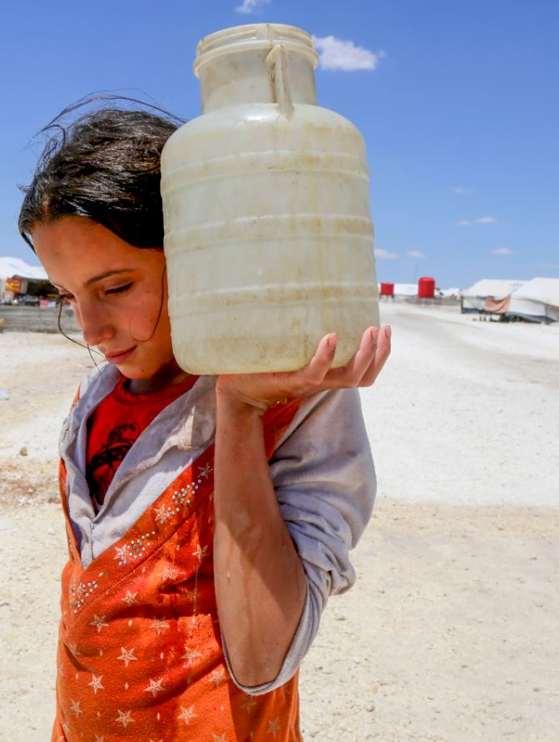
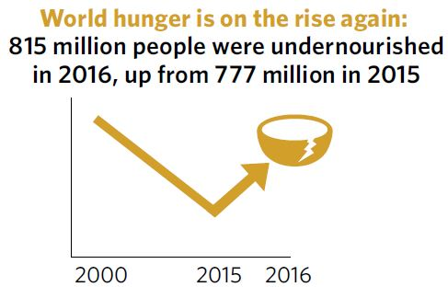
A resilient society can deflect the threat of conflict
Over the last decade, the number of violent conflicts has increased significantly:
Conflict influences urbanization patterns: people displaced from conflicts are living in slums where living conditions are not adequate.
Effects of climate change exacerbate conflict by creating competition for natural resources.
Photo: ©UNICEF/Souleiman
Notes:
Over the last decade, the number of violent conflicts has increased significantly, leading to the forced displacement of millions of people (the number in 2017 reached another record high of 68.5 million). According to recent analyses, one of the effects of conflict is a rise in hunger and food insecurity.
And for the first time in more than a decade, the number of people who are undernourished has increased—from 777 million in 2015 to 815 million people in 2016. Conflict is one of the main drivers of food insecurity in 18 countries, where 74 million people are in need of urgent humanitarian assistance.
Investing in good governance, improving the living conditions of people, reducing inequality and strengthening the capacities of communities can help build resilience to the threat of conflict and maintain peace in the event of a violent shock or long-term stressor.

Slide 9

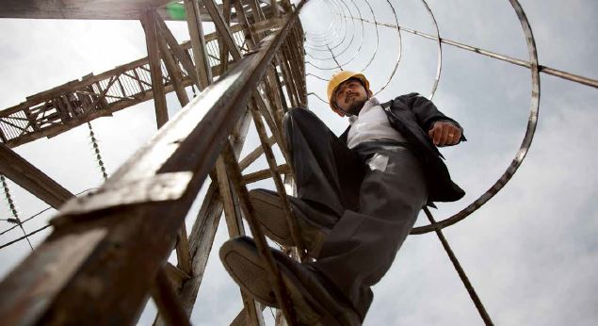
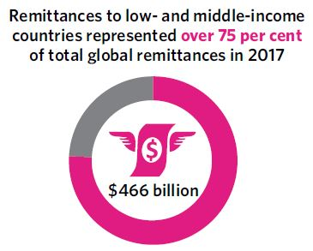
Migration can work for all in building more inclusive and sustainable societies
Photo: ©UNDP Picture This/Jean-Francois Mousseau
Photo: ©The World Bank/Graham Crouch
Migration contributes to inclusive and sustainable economic growth and development.
Globally, the number of international migrants reached 258 million in 2017
Remittances to low and middle-income countries is more than three times the amount of ODA
Notes:
Globally, the number of international migrants reached an estimated 258 million in 2017, up from 173 million in 2000. Migration contributes to inclusive and sustainable economic growth and development, in both countries of origin and destination.
In 2017, remittance flows to low- and middle-income countries reached $466 billion, more than three times the amount of ODA they received that year. Countries of destination also benefit since migrants fill critical labour gaps, create jobs, pay taxes and social security contributions. Migrants remain highly vulnerable and investments in sustainable and resilient societies benefit all.
Nevertheless, many migrants remain highly vulnerable, and investments in sustainable and resilient societies will benefit them as well.

Slide 10
SDG Data Gaps

Slide 11
Data availability a serious concern in many countries
Mainstreaming global Agenda to national development agenda – national priorities and country-specific context
Data gaps and statistical capacity building have been raised by many developing countries
New/smart governance requires high quality, timely and disaggregated data
Open government initiative especially open government data, including big data collected by government, requires more data categories to be open, better data catalogues and better metadata
Notes:
The report of the Secretary-General, the “Sustainable Development Goals Report 2018” was launched on 20 June 2018 in advance of the High-Level Political Forum. The report includes an overview of all 17 Goals, in-depth focus on the Goals that were under review at the HLPF and analysis of interlinkages between Goals using data currently available to highlight the most significant gaps and challenges.
For info:
2018 HLPF theme: Transitioning towards more sustainable and resilient societies
2018 HLPF Goals under review: Goals 6 (Water), 7 (Energy), 11 (Cities), 12 (Sustainable consumption and production), 15 (Forests) and 17 (Means of implementation).
The report presents data and analysis on the SDGs in a user-friendly format, with charts, infographics and analysis on selected indicators for which data are already available. The report is built upon official data provided by Member States and is the result of a collaboration of the entire UN System.

Slide 12
Data availability a serious concern in many countries
New methods to collect data for improving efficiency in data reporting, e.g. direct reporting without going through layers through mobile devices and GIS system with location based data
Rapid assessment – responsive governance
CRVS and ID management for building an inclusive society: The 2020 World Population and Housing Census Programme
Notes:
The report of the Secretary-General, the “Sustainable Development Goals Report 2018” was launched on 20 June 2018 in advance of the High-Level Political Forum. The report includes an overview of all 17 Goals, in-depth focus on the Goals that were under review at the HLPF and analysis of interlinkages between Goals using data currently available to highlight the most significant gaps and challenges.
For info:
2018 HLPF theme: Transitioning towards more sustainable and resilient societies
2018 HLPF Goals under review: Goals 6 (Water), 7 (Energy), 11 (Cities), 12 (Sustainable consumption and production), 15 (Forests) and 17 (Means of implementation).
The report presents data and analysis on the SDGs in a user-friendly format, with charts, infographics and analysis on selected indicators for which data are already available. The report is built upon official data provided by Member States and is the result of a collaboration of the entire UN System.

Slide 13
Data availability a serious concern in many countries
Based on the findings and analysis of the Capacity Needs Assessment conducted by DPIDG/UNPOG, development of capacities for monitoring SDG indicators is required, which include data gathering, in particular on Tier II and III data, data management system, data analysis, disaggregation of data, reporting and dissemination.
This concerns both improvement of administrative data gathering systems as well as development of capacities of statistical agencies on the gathering of survey data.
Photo: ©FAO
Notes:
The report of the Secretary-General, the “Sustainable Development Goals Report 2018” was launched on 20 June 2018 in advance of the High-Level Political Forum. The report includes an overview of all 17 Goals, in-depth focus on the Goals that were under review at the HLPF and analysis of interlinkages between Goals using data currently available to highlight the most significant gaps and challenges.
For info:
2018 HLPF theme: Transitioning towards more sustainable and resilient societies
2018 HLPF Goals under review: Goals 6 (Water), 7 (Energy), 11 (Cities), 12 (Sustainable consumption and production), 15 (Forests) and 17 (Means of implementation).
The report presents data and analysis on the SDGs in a user-friendly format, with charts, infographics and analysis on selected indicators for which data are already available. The report is built upon official data provided by Member States and is the result of a collaboration of the entire UN System.

Slide 14
Data availability a serious concern in many countries
Tier Classification for Global SDG Indicators
As of 11 May 2018, the updated tier classification contains 93 Tier I indicators, 72 Tier II indicators and 62 Tier III indicators
Notes:
The report of the Secretary-General, the “Sustainable Development Goals Report 2018” was launched on 20 June 2018 in advance of the High-Level Political Forum. The report includes an overview of all 17 Goals, in-depth focus on the Goals that were under review at the HLPF and analysis of interlinkages between Goals using data currently available to highlight the most significant gaps and challenges.
For info:
2018 HLPF theme: Transitioning towards more sustainable and resilient societies
2018 HLPF Goals under review: Goals 6 (Water), 7 (Energy), 11 (Cities), 12 (Sustainable consumption and production), 15 (Forests) and 17 (Means of implementation).
The report presents data and analysis on the SDGs in a user-friendly format, with charts, infographics and analysis on selected indicators for which data are already available. The report is built upon official data provided by Member States and is the result of a collaboration of the entire UN System.

Slide 15
Data availability a serious concern in many countries
Tier 1: Indicator is conceptually clear, has an internationally established methodology and standards are available, and data are regularly produced by countries for at least 50 per cent of countries and of the population in every region where the indicator is relevant.
Tier 2: Indicator is conceptually clear, has an internationally established methodology and standards are available, but data are not regularly produced by countries.
Tier 3: No internationally established methodology or standards are yet available for the indicator, but methodology/standards are being (or will be) developed or tested.
Notes:
The report of the Secretary-General, the “Sustainable Development Goals Report 2018” was launched on 20 June 2018 in advance of the High-Level Political Forum. The report includes an overview of all 17 Goals, in-depth focus on the Goals that were under review at the HLPF and analysis of interlinkages between Goals using data currently available to highlight the most significant gaps and challenges.
For info:
2018 HLPF theme: Transitioning towards more sustainable and resilient societies
2018 HLPF Goals under review: Goals 6 (Water), 7 (Energy), 11 (Cities), 12 (Sustainable consumption and production), 15 (Forests) and 17 (Means of implementation).
The report presents data and analysis on the SDGs in a user-friendly format, with charts, infographics and analysis on selected indicators for which data are already available. The report is built upon official data provided by Member States and is the result of a collaboration of the entire UN System.

Slide 16
Country practices – Bhutan, Lao PDR and Mongolia
Bhutan STRATEGIC FRAMEWORK for the 12th Five Year Development Plan (2018-2023)
Challenges - Weak data Quality & Availability, and weak statistical capacity & management
Notes:
The report of the Secretary-General, the “Sustainable Development Goals Report 2018” was launched on 20 June 2018 in advance of the High-Level Political Forum. The report includes an overview of all 17 Goals, in-depth focus on the Goals that were under review at the HLPF and analysis of interlinkages between Goals using data currently available to highlight the most significant gaps and challenges.
For info:
2018 HLPF theme: Transitioning towards more sustainable and resilient societies
2018 HLPF Goals under review: Goals 6 (Water), 7 (Energy), 11 (Cities), 12 (Sustainable consumption and production), 15 (Forests) and 17 (Means of implementation).
The report presents data and analysis on the SDGs in a user-friendly format, with charts, infographics and analysis on selected indicators for which data are already available. The report is built upon official data provided by Member States and is the result of a collaboration of the entire UN System.

Slide 17
Data availability a serious concern in many countries
One key lesson learnt: Administrative data need to be harmonized, streamlined and strengthened and institutional and statistical capacities need to be enhanced
Lao PDR - LOCALIZATION OF SDGs:
Nearly
60%
of the 8th NSEDP indicators are linked to SDG indicators.
The remaining SDG indicators will be integrated in the future 9th and 10th NSEDP
Notes:
The report of the Secretary-General, the “Sustainable Development Goals Report 2018” was launched on 20 June 2018 in advance of the High-Level Political Forum. The report includes an overview of all 17 Goals, in-depth focus on the Goals that were under review at the HLPF and analysis of interlinkages between Goals using data currently available to highlight the most significant gaps and challenges.
For info:
2018 HLPF theme: Transitioning towards more sustainable and resilient societies
2018 HLPF Goals under review: Goals 6 (Water), 7 (Energy), 11 (Cities), 12 (Sustainable consumption and production), 15 (Forests) and 17 (Means of implementation).
The report presents data and analysis on the SDGs in a user-friendly format, with charts, infographics and analysis on selected indicators for which data are already available. The report is built upon official data provided by Member States and is the result of a collaboration of the entire UN System.

Slide 18
Data availability a serious concern in many countries
Notes:
The report of the Secretary-General, the “Sustainable Development Goals Report 2018” was launched on 20 June 2018 in advance of the High-Level Political Forum. The report includes an overview of all 17 Goals, in-depth focus on the Goals that were under review at the HLPF and analysis of interlinkages between Goals using data currently available to highlight the most significant gaps and challenges.
For info:
2018 HLPF theme: Transitioning towards more sustainable and resilient societies
2018 HLPF Goals under review: Goals 6 (Water), 7 (Energy), 11 (Cities), 12 (Sustainable consumption and production), 15 (Forests) and 17 (Means of implementation).
The report presents data and analysis on the SDGs in a user-friendly format, with charts, infographics and analysis on selected indicators for which data are already available. The report is built upon official data provided by Member States and is the result of a collaboration of the entire UN System.

Slide 19
UN World Data Forum Initiative led by UN DESA on sustainable development data Dubai Declaration (24 October 2018) Supporting the Implementation of the Cape Town Global Action Plan for Sustainable Development Data 16. Mobilise financing at domestic and international levels and ensure political commitment within each country for adequate allocation of domestic resources to strengthen data systems to address existing gaps in the technical and institutional capacities of national data and statistical systems to improve the coverage, frequency, and availability of quality data.

Slide 20
Tracking implementation of SDG 16

Slide 21
16.7 Ensure responsive, inclusive, participatory and representative decision-making at all levels
16.7.1 Proportions of positions (by sex, age, persons with disabilities and population groups) in public institutions (national and local legislatures, public service, and judiciary) compared to national distributions (Tier III, custodian UNDP and UNICEF)
16.7.2 Proportion of population who believe decision-making is inclusive and responsive, by sex, age, disability and population group (Tier III, custodian UNDP )
16.9 By 2030, provide legal identity for all, including birth registration
16.9.1 Proportion of children under 5 years of age whose births have been registered with a civil authority, by age (Tier I, custodian UNSD &UNICEF)
16.10 Ensure public access to information and protect fundamental freedoms, in accordance with national legislation and international agreements
16.10.2 Number of countries that adopt and implement constitutional, statutory and/or policy guarantees for public access to information (Tier II, custodian UNESCO - UIS)

Slide 22
For more data on the SDGs

Slide 23
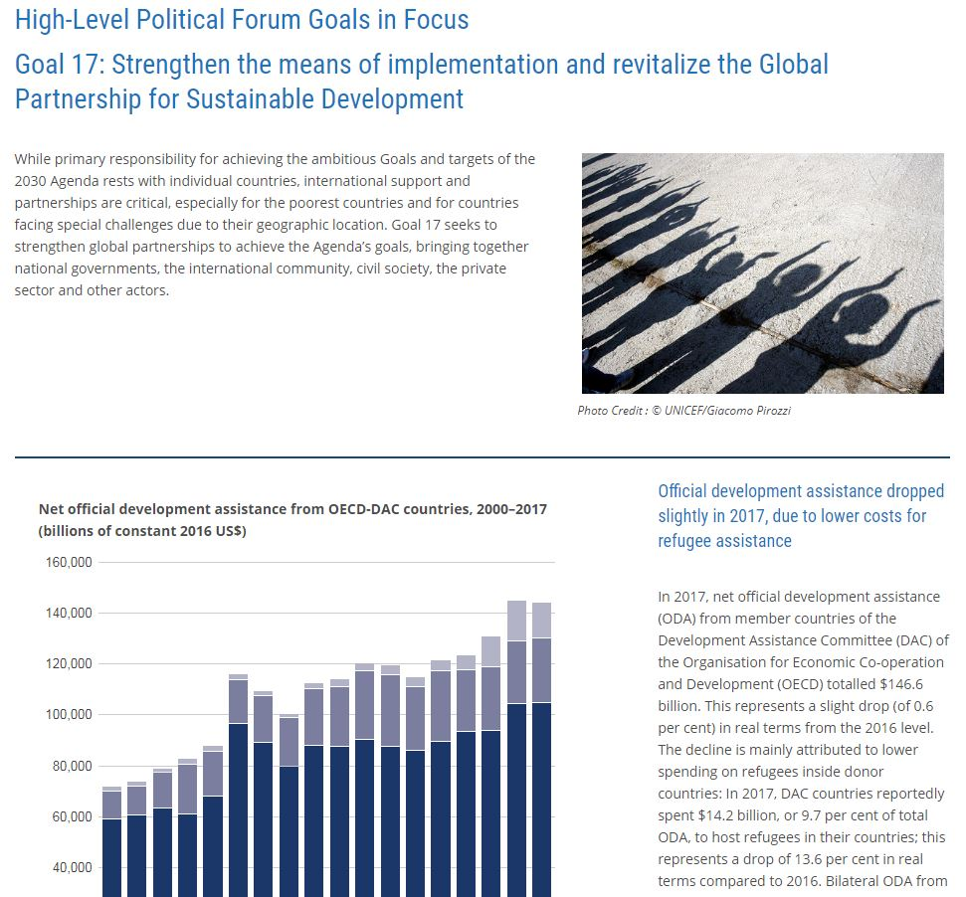
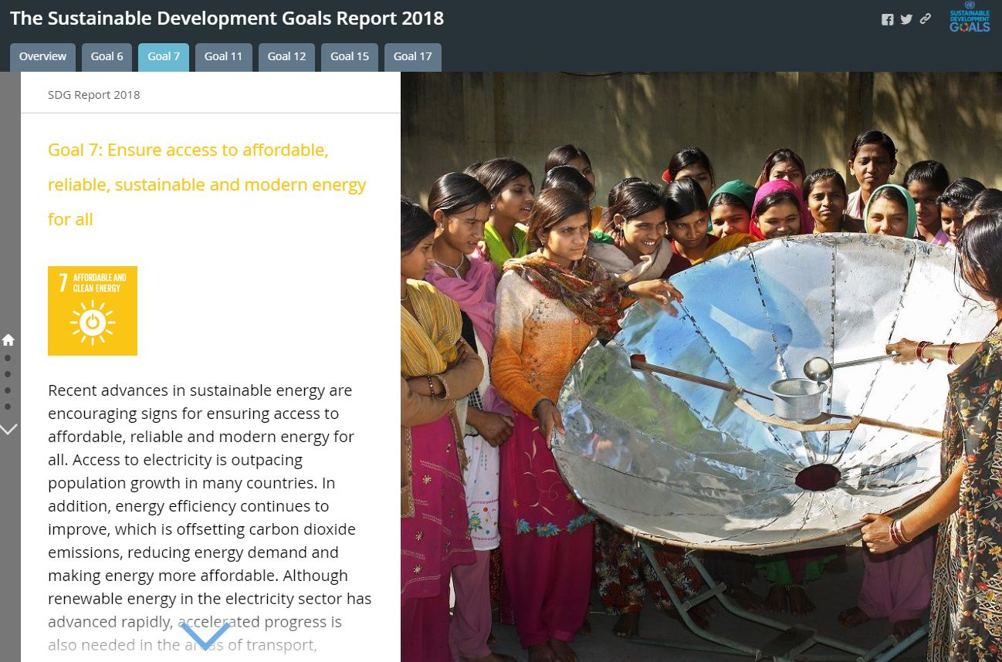
SDG Website: http://unstats.un.org/sdgs/
Photo: © UNDP Picture This/Kailash
Explore the Report online with interactive charts and graphs for the HLPF Goals in Focus
Explore the SDG Story Map, showcasing the report and incorporating charts, maps and graphs
Notes:
For more information on the SDG Report 2018 and other ways to interact with the data, please visit the SDG website at the link listed on the slide. For instance, the SDG story map showcases the report incorporating charts, maps and graphs.

Slide 24
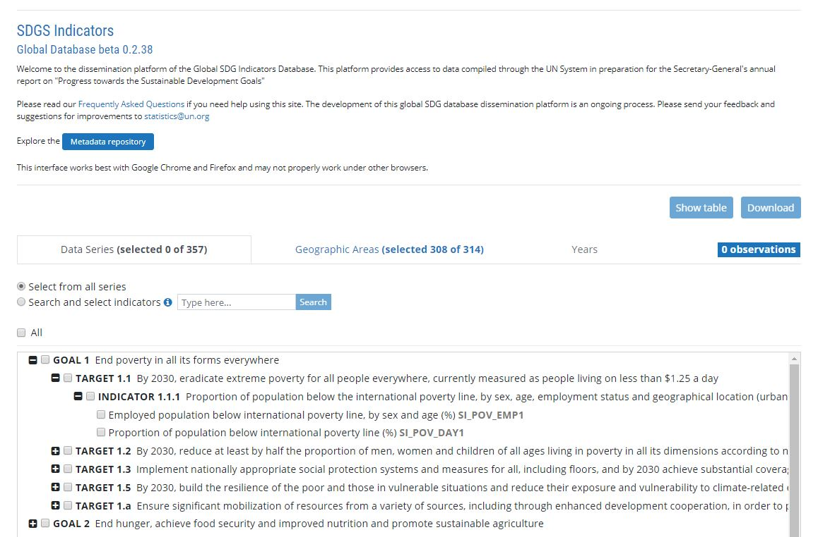
SDG Website: http://unstats.un.org/sdgs/
SDG Indicators Global Database with country-level data and metadata for the indicators
Notes:
The SDG indicators global database is also found on our website, providing country-level data and metadata for the indicators.

Slide 25

http://unstats.un.org/sdgs/

