Slide 1

Session 5. Effective M&E systems for the SDGs
A tactical, problem-solving tool to strengthen governance of data ecosystems for SDGs
Sub-session 1. Monitoring SDGs: the perspective of NSOs
Sub-session 2. Effective national M&E systems
Shanghai, 24 January 2019

Slide 2


Sub-session 1. Monitoring SDGs: the perspective of NSOs

Slide 3

Global indicator framework is..
Designed by the Inter-Agency Expert Group on SDG indicators.
Composed of 232 different indicators.
Adopted by UN Statistical Commission and the UN General Assembly in 2017.
Currently, the indicators are classified into 3 tiers at global level.
Notes:
Tier 1: both international methodologies and data are available
Tier 2: international methodologies are available but data are scarce
Tier 3: international methodologies are still under development.

Slide 4
Compilation of national SDG indicators that are…
Designed with a view to supporting national priorities tailored to national needs.
Expected to include most of the global indicators and reflect international statistical standards and practice.
Key considerations:
1) multi-stakeholder mapping of the indicators, 2) production of disaggregated data and 3) improved data accessibility.
Notes:
Tier 1: both international methodologies and data are available
Tier 2: international methodologies are available but data are scarce
Tier 3: international methodologies are still under development.

Slide 5

Overall challenges
Emerging solutions
Ensuring robust, quality, timely and disaggregated data
Coordination of National Statistical Systems and the role of NSOs
How to make better use of other data: administrative data and new sources of data (such as Big Data, geospatial, data from the private sector and civil society, etc)
Difficulties of engagement between data producers and data users
Financial and human resource constraints
Other…
Statistical legislation reflecting UN Fundamental Principles of Official Statistics
National Strategies or Plans on Statistical Development
Statistical Councils comprising data users and producers
Improving IT infrastructure, e.g. interoperability between databases
Open data SDG platforms
Strengthening data literacy
Other…
?

Slide 6
Methodolgy
1 international expert “Global monitoring of progress and SDG16”
4 National Statistical Offices
2-3 challenges
1-2 Innovative practices
1-2 significant opportunities

Slide 7

Sub-session 2. National M&E frameworks

Slide 8
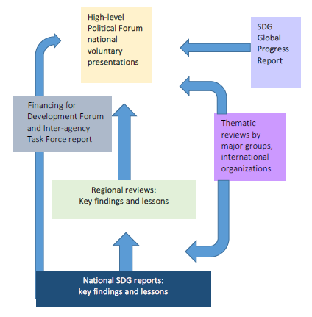
Follow-up and Review architecture for the 2030 Agenda
“conduct regular and inclusive reviews of progress at the national and sub-national levels, which are country-led and country-driven”, par. 79, 2030 Agenda

Slide 9
“rigorous and based on evidence, informed by country-led evaluations and data which is high-quality, accessible, timely, reliable and disaggregated by income, sex, age, race, ethnicity, migration status, disability and geographic location and other characteristics relevant in national contexts”
Paragraph 74, The 2030 Agenda for Sustainable Development

Slide 10
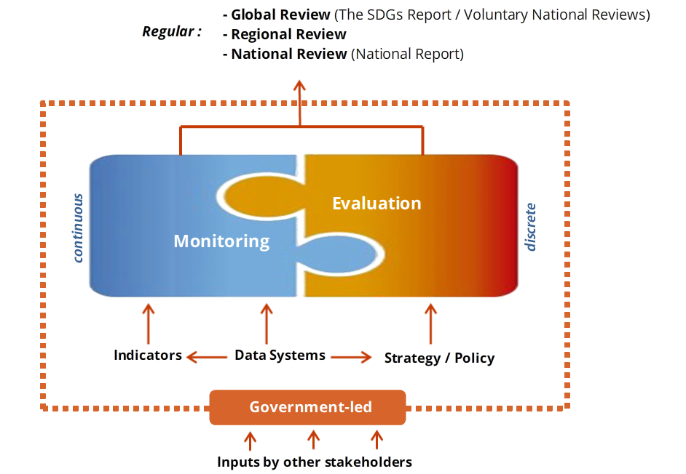
Integrated review and M&E systems
Equity
Complexity of interlinkages
Notes:
Review processes at all levels to be:
Rigorous and based on evidence
Informed by country-led evaluations and data
The follow-up Secretary-General’s report recommended that VNRs are made by each UN Member State up to two times over a 15-year period.

Slide 11
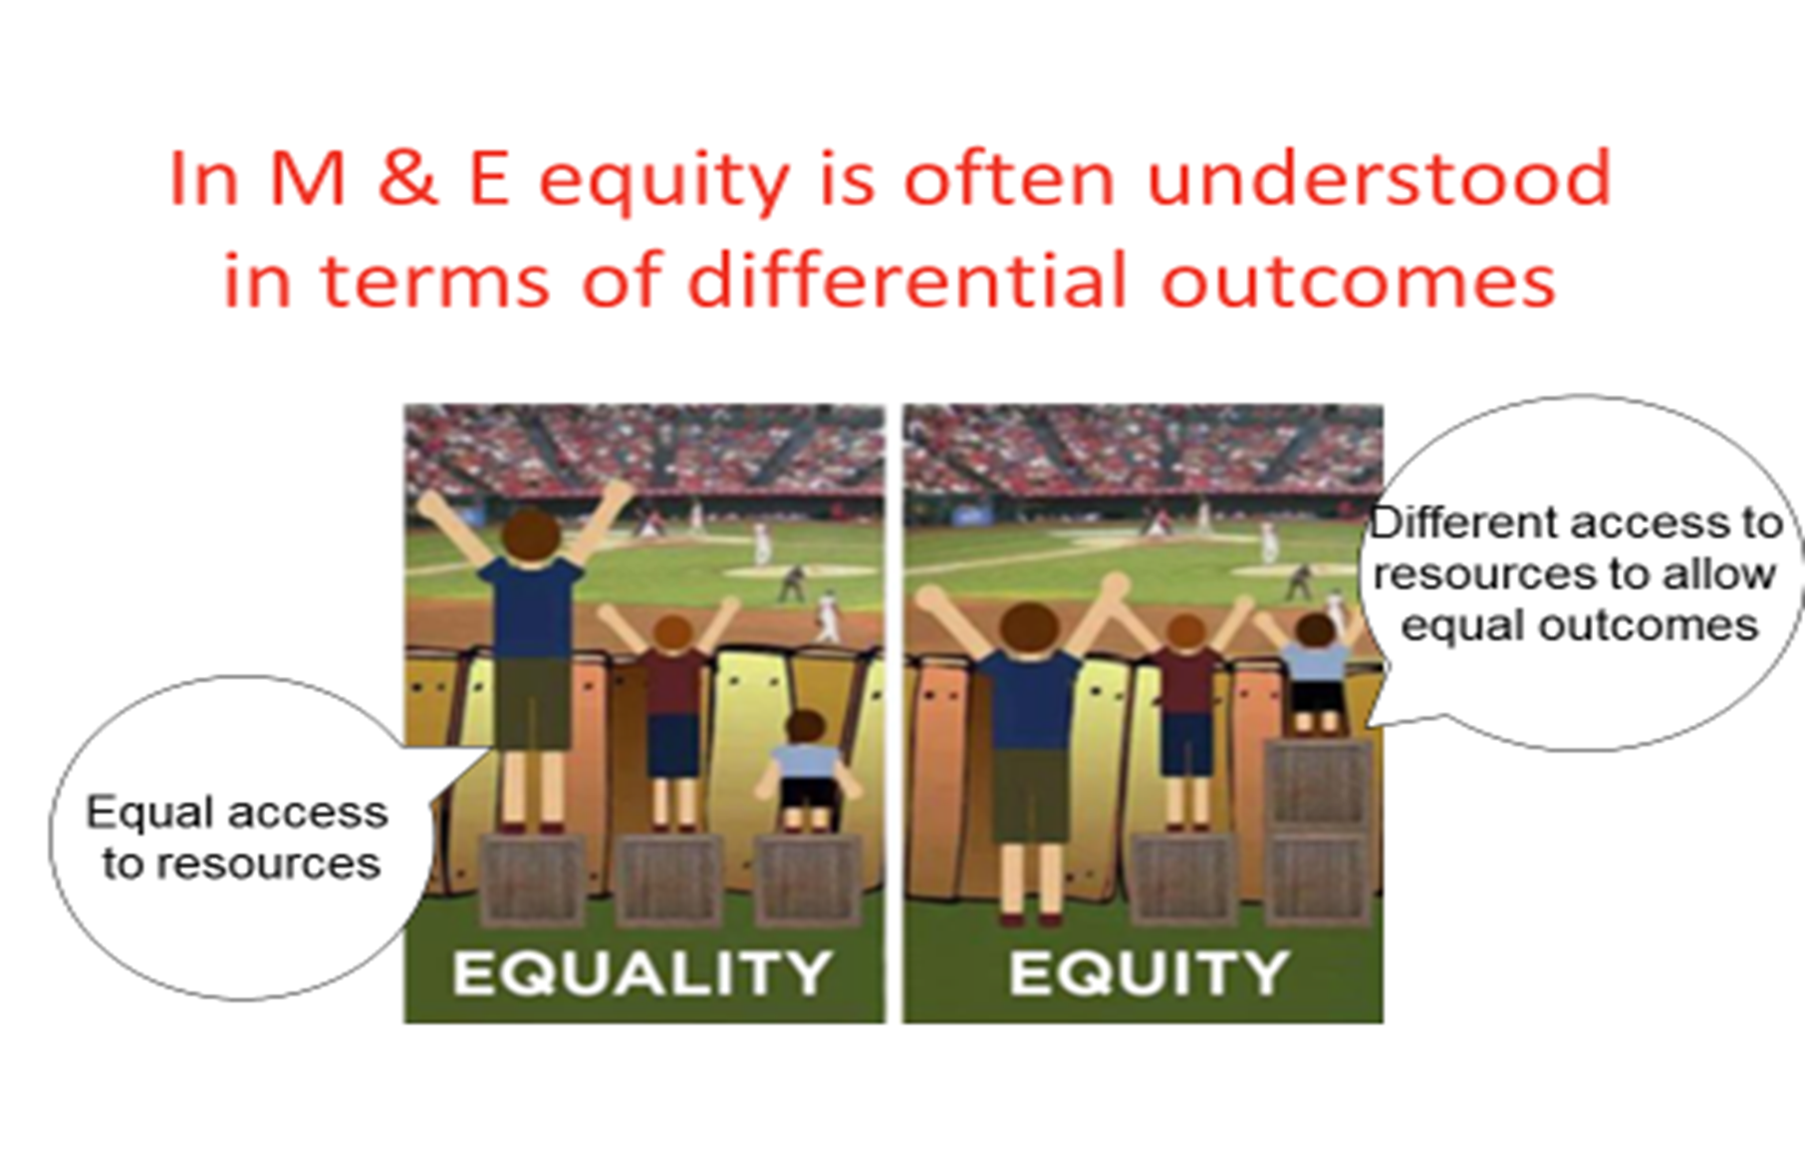
Equity-focused evaluations
he can’t speak…
COLLECTING INFORMATION ON DIFFICULT TO REACH GROUPS
Rogers (Xi’an, 2016)
Notes:
Equity focused evaluations:
Collect information on difficult-to-reach socially marginalized groups.

Slide 12
Evaluation for the SDGs: EVALSDGs findings
A number of countries established SDGs evaluation plans.
Countries that started implementation of SDGs-related evaluations use variety of evaluation approaches.
Factors that facilitate the use of evaluation include strong evaluation culture, history of comprehensive country-wide evaluations; evaluation champions in the SDG coordinating bodies; and VOPEs promoting SDG-relevant evaluation approaches.
Audits conducted by the national Supreme Audit Institutions are emerging as one of the approaches to evaluation of government preparedness for and national implementation of the SDGs.
While NSOs and Supreme Audit Institutions have global level platforms, there is no global platform connecting national institutions that have a mandate for the SDGs-related evaluation.
No evidence so far of use of SDG audit reports by Parliaments.
EVALSDGs Spotlight Maturity Tool
EvalSDGs, 2018

Slide 13
Methodolgy
3 countries will share their experiences and propose 4 challenges
Each challenge will be discussed in one of the 4 groups: find possible solutions or share practices
Groups report back
Experiences
4 challenges

Slide 14
Proposed challenges
4 challenges
Vanuatu 1:
Report content and analysis: “How do you know enough is enough and how do you make sure the important stuff gets in?”
Vanuatu 2:
“”
Sri Lanka 3:
“What mechanisms do you have to evaluate policies, programmes and projects? What different stake holders are engaged in the M&E process and how?
Nepal 4:
“How to enable adoption of the SDGs and strengthening of M&E systems at local and provincial levels in a newly federal state?”

