Slide 1

Asia Pacific Regional CSO Engagement Mechanism
a platform for effective engagement for development justice

Slide 2
Outline
Modalities of stakeholder engagement for SDGs – Global Level
CSO Engagement in Asia and Pacific
Opportunities for CSOs in the Region

Slide 3
Modalities for engagement – Global Level
Major Group System – 9 Major Group and Other Stakeholders
  1) Women
  2) Children and Youth
  3) Indigenous Peoples
  4) Non-Governmental Organizations
  5) Local Authorities
  6) Workers and Trade Unions
  7) Business and Industry
  8) Scientific and Technological Community
  9) Farmers
Notes:
Agenda 21, adopted at the Earth Summit, drew upon this sentiment and formalized nine sectors of society as the main channels through which broad participation would be facilitated in UN activities related to sustainable development. These are officially called "Major Groups" and include the following sectors:
referencing paragraphs 8c, 13, 14, 15, 16, 22 and 24 of 67/290 which all mandate the major groups and other stakeholders to be actively involved in all activities pertaining to HLPF at all levels;
And finally recalling Section C, paragraphs 42 to 55, of the Rio Outcome Document, explicitly involving major groups and other stakeholders in all matters relating to the UN and Sustainable Development;
Some critique of MGoS:
It gives opportunities for stakeholders but limited to only 9
Very northern-based – New York based centric

Slide 4
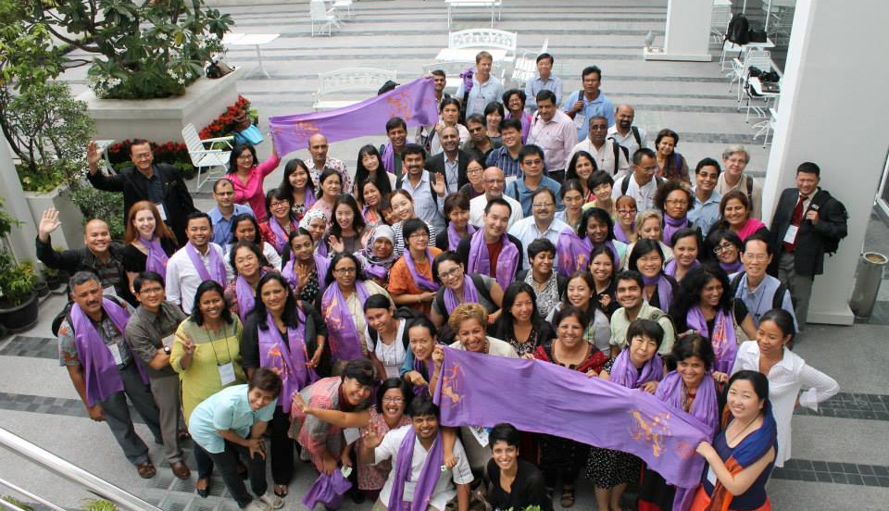
Bangkok Declaration: AP CSO Consultation on Just and Transformative Development Agenda
Notes:
History of APRCEM: came from consistent calls from Asia Pacific CSOs on the need to bridge the gap between global level engagement to national/level engagement.
Asia Pacific Regional CSO Meeting for UNEP in 2012, Kathmandu – firstly AP CSO came together to put forward RCEM and reflect that in report of the meeting
ESCAP Meeting on Follow Up of Rio+20, May 2013 – AP CSOs circulated a conference paper on the need of CSO mechanism in Asia and Pacific.
ESCAP Meeting “Asia Pacific Ministerial Dialogue on Post 2015 Agenda”, August 2013 – The first CSO Forum - Asia and the Pacific civil society groups representing 92 organisations from 21 countries representing various major groups and stakeholders gathered in Bangkok to formulate a just and transformative development agenda towards post-2015 and beyond. Highlight: we established a call for unity for Development Justice, and again pushing for the need of regional CSO engagement mechanism.
ESCAP Committee on Environment and Development Meeting, October 2013 – Several CSOs came together to concretise the plan together with UNESCAP to establish APRCEM – steering committee was established.

Slide 5

What is the AP-RCEM?
open, inclusive and flexible civil society platform in Asia and Pacific designed to reach the broadest number of CSOs, to harness the voice of grassroots and peoples’ movements to advance Development Justice which calls for a model of development that address inequalities of wealth, power and resources between countries, between rich and poor, between men and women and other social groups
Notes:
Established in 17 May 2014, during the first CSO Forum before the 1st APFSD.

Slide 6















Regional Coordinating Committee
17 Constituency Focal Points
5 Sub-Regional Focal Points
Advisory Group
AP- RCEM
Constituents
Sub-regional Groups
Pacific, North East Asia, Central Asia,
South Asia, South East Asia
Constituency Groups
(1) Women, (2) farmers, (3) fisherfolk, (4) youth, children and adolescents (5) migrants, (6) trade union/workers, (7) people living and affected with HIV, (8) LGBTIQ, (9) urban poor, (10) people displaced by disasters and conflict, (11) social and community enterprise, (12) science and technology, (13)persons with disability, (14) Indigenous peoples, (15) Older People, (16) Local Authorities, (17) NGOs
Thematic Working Groups : Environment, Trade and Corporate Power, SRHR, Land, Energy, Macroeconomic and Financing, Accountability
Notes:
+ The RCEM builds upon the Major Groups structure while expanding it to ensure that constituencies most relevant to the region are recognized and provided equitable space for engagement with the UN system in the region.
+Knowing fully well that the APRCEM’s first activities were done experimentally, the CSOs decided that the first phase of its existence should be transitional, and that through engagements, a more lasting core-structure would be defined. In this light, its working bodies were made ‘transitional’ while the involved CSOs drafted a concrete Terms of Reference (TOR), established a Transition Committee and an Advisory Group to help strengthen APRCEM operations and structure and find a way forward. On May 2015, the Regional Coordinating Committee has formally formed through and election process.
+The RCEM recognizes 17 constituencies and 5 sub-regions. The 17 constituency groups under the RCEM are: women; farmers; fisherfolk; youth, children and adolescents; migrants; trade union/workers; people living with HIV; LGBTIQ; urban poor; people displaced by disasters and conflict; small and medium enterprises; science and technology; persons with disability; Indigenous peoples; elderly; Local Authorities and NGOs.
+ The RCEM, with its inclusive mandate, will ensure that the people in the “region, which by the way constitue 60% of the world’s population, are better represented by civil society and social movements in global negotiations and have a stronger, coordinated, and more effective voice in regional processes.”
NOTES TO TESSA: Click the link of Regional Coordinating Committee to show them the role and function of RCC in AP-RCEM website
To strengthen accountability, ownership and self-organisation, each sectoral and sub- regional constituency will propose, elect (or select by consensus as may be decided by the constituency) their own Focal Point. The Focal Point position is organisational instead of individual, but each organisation should assign one main contact person, and one alternate .They should be willing to serve for a term of two years
NOTES TO TESSA:
Click the link of Constituency Focal Points to show the current list of RCC focal points
Click the link of Sub-Regional Focal Points to show the current list
Just to let you know that we called the organisations part of/affliated with RCEM as 'constituents'. Now we have 377 constituents from 17 constituencies and 5 sub-regions. The large number of constituncies are 1) NGOs, 2) Women and follow by 3) Youth. Based on our operational document (attached), constituents are:
agree to the Bangkok declaration: "Advancing People's Agenda Through Development Justice", AP-RCEM’s Functional Operation Document, and TOR
Submit a profile to the secretariat and self-define the Subregional andThematic AP-RCEM Constituencies they should be placed in. Constituents may participate in multiple themes and sub-regions (in the case of region-wide groups). But for membership and voting/decision making purposes, eachconstituent can belong to only 1 primary Sectoral Constituency and/or 1Geographic (sub-regional) Constituency. Regional organisation can choose whether they want to affiliate themselves with specific sub-regions or not to.
Provide a copy of registration of the organization. In the absence of such, endorsement by at least one existing member of that Constituency will be necessary.
On THEMATIC WORKING GROUP:
2. Alhough the thematic working groups was in the structure since last year, but we just develop a more details mehanism for the thematic groups this year (CSO Forum 2015). Again, refering to the operational document, thematic working group are ad-hoc cross-cutting groups of constituents that come together temporarily to work on a specific issueor prepare for a meeting or specific engagements.
They are initiated by posting a thematic concept on the RCEM website and they need toassign one coordinator, who reports to the RCC and makes it available online in thesame fashion as regular reporting. The role of the TWGs is to develop common positionsor messages for sustainable development processes in the region where possible onspecific themes. It will be composed of volunteers from the various sub-regions,constituency groups and experts. Membership in them is voluntary and based onexpertise or interest, rather than representation. A working group may be formed arounda theme proposed by any member of the AP-RCEM if:
(1) the topic is related to sustainable development; and
(2) at least 5 member-organizations from at least 5 sectoralconstituencies commit to work together on this theme
​On the last CSO Forum, we formed the thematic working group on SRHR, Environment, Trade, FfD. The number may increase later.

Slide 7
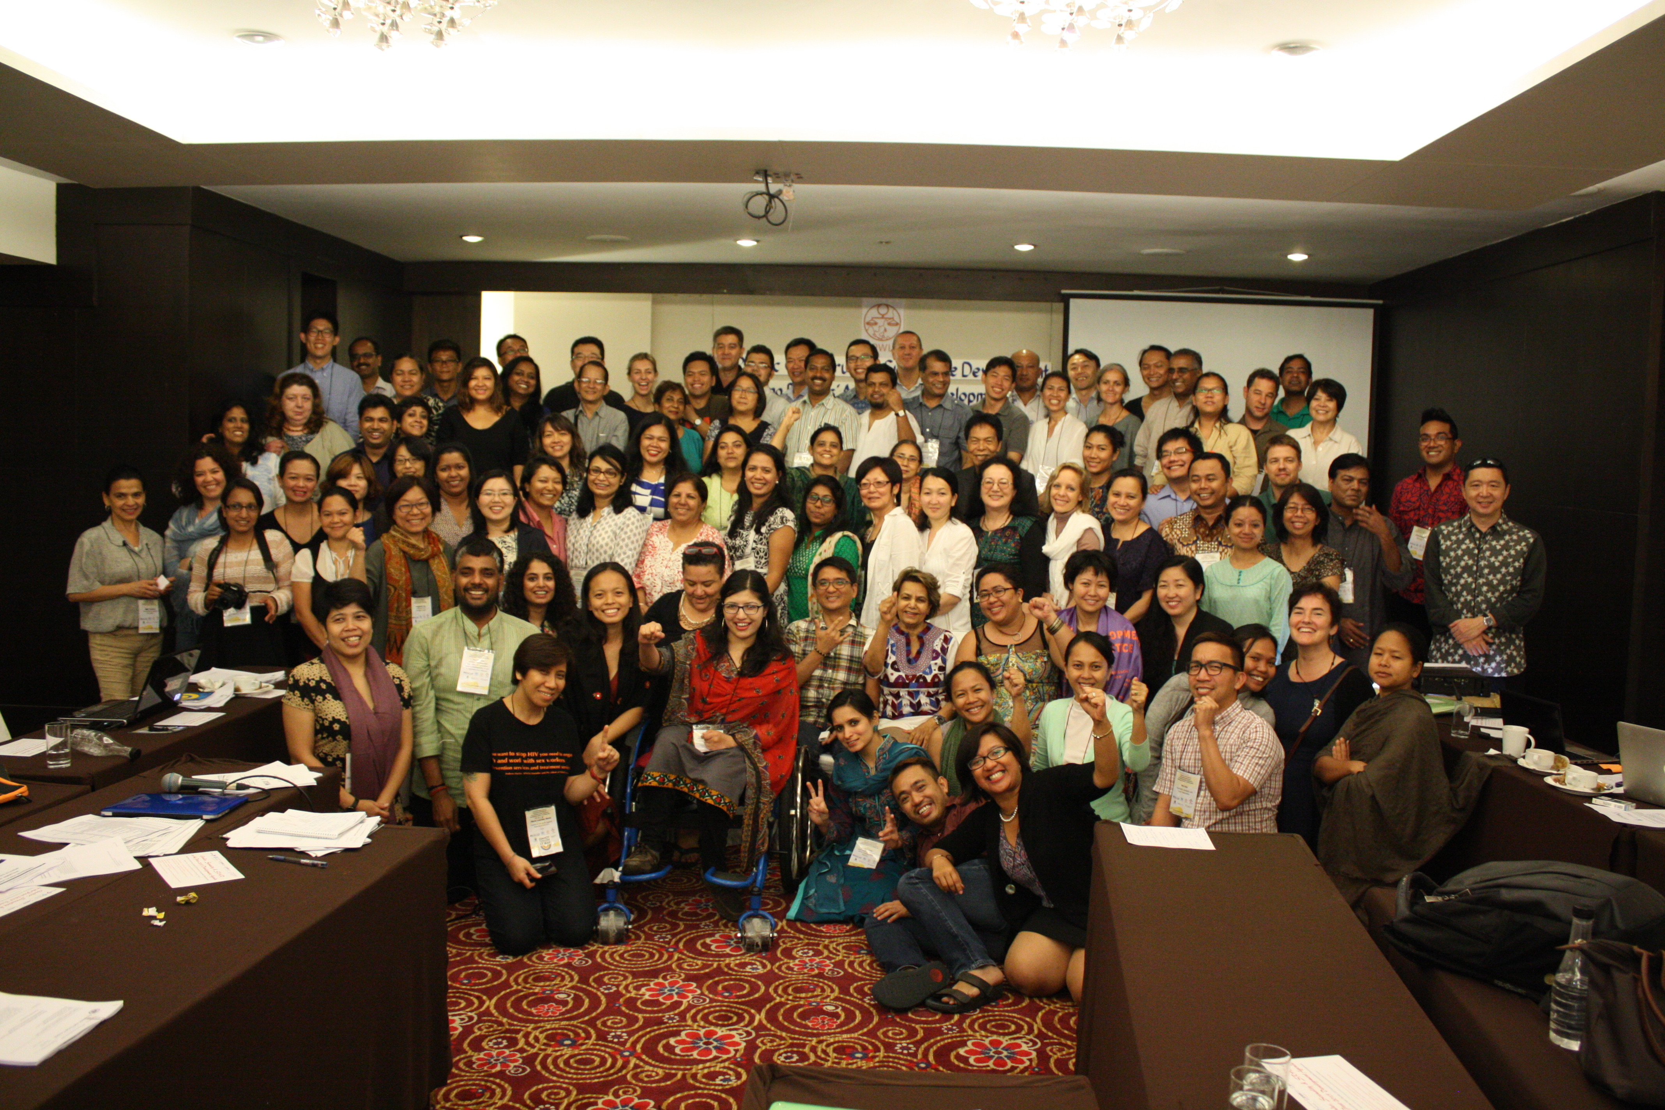
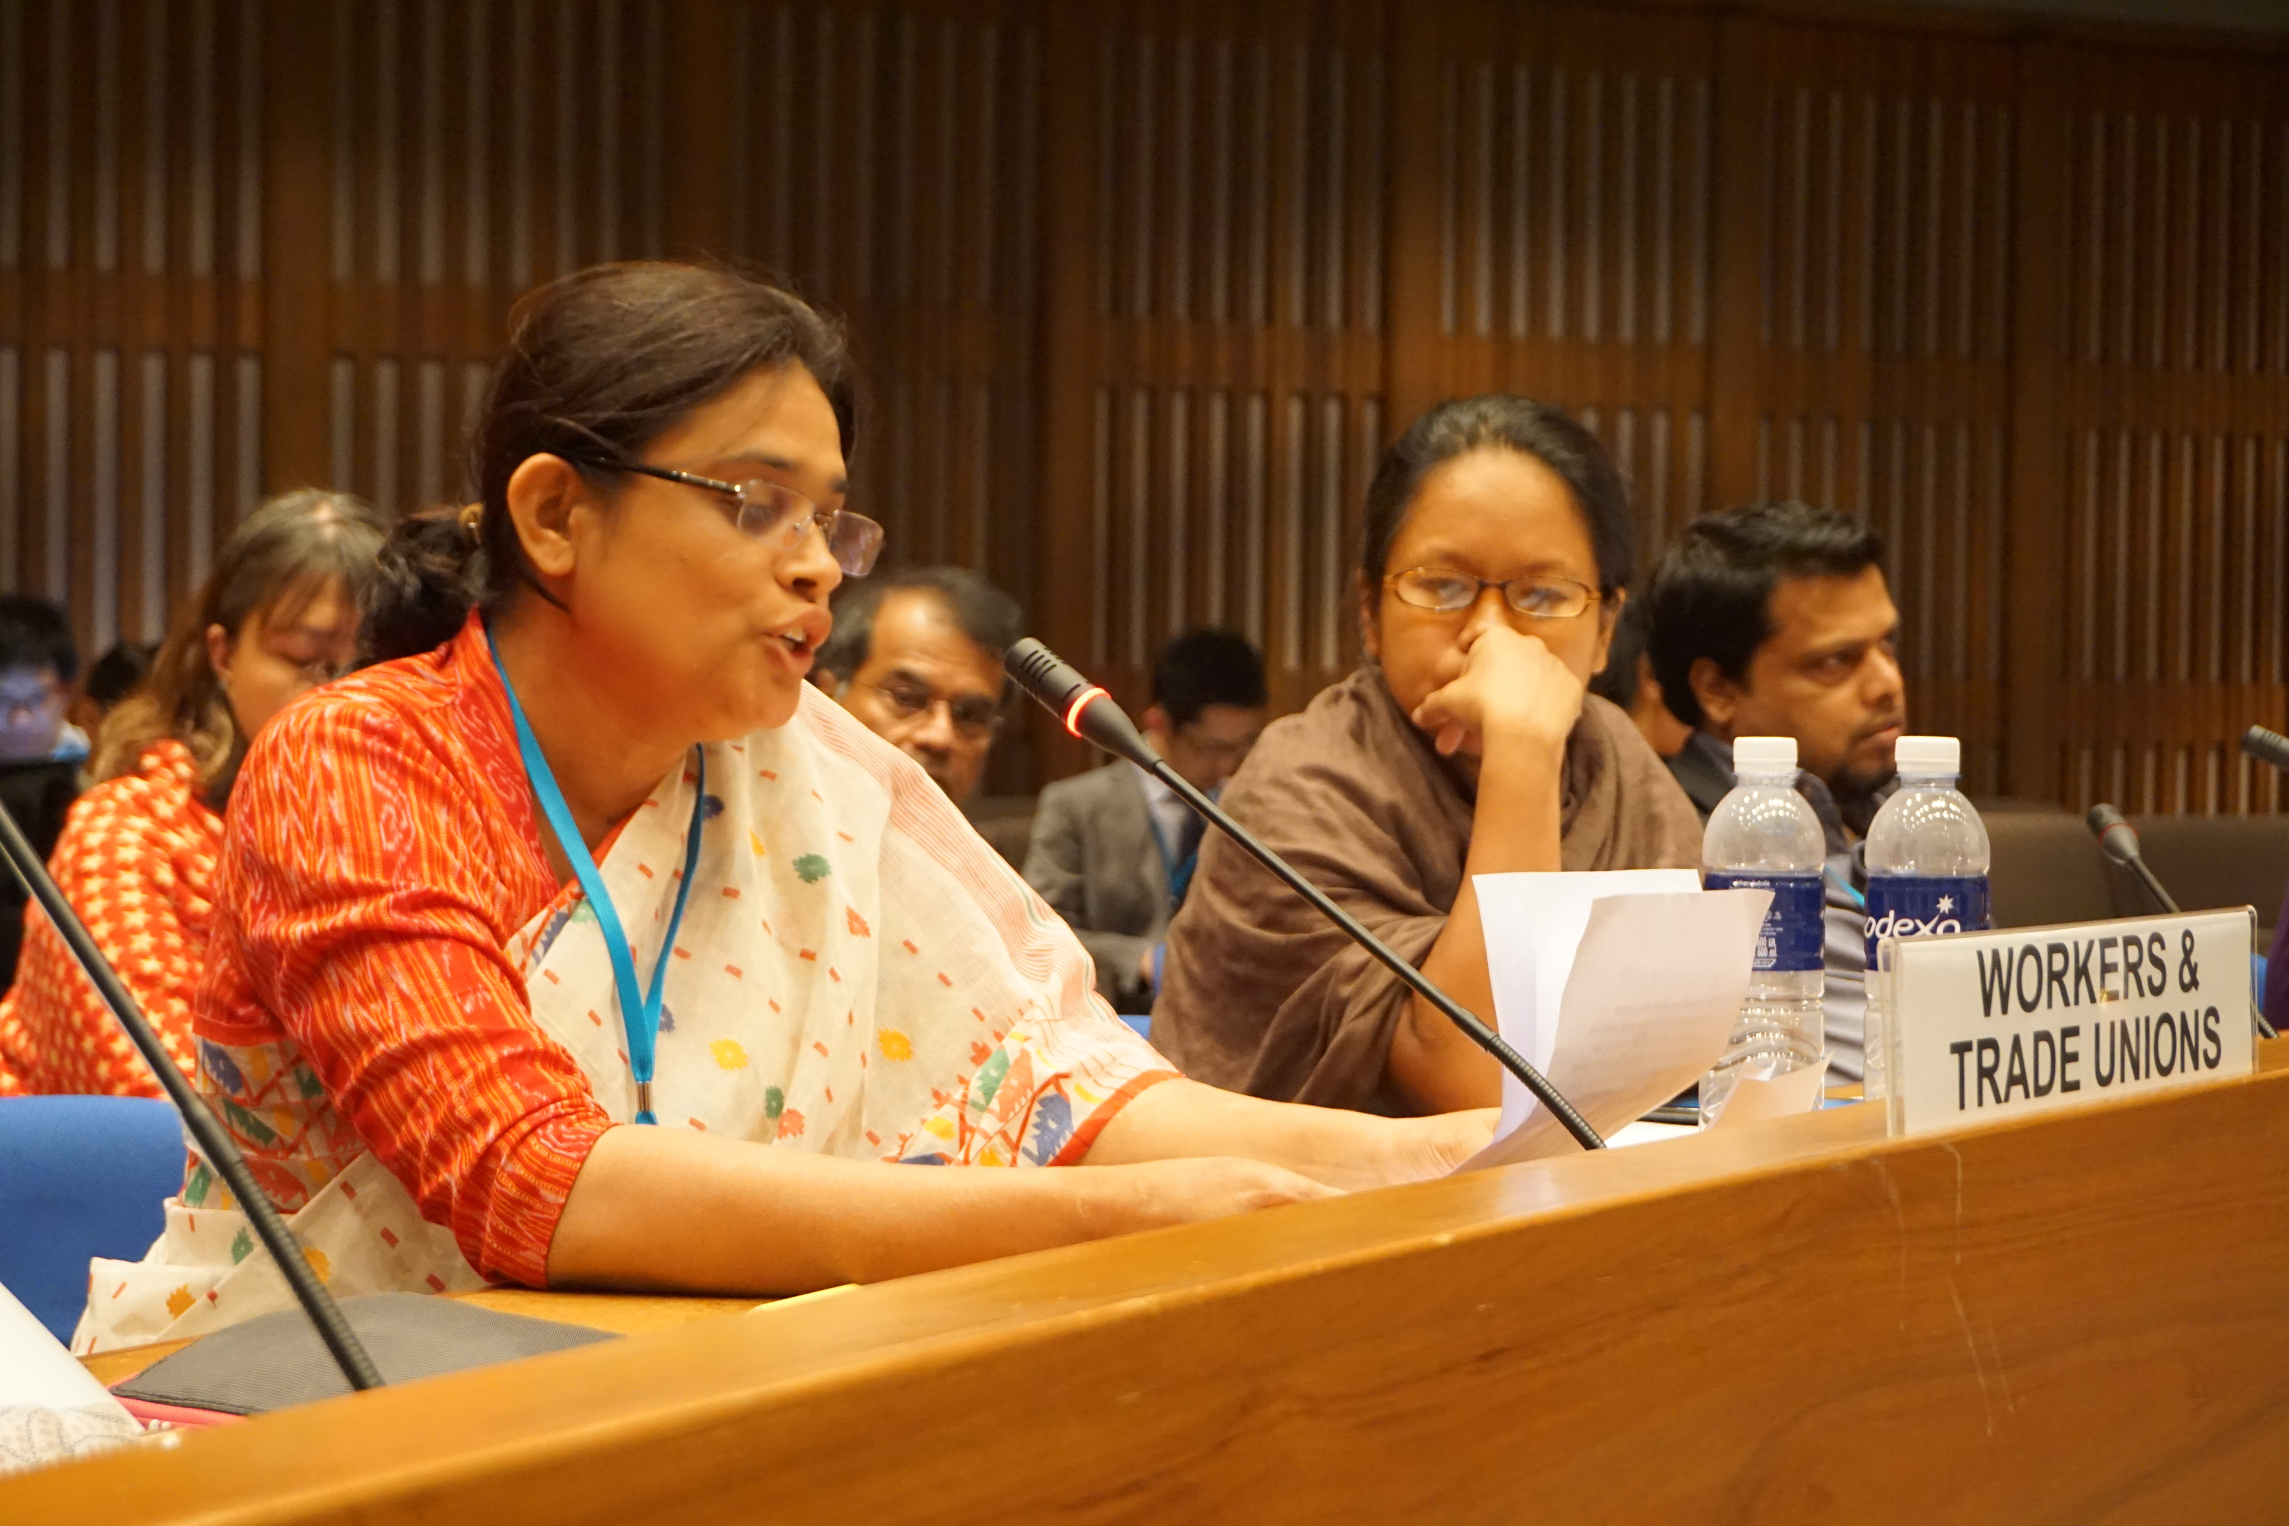
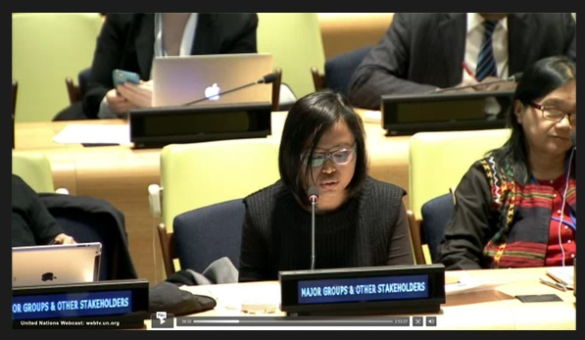
Why AP-RCEM?`
Ensure that the diversity of Asia and Pacific civil society is able to engage with and influence national, sub-regional, regional and international intergovernmental processes on sustainable development, and
To also ensure that the peoples of Asia and Pacific are able to monitor the implementation of the SDGs in national, regional and global level and hold the UN, governments and corporations accountable.
Building and generate power of RCEM constituency, give pressure to the governments, reshape the sustainable development discourse through collective mobilised actions on development justice and reshape the way Gov and UN work with civil society

Slide 8
Opportunities for civil societies in the regional processes of SDGs
Regional processes provides proximity, accessibility, relevance, and enhancing accountability.
APRCEM as official partners in organizing the CSO forum from 2014-2018 and faciltates CSO Engagement in APFSD:
  Selection of participants
  Independence in setting the agenda of CSO Forum
  Providing direct inputs in the preparations of the official process – including APFSD programme, open nomination process for CSOs speakers and discussant roles.
Opportunities for interventions and giving substantive contribution:
  Opening Speech, Formal Sessions - speakers/discussants in the panels, MGoS interventions, Side Events, Meeting with Chair of APFSD, Inputs to the Chair Summary and Report of APFSD
Engaging in other global, regional, subregional and national forums on Agenda2030.
Notes:
Principles:
Self-organising
Representation
Inclusive
Capacity Building
Solidarity - Power Sharing
Sharpening our perspective and analysis - coherent picture of APFSD.
Breaking silos.

Slide 9
Impact
Better quality of dialogue at the APFSD, Growth of the Forum
Regional contribution is solid - Regional issues better represented at global level
Independence of Committee – self-organise principles creates trust.
High degree of empowerment - promotes ownership >> Self-regulation of participants
Understanding and awareness builds credibility
Ability to engage more deeply over time - e.g. roundtables
Mobilisation of community voices - capacity to mobilise
To get more coherent picture on our engagement
Increased Credibility -
  Effectiveness of facilitating the engagement - APRCEM - facilitating the GMGSF of UNEP, UNDP Regional Knowledge.
  As best model of CSO Engagement - HLPF Coordination Mechanism. ECE
  Harnessing grassroots voices - Eni, Helen,

Slide 10
Modalities for engagement – Global Level
Major Group System – 9 Major Groups recognising other stakeholders/sectors
1) Women
2) Children and Youth
  3) Indigenous Peoples
  4) Non-Governmental Organizations
  5) Local Authorities
  6) Workers and Trade Unions
  7) Business and Industry
  8) Scientific and Technological Community
  9) Farmers
  10) Education Group
  11) Older People
  12) People with Disabilities
  13) Volunteer Groups
  14) LGBTIQ
  15) Asia Pacific Regional CSO Engagement Mechanism

Slide 11
HLPF MGoS Coordination Mechanism
https://sustainabledevelopment.un.org/content/documents/9105HLPFWGToROriginal.pdf
Broadening the scope of constituencies – disability, older people, education group, volunteer group – note that education group has been very active in the negotiations.
Try to work on more coordinate and consolidated manner among the constituencies

Slide 12
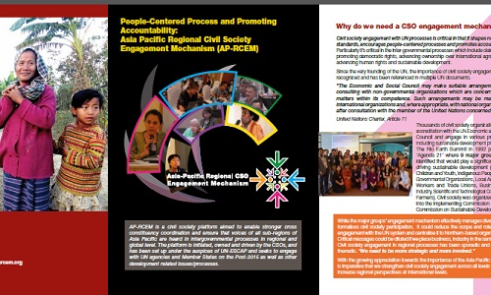

WAYS TO KNOW MORE AND ENGAGE WITH AP-RCEM
Visit our website : www.asiapacificrcem.org
Read our previous submissions, endorse our statement : Advancing a Peoples’ Agenda for Development Justice
Fill in the forms to join as AP-RCEM constituents
Follow and like us in Facebook: CSO Asia Pacific

