Slide 1

Mainstreaming the 2030 Agenda for Sustainable Development Stakeholder Engagement
Katinka Weinberger
Chief,
Environment and Development Policy Section
ESCAP

Slide 2
Engagement of non-government actors in the 2030 Agenda is not “business as usual” ….
2030 Agenda commitments
“Leave no one behind”; Inclusion; partnership (Goal 17), participation
Policy coherence, balanced integration of the three dimensions of sustainable development – economic, social and environmental
Effective institutions, transparency & accountability (Goal 16)

Slide 3
How can non-government actors contribute?
Planning
Help develop social, political and scientific consensus on priorities & targets
Delivery/action
Follow up and review
Data gaps
Strengthen integration and policy coherence
Ensuring that the perspectives of the disadvantaged are taken into account
Spread the word - public outreach and awareness
Partnerships for delivery
Help define data disaggregation needs
Shared vision and awareness at national/province/district & community levels
Develop social consensus on progress, priorities and gaps
Notes:
Each area of implementation of the 2030 Agenda activity has different purposes for engagement.
When we look at the area of planning – it is about developing consensus and understanding inter-relationships as a basis for integrated and coherent policy, and about ensuring that marginalized and impacted groups are part of the conversation. We can also engage stakeholders in ensuring that resources are effectively allocated.
When we look at the area of delivery/action
It is about creating ownership an motivating stakeholders to act. We need here pubic outreach, developing shared vision and aligning the interests of different stakeholders to promote partnerships.
In the area of follow up and review,
We need to have

Slide 4
Stakeholder engagement is ..
PURPOSEFUL: An intentional process that has a clear objective and is mostly planned
INFLUENTIAL: Provides opportunities to shape decisions and actions of individuals, communities and/or organizations
ITERATIVE: Recognizes of the interrelationships between the decisions and actions of organizations, stakeholders, communities and individuals
COLLABORATIVE: Recognizes the rights and responsibilities and roles of organizations, stakeholders, communities and individuals.

Slide 5
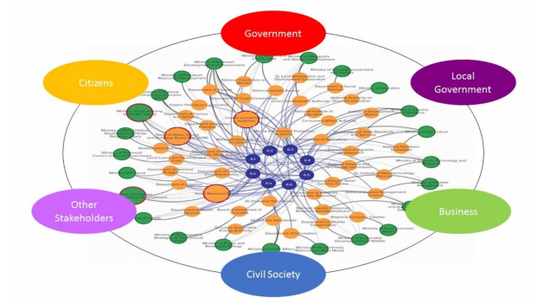


Why is stakeholder planning needed ?
Integration requires the meaningful dialogue and understanding between stakeholders;
The integrity of the analysis of SDG interlinkages depends on who is involved;
Meaningful engagement requires a systematic, planned approach
Notes:
Integration requires, by definition, the involvement of stakeholders — but which stakeholders? An analysis of the linkages between the SDGs and issues helps to better understand the reality behind the challenge or decision, who should be involved.
Exploring the appropriate and relevant stakeholders that should be involved in the engagement process. Identification of key stakeholders is vital to the success of an engagement approach.
When considering stakeholders there is value in undertaking a Stakeholder Analysis to better understand expectations, how each stakeholder can add value to the project and communication needs that the stakeholder may have. Stakeholder analysis approaches can be adapted specifically for the 2030 Agenda depending on the topic or the scale/level of the policy or intervention that is being considered.

Slide 6

Stakeholder Engagement Policy
A good first step towards institutionalized engagement is to develop appropriate policy and practice frameworks to inform practice and capacity building.
The policy should set out a vision for engagement, with a description of how it aligns with decision making, and explains the role of the stakeholders.
It should establish the standards of engagement that institutions are expected to meet, and the issues and decisions on which engagement is needed.
Policies for engagement can exist at the national or sub-national levels.

Slide 7




4 Dimensions of quality engagement
Clear objective, a plan, resources, responsibility & follow up
Barriers to participation (cultural, ability, geographic, other) removed/recognized, stakeholders mapped and analyzed, ensuring “no one left behind”
Facilitates collaboration, empowerment, partnership, cross-sectoral, multi-perspective dialogue to develop shared understanding and build trust
Outreach, involve stakeholders in designing participation, provide information and feedback needed & institutionalize
PURPOSEFUL ENGAGEMENT
INCLUSIVE ENGAGEMENT
TRANSFORMATIVE ENGAGEMENT
PROACTIVE ENGAGEMENT
- Based on ESCAP & IAP2 preliminary framework

Slide 8
Planning for engagement - good practice
Defining a clear objective for your engagement with stakeholders
Review the planned report structure and identify the specific points at which stakeholder input will be sought & input (what input, who, how?)
Map your stakeholders (ensuring inclusion, identifying partners) – ideally in a participatory exercise
Defining the right institutional lead is critical (trust, impartiality, competence, involvement in the process) – responsibility & resources
Communicate the entry points clearly & early on to stakeholders
Communicate early with the Stakeholder platforms/bodies on the plans and consult on inputs that could be provided by stakeholders
Develop some basic communication material that can be quickly shared with stakeholders on substance and process. Is there a role that the media can play – as partners ?
Planning for after the VNR

Slide 9
Initial steps
Dialogue with stakeholders
- What can stakeholders contribute to the VNR short term and long term across planning, delivery, monitoring?
- How would they like to be engaged?
- What are there specific expectations and needs?
Dialogue within government
- How does engagement support ministry/agency mandates ? (accountability, service delivery, other?)
- Who are your stakeholders?
- Standards (what, how, responsibility, capacity, tools)
Use the VNR process to explore opportunities & pathways to institutionalization
Very often the VNR process exposes weaknesses/gaps in engagement “infrastructure” or trust. The report can document steps taken, lessons learned, & intention to continue with processes that are not yet complete

Slide 10
Some under-exploited opportunities..
Potential strengthening governance & development outcomes through better understanding of interlinkages
Exploring persistent issues and areas where there are shortcomings
Understanding and addressing the leave no one behind imperative
Strengthening technical assessments & official data sources with stakeholder views
Moving beyond standard workshops – specific methods for integration and meaningful, informed deliberation are available

Slide 11
ESCAP support on stakeholder engagement to date
Developing planning and assessment tool
Technical assistance to VNR countries
Intensive professional development workshop on stakeholder engagement, tailored to the 2030 Agenda
Training material, facilitators oriented to the 2030 Agenda
Orientation/planning workshop for the VNR including stakeholder engagement & integration (for policy coherence)
> Again partnership is critical – ESCAP partners with the International Association for Public Participation

Slide 12
Thank you ! Environment and Development Division ESCAP

