Slide 1

Fiji’s Implementation of the SDGs
Holistic Approaches for Implementing the 2030 Agenda in the Asia-pacific Region
23rd January, 2019

Slide 2
Overview
Background
Introduction
NDP Targets
SDGs Update
SDG Challenges and Lessons
Conclusion

Slide 3
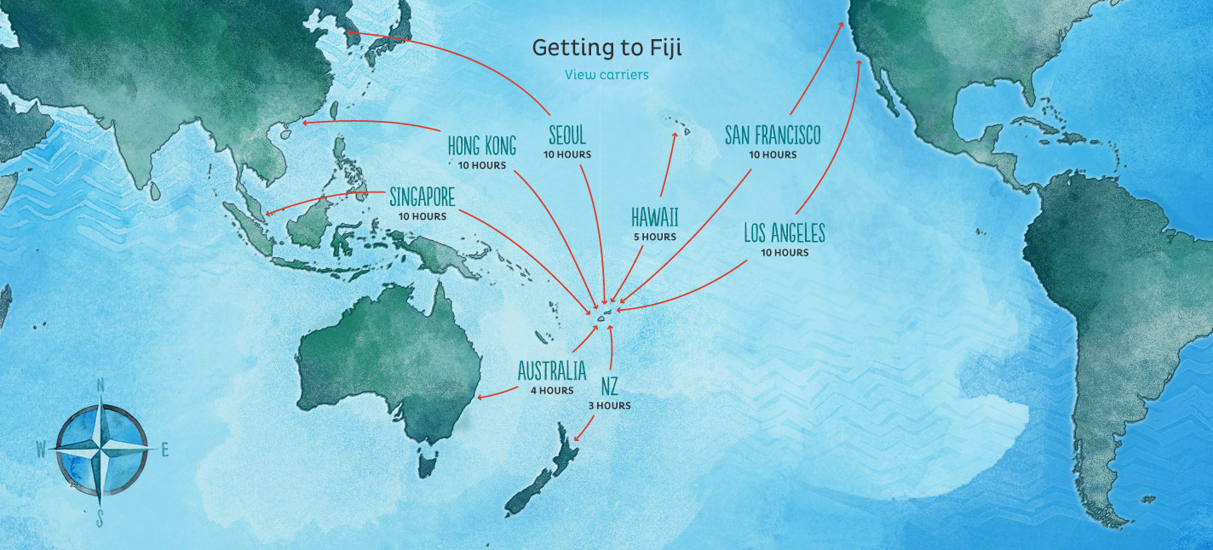
Background
Fiji is an island nation in Oceania in the South Pacific Ocean
Archipelago of more than 330 islands – 110 are permanently inhabited and more than 500 islets
Total land area is about 18,300 square kilometres (7,100 sq mi)
There are two major islands, Viti Levu and Vanua Levu
Total population is close to 900,000
Capital is Suva the other major area is Nadi
Economy is agro-based (agriculture, fisheries and forestry) with some reliance on Tourism

Slide 4
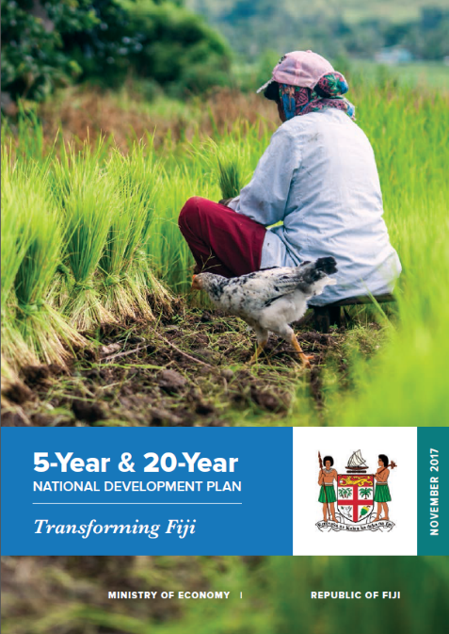
Introduction
National Development Plan - 20-Year and 5-Year Development Plan
Detailed action agenda with specific targets and policies that are aligned to the long-term transformation of the country
The plan for each Government Ministry/Agency is aligned to the NDP through their own costed operational plans
The SDG priorities are integrated into the NDP and clearly linked
Criteria for annual funding includes the alignment of projects/programmes with the NDP (and SDGs) and other national plans such as the Green Growth Framework

Slide 5
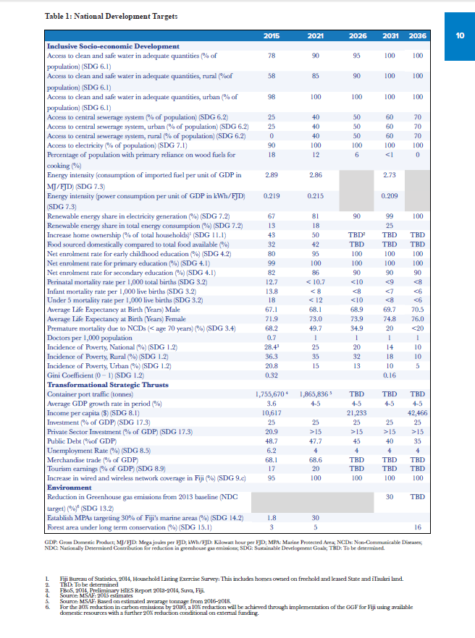
NDP Targets
Outcome of a nationwide consultation process
Aligned to global commitments including the 2030 Agenda for Sustainable Development and the Paris Agreement on Climate Change
Inclusive of critical cross-cutting issues
Financing through private sector partnerships and climate finance
With key national development targets for the next 20 years.

Slide 6
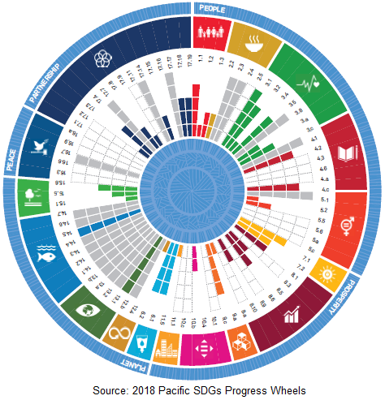
SDGs Update
Fiji’s first draft is proposed to be submitted on 31 January, 2019
Relevant consultations have been undertaken with line Ministries
Lead role given to staff in the composition of the SDGs chapters
Engagement of a Data Consultant
Senior officials to undertake content validation
SDGs Self Assessment submitted to Fijian Parliament in 2017

Slide 7
SDGs Challenges
Solutions Going Forward
Need to strengthen the collaboration and discussion at the state agency level. Weak institutional links in government, private sector, general public and stakeholders
Ensuring that responsible state agencies place proper priority in ensuring that timelines are met.
Difficulty in identify and synergizing existing Data and its sources. Agreeing on credible, reliable and clear sources is important. Agencies are sensitive to the sharing of information and its management.
Commitment to improve and implement consistent dialogue with line Ministries. Important step towards this was the integration of SDGs into NDP, which is the whole of government strategic plan
Improving the existing resource base including technical capacity within Fiji institutions and through training/learnings with development partners
Engaging political support through regular updates to heads of government and policy makers, both national and internationally

Slide 8
Conclusion
Fiji’s commitment to the 2030 global sustainable development agenda is absolute and is a cornerstone of our national policies
Climate change is threatening the social and economic wellbeing not only of Fijians but the people of small and vulnerable developing states the world over
Engagement and dialogue, intertwined with genuine actionable commitment, is the only significant means of achieving success not just for us, but for our children

Slide 9
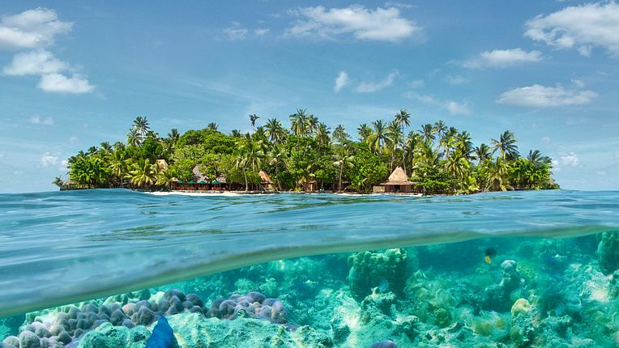
Vinaka! Thank you!

