Slide 1
Voluntary National Reviews: Challenges and Opportunities
The Lao PDR
Presented by:
Viengdalat Somphet
Technical Officer, Department of International Organizations
Ministry of Foreign Affairs of Lao PDR

Slide 2
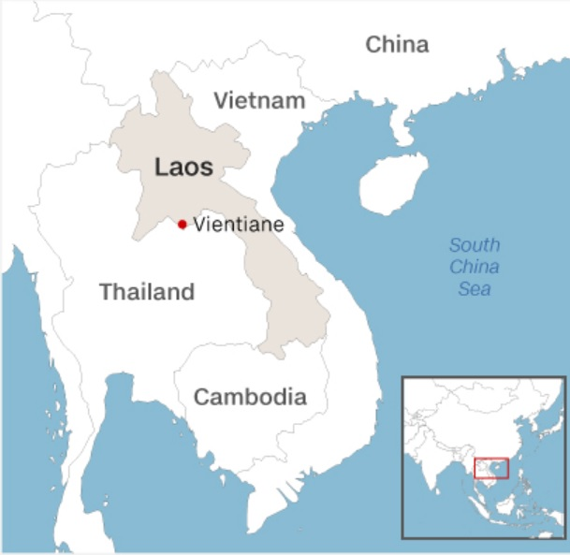
Laos
Profile: LDC, LLDC
Population: 6.8 million
Areas: 236,800 sq.km
GDP: 6.9% (2017)
HDI: 138th/188
Poverty rate: 23% (2015)
GNI: $1996 (2018)
Main Income/Export: Natural Resources, Agriculture, Hydropower, Tourism
Notes:
On LDC status, Laos is one of many low income countries that eligible to graduate from the LDC status. The current 8th National Socio-Economic Plan (NSEDP) is targeting that Laos can graduate by 2021.
On poverty rate, with such high poverty rate, inequality remains high as well. There are obvious evidence of inequality between urban and rural areas. There are also issue of gender inequality as well, mainly from the cultural aspect in Laos.

Slide 3

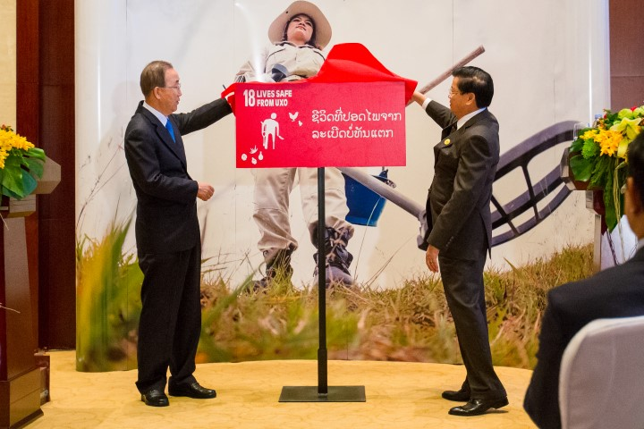

The 2030 Agenda for Sustainable Development in the Lao PDR
Overview
SDG Localized in the beginning of 2016 to ensured early integration of the goal into national development planning frameworks
Nearly 60 percent of national development plan linked to SDG indicators
In 2016, Lao PDR formally launched and adopted its own national SDG18: Lives Safe from UXO

Slide 4


Lead Implementers in the Lao PDR
The National Steering Committee for SDG Implementation
Chaired by the Prime Minister
The National SDG Secretariat
- Dept. of International Organization, MoFA
- Dept. of International Cooperation, MPI
- Laos Statistic Bureau, MPI
National Focal Point
17 lines Ministries
National Focal Point
Other National Organization and equivalent
Together with the
United Nations agencies and other Development Partner s
Notes:
In 2017, the president of Laos issued a Decree on appointing the Prime Minister to chair the Naitonal Steering Committee for SDG Implementation with members of the committee drawn from all concerned ministries, ministry equivalent agencies, and mass organizations.
The committee also appointed the National SDG Secretariat, led by the Ministry of Foreign Affairs and the Ministry of Planning and Invesment as well as the focal points within each of the relevant lines ministries to lead and take ownership of each SDG

Slide 5
The 2030 Agenda for Sustainable Development in the Lao PDR

Slide 6
SDGs Integration into Development policies of the Lao PDR
Vision 2030
10th Year Socio-Economic Development Strategies
National Five-Year Socio-Economic Development Plan VIII (2016-2020) (8th NSEDP)
Early integration allowed us to identified the linkages between the national plan and the global goals, nearly 60 percent of the national development indicators linked to SDG indicators

Slide 7
The 2030 Agenda for Sustainable Development in the Lao PDR

Slide 8
The Lao PDR Voluntary National Review in 2018
Process
Country-led and Country driven: National SDG Secretariat led the process together with each lines Ministries focal points
Consulting, Stakeholder Workshops and National SDG Focal point workshops
Designing the structure, identifying and collecting relevant data
Committee reviewing
Presenting

Slide 9
Content of the SDG Voluntary National Review
Opening Statement
Summary
Introduction
Methodology and process
Policy and enabling Environment
Ownership
Incorporating SDG in national framework
Integrating the three dimension of sustainable development
Leaving no one behind
Consolidating institutional mechanism
Addressing structural issues
6. Progress on Goals and Targets
Overview of all 18 Goals (Progress and Challenges)
7. Means of Implementation
8. New Steps
9. Conclusion

Slide 10
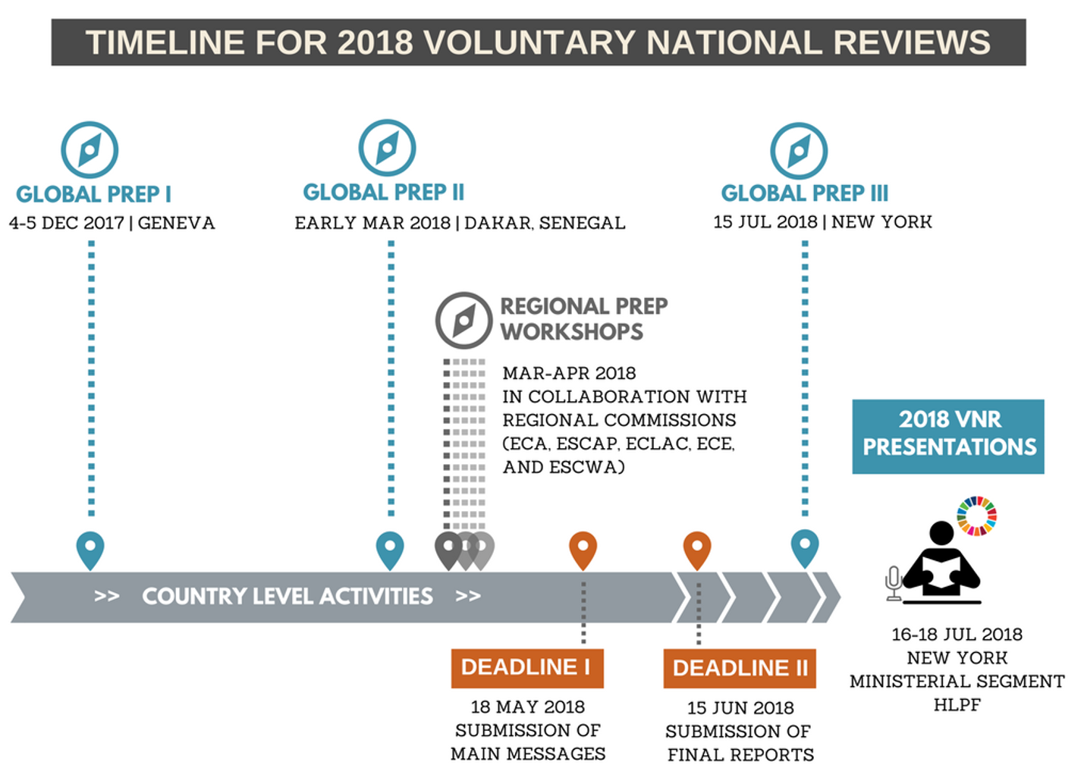
The Lao PDR Voluntary National Review in 2018

Slide 11
The Lao PDR Voluntary National Review in 2018
Process
November 2017: Final draft of national SDG indicators
December 2017: Data collection and inputs
December 2017: Stakeholder engagement workshop
January 2018: Zero draft VNR
February 2018: Technical SDG Focal point workshop with
key partners
March 2018: Frist draft VNR
April 2018: Second draft VNR; workshop for final review
June 2018: Publication and dissemination
July 2018: Presentation at the High Level Political
Forum

Slide 12
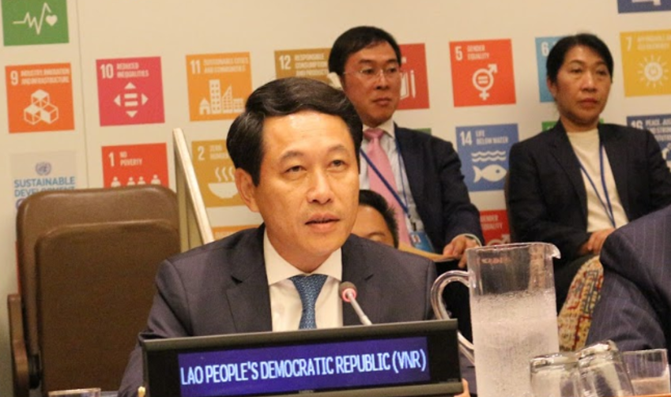
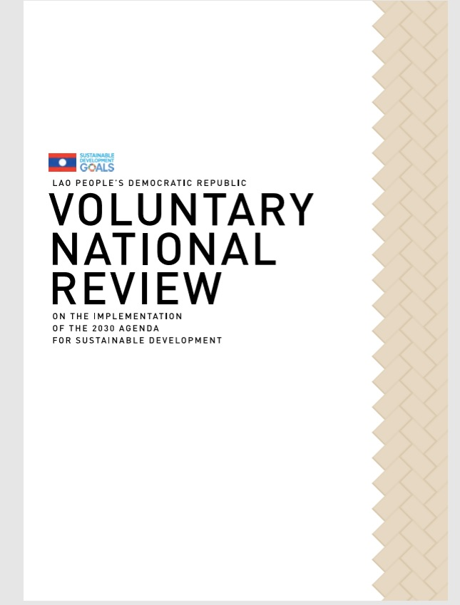
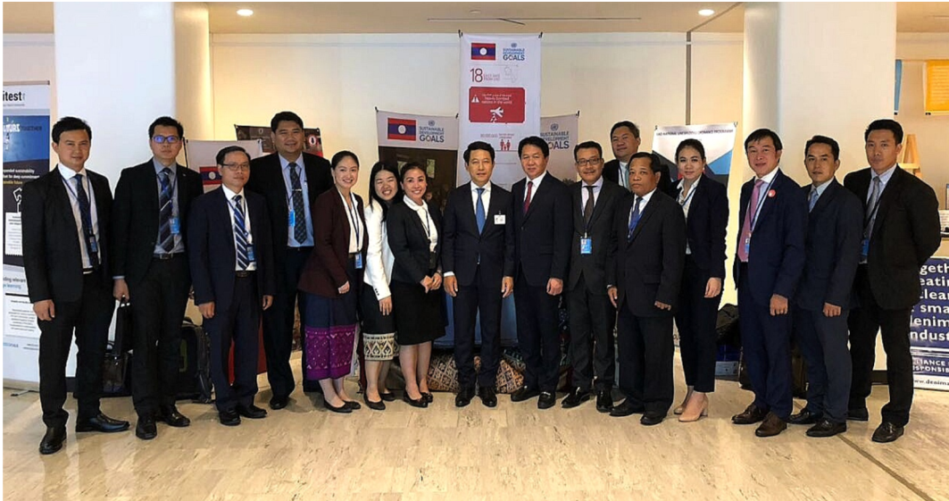

Slide 13
Challenges
What to include and What is not
Who will be the ‘Penholders’
Alignment of data collection and report format from the SDGi owner and implementer
lack resources and capacities, both human resources and systems that are unified, qualified and reliable
Central to Local level, issue of inclusive and participatory
Understanding and awareness

Slide 14
Lesson Learned
Started early
Designed coordinator(s) and the ‘penholders’
Engage a broad range of stakeholders early on
Focus on Quality, not quantity
Include a statistical annex, if suitable
Include analysis, lessons learned and detailed examples
Avoid listing of strategies and progammes
Showcase both strengths and weakness
Identify areas where additional support is needed
Spell out the next steps in implementation

Slide 15
Way Forward: 2nd Voluntary National Review
National circumstances
Catalyzer, Stocktaking, coordination, Whole of government approach, areas for support, communication tool
The experiences gained from the 1st VNR and translate into action plan and way forward
(National SDG Roadmap, National SDG
Communication Strategies, National SDGi Meta-
data Handbook)
Specific focus on goals and indicators, especially the off-track
National Reporting Team in place

Slide 16
Thank You

