Slide 1
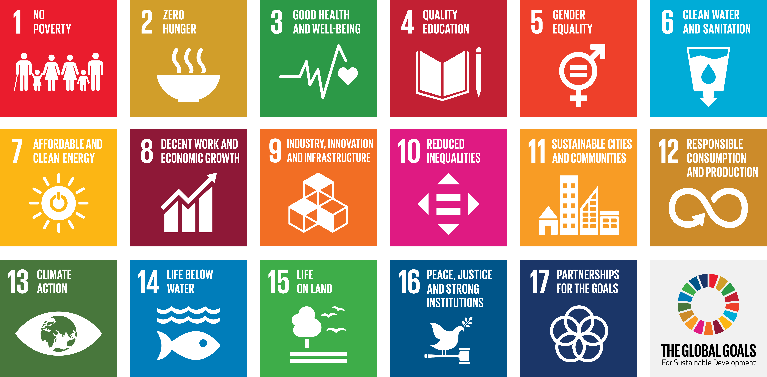
Assessing SDGs Progress in Asia-Pacific
Katinka Weinberger
Chief,
Environment and Development Policy Section
ESCAP

Slide 2

Implementation is faster post-MDGs
China Philippines Azerbaijan, others
Integration into national development plans & policies and national laws
Adaption to national context
Institutional strengthening & coordination
  Mapping responsibilities
  Creation of coordination bodies
  Creation of dedicated ministry
NGO involvement in implementation structures
Indonesia Pakistan
Cambodia Lao PDR
India
Azerbaijan Japan Indonesia Philippines Turkmenistan Armenia China
Sri Lanka
Indonesia Sri Lanka

Slide 3
Two big questions:
As of now, where does the region stand for each of the goals?
By 2030, how likely will the region be able to achieve the targets, judging by the past progress?

Slide 4
Achievements of goals since 2000
Notes:
Prepared on an annual basis by our colleagues in Statistics. As of 2017, two years after the adoption of the global agenda, this slide shows where the Asia-Pacific region stands for each of SDGs 1 to 16? It highlights where the region has made sufficient progress since 2000 and can expect to achieve the goal by 2030 at the current rate of progress.
Implementation across the SDGs needs to be scaled up substantially, especially in critical areas where the region as a whole seems to be regressing, namely on reducing inequalities and on promoting peaceful societies, access to justice and strong institutions.
While the region is making satisfactory progress on a few SDGs in the social domain (SDG1, SDG 3), it is only fully on target to achieving one by 2030 (quality education).
Inequality is widening
Regional progress towards SDGs focused on improving environmental stewardship has been insufficient across the board.
The Asia-Pacific region is not on track to meet the goal on promoting peaceful and inclusive societies (Goal 16), albeit measured by only three indicators focused on intentional homicide, unsentenced detainees, and corruption perception. The region performs less well than in 2000 against this SDG area.

Slide 5
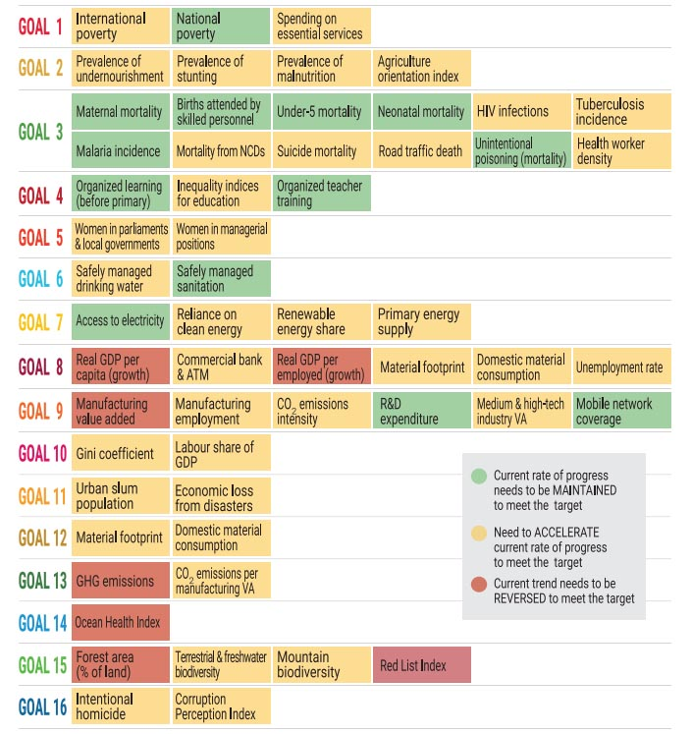
Distance to achievements of targets by 2030
Source: ESCAP (2017)

Slide 6
Progress on four areas:
  Poverty eradication
  Quality education
  Affordable & clean energy
  Life below water
Deteriorated situation in five areas
  Food security & zero hunger
  Decent work & equitable economic growth
  Reduced inequality
  Sustainable cities & communities
  Life on land

Slide 7

Unequal progress
Goal6- Clean water and sanitation
ENEA
SEA
SSWA
NCA
Pacific

Slide 8

Unequal progress
Goal10- Reduced inequalities
ENEA
SEA
SSWA
NCA
Pacific

Slide 9
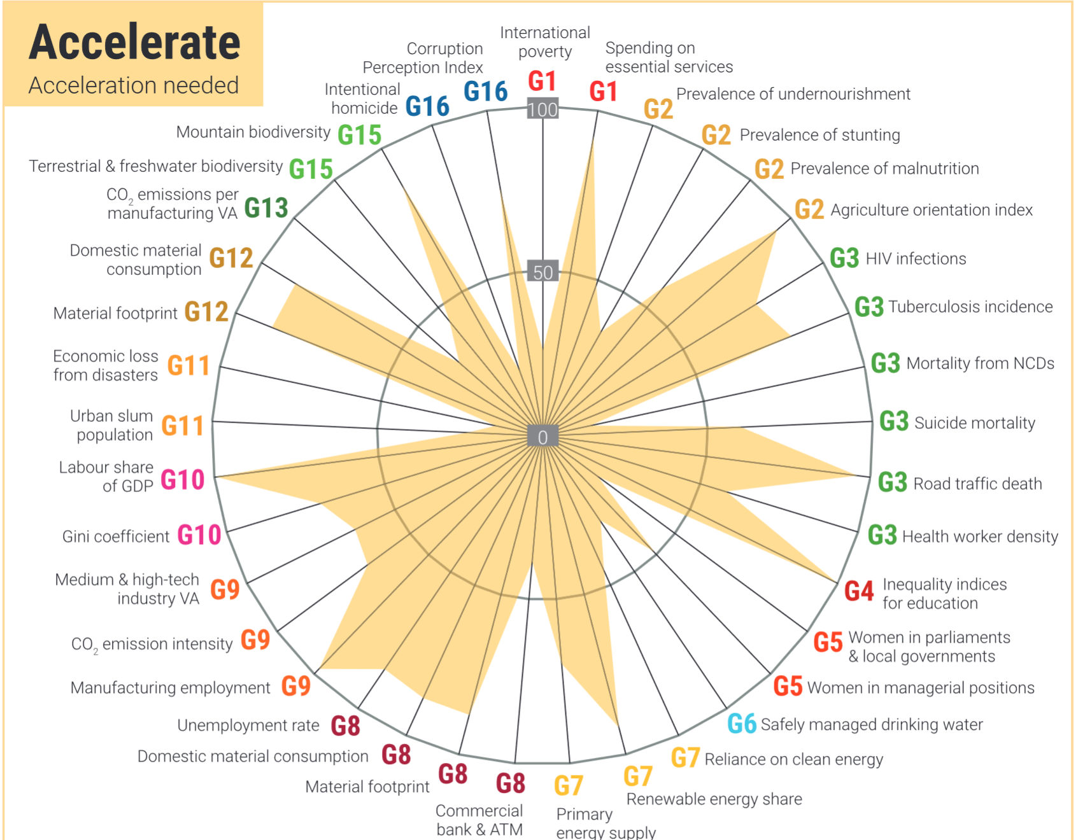
Magnitude of Progress Gap in SDG targets

Slide 10
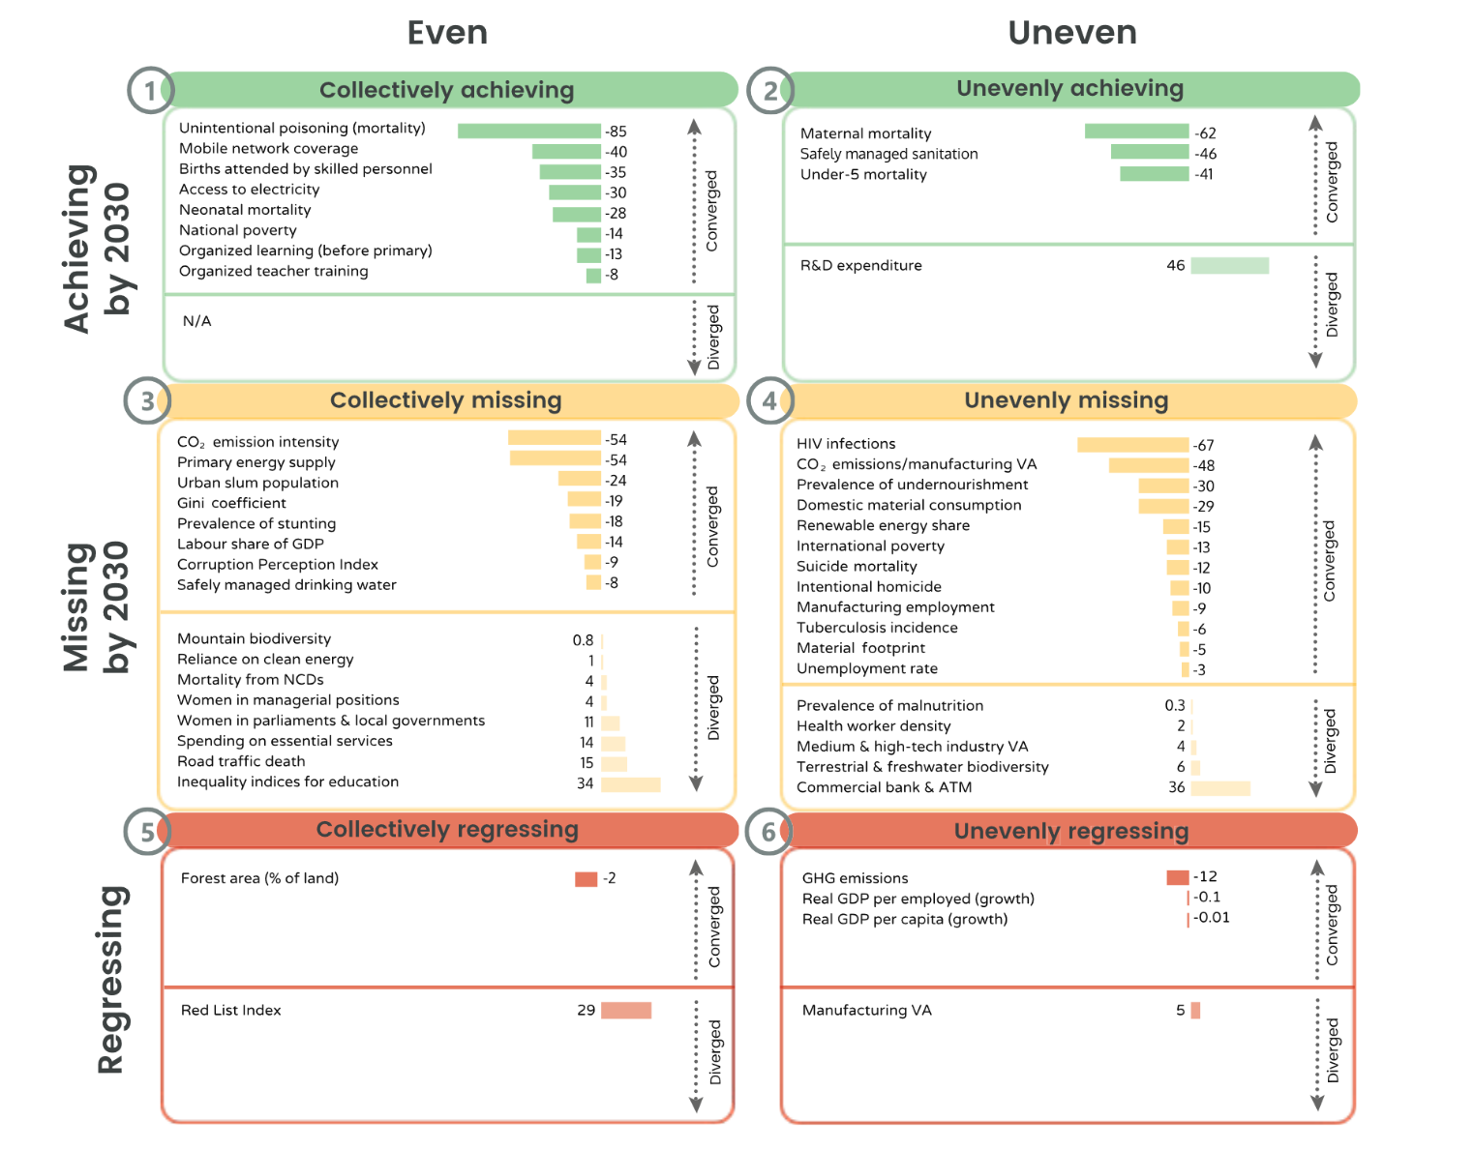

Slide 11
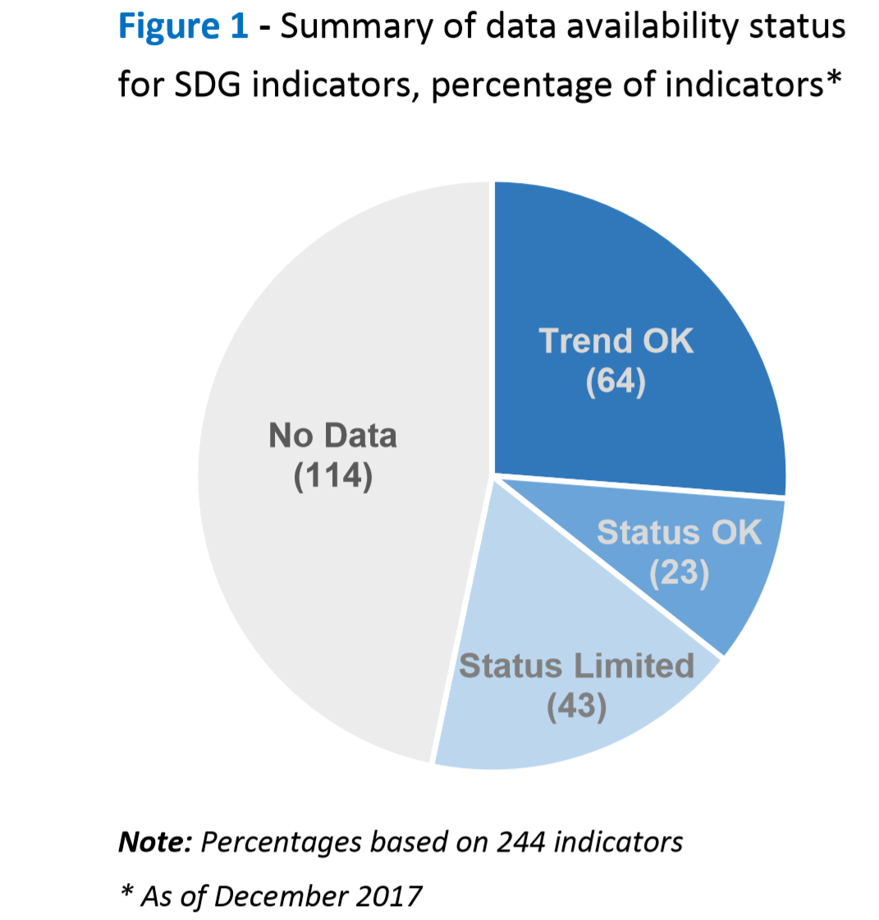
SDG Data availability in Asia-Pacific region

Slide 12
Conclusion
Asia and the Pacific has unfinished work and needs to increase the pace of progress
The progress is
  Uneven: across goals/targets
  Unequal: across sub-regions
The region is making satisfactory progress on a few SDGs, but it is on track only on Goal 4 and regressing on two goals
Inter and Intra-regional disparities highlight the need for policy prioritizations at the sub-regional level

Slide 13
Thank you !
Environment and Development Division
ESCAP

