Slide 1


“Implementing the 2030 Agenda: Lessons learned from country experiences”
Learning Conference on
“Implementing the 2030 Agenda for Sustainable Development”
Shanghai, China
Adriana Alberti, Chief, Capacity Development Unit
Division for Public Institutions and Digital Government (DPIDG)
United Nations Department of Economic and Social Affairs (UN DESA)

Slide 2

CONTENTS
1
The 2030 Agenda and the Process to Review Progress
2
Key Elements for Implementation based on the VNR reports
3
Lessons Learned and Key Messages from VNRs/HLPF
4
Holistic approach

Slide 3

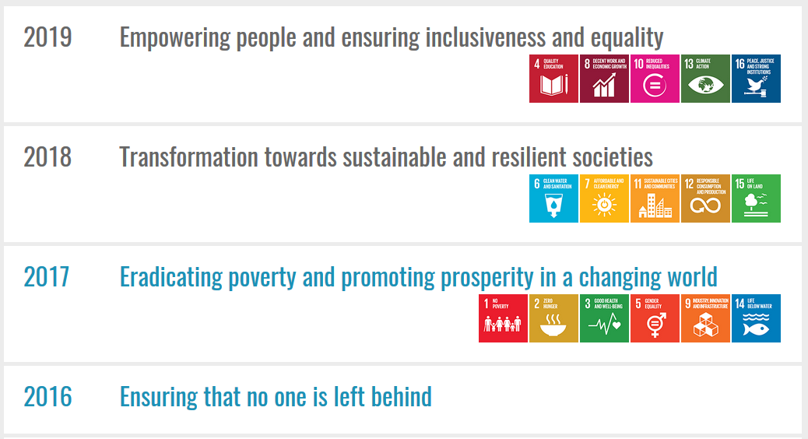
1. The 2030 Agenda and the Process to Review Progress
Notes:
As you may know, SDG 16 is one of the goals to be reviewed during the High-Level Political Forum (HLPF) in 2019, under the theme of “Empowering people and ensuring inclusiveness and equality”.
Public administration is a key driver in the process of implementing the SDGs effectively and inclusively. SDG Goal16 of the 2030 Agenda specifically calls for effective, accountable and inclusive institutions at all levels.
The foundations of sustainable development at all levels include transparent, participatory and accountable governance and a professional, ethical, responsive and information and communications technology-enabled public administration, and encourages the international community to continue to support capacity development in public governance and institution-building at all levels, with a view to accelerating progress towards sustainable development.
As you know, effective institutions are essential to deliver quality services to people, including justice, education, health, sanitation, etc. They are critical to fostering the conditions for job creation and prosperity for all. They are essential to enable people’s participation in decision-making processes and service delivery. They are critical to maintain peace and preserve the environment. Investing in basic services and in societies that can manage shocks without falling into crisis, is indeed investing in sustaining peace.

Slide 4
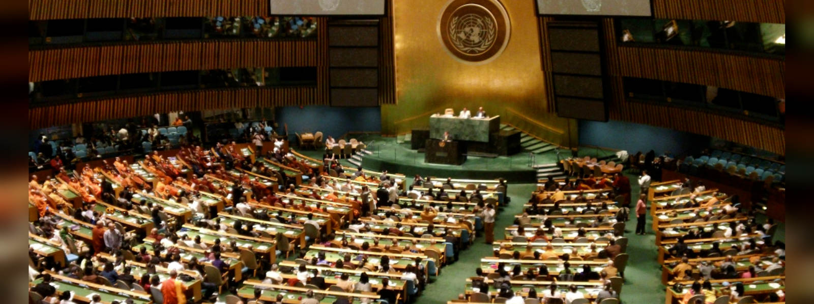
2019 HLPF Summit
HLPF Summit convened under the auspices of the General Assembly will be held in September 2019
Attended by Heads of State and Government
Reaffirm shared commitment to realize the SDGs by 2030

Slide 5

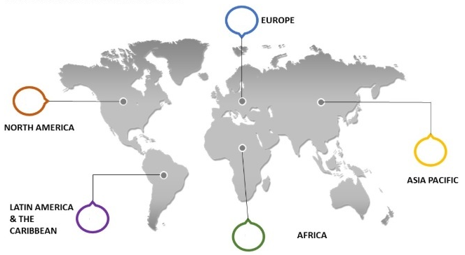
Voluntary National Reviews (VNRs) Accelerate Progress
146
By 2019, 146 countries will have presented their VNRs with 47 countries yet to present
39
VNRs from 2016-2019 by region*
1
46
21
35
*some countries reported more than once
Notes:
The Voluntary National Reviews (VNRs) of SDG progress presented at the High-level political forum are an important platform where Member States highlight their progress, share information about the challenges they face, and lessons learned, and mobilize additional support and build partnerships. By 2019, 146 countries will have presented their VNRs, with 47 countries yet to present. While a few countries in conflict or post-conflict situations cannot be expected to conduct VNRs, almost all countries will have presented a VNR by 2020 in time for the 75th anniversary of the UN.

Slide 6
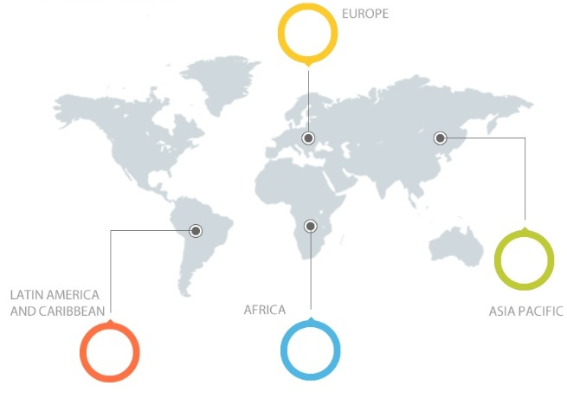
In 2019, 51 countries (10 for the 2nd time) have volunteered to present their national voluntary reviews to the HLPF
Algeria
Azerbaijan
Bosnia and Herzegovina
Brazil
Burkina Faso
Cambodia
Cameroon
Central African Republic
Chad
Chile
Congo (Republic of the)
Cote d’Ivoire
Croatia
El Salvador
Eritrea
Eswatini
Fiji
France
Ghana
Guatemala
Guyana
Iceland
Indonesia
Iraq
Israel
Kazakhstan
Kuwait
Lesotho
Liechtenstein
Mauritania
Mauritius
Mongolia
Nauru
New Zealand
Oman
Pakistan
Palau
Philippines
Rwanda
Saint Lucia
Serbia
Sierra Leone
South Africa
Timor Leste
Tonga
Tunisia
Turkey
Turkmenistan
United Kingdom of Great Britain
and Northern Ireland
United Republic of Tanzania
Vanuatu
Voluntary National Reviews 2019
7
20
6
18

Slide 7


2016
2017
2018
China
Philippines
Republic of Korea
Bangladesh
India
Indonesia
Japan
Thailand
Lao PDR
Singapore
Sri Lanka
Vietnam
12 VNRs in Asia

Slide 8
2. Key Elements for Implementation based on the VNR reports
(a) Legal frameworks and national development plans
In many countries, the SDGs are included into existing national development plans and in some cases, they are supplemented by an operational plan (such as in the case of Namibia or China). China for example has linked the 2030 agenda with its domestic mid and long-term development strategies.
Colombia is also much advanced in aligning the SDGs with its National Development Plan, including the establishment of indicators and respective national goals, with guidelines, actions and actors responsible for implementation.
An important question is if the plan is accompanied by budgetary resources.

Slide 9
(b) Institutional Arrangements for SDG Implementation: Lessons learned
There is no single model.
Creation of new institutional arrangements, such as national SD commissions (Germany) or inter-ministerial committees (Estonia, Morocco, and France). Bangladesh, Japan, Nepal and Pakistan created a new cross-sectoral commission or committees.
New mandates to existing institutions. Gross National Happiness Commission in Bhutan or the National Institution for Transforming India Aayog in India.
Establishment of entities within the office of the Head of State or Government to spur implementation (Mexico)
In some other countries, a ministry or other institution leads and coordinates implementation. In Laos, the Ministry of Foreign Affairs (MOFA) created the SDG Secretariat which is the main focal point for the 2030 Agenda.
Notes:
Achieving progress in the implementation of the SDGs will require adaptation of institutional frameworks and arrangements to deliver integrated policies that effectively address existing inter-linkages among the SDGs to the extent that socio-economic, climate and environmental aspects need to be considered in a balanced way.
Out of 64 VNRs presented at the High-Level Political Forum (HLPF) in 2016 and 2017, many referred to the need to gear efforts towards coherent and effective policy making. In light of the review of SDG 16 in the 2019 HLPF - which amongst others promotes building effective, accountable and inclusive institutions, it is important to share insights and lessons learned about the challenges governments are facing in this regard. The national voluntary reviews and the discussions at the high-level political forum on sustainable development (HLPF) showed that one of the first steps taken by countries to implement the 2030 Agenda for Sustainable Development is putting in place effective institutional arrangements to promote and coordinate implementation. Policy integration and institutional coordination are central to the advancement of sustainable development given the inter-linkages and multi-dimensional nature of the SDGs and its targets, and effective integration is one of the responses to the demand for more innovative and responsive service delivery, transcending the competencies of individual institutions.
Compendium of institutional arrangements for the SDGs
Construction of inter-ministerial committees or task forces (Estonia, Morocco and France)
Development of institutional engagement with local authorities (Norway, Samoa, and Sierra Leone)

Slide 10
(b) Institutional Arrangements for SDG Implementation
A High-level Inter-Agency Commission was established with the objective of facilitating participation of all stakeholders and all sectors at all levels in the implementation of the SDGs through five working groups which address the following areas of major concern: 1) indicators, 2) territorial issues, 3) resource mobilization, 4) international affairs, 5) communications.
A State Secretaries’ Committee for Sustainable Development with all federal ministries involved is chaired by the Head of Federal Chancellery.
A Steering and Monitoring Committee was created by Office of the Prime Minister and is chaired by Prime Minister.
The Prime Minister oversees the SDGs implementation and the Government Council for Sustainable Development is under his authority. The Council has nine thematic committees, and includes municipalities, parliament, trade unions, the private sector, academia, NGOs, and ministries.
Colombia
Germany
Madagascar
Czech Rep.
Notes:
Estonia has implemented inter-ministerial coordinating mechanisms. Georgia has created a joint technical working group from various ministries to oversee the implementation of SDGs. In the case of the Philippines, the Ministries involved in implementation include the Ministry of Foreign Affairs, the Ministry of Environment, the Statistics office, and the Office for Government Policy Coordination overseeing the process. In Sierra Leone, the Ministries of Finance and Economic Development and Foreign Affairs provide operational, technical and diplomatic leadership to efforts throughout the government. In Switzerland, there has been the creation of a temporary inter-ministerial working group in charge of: clarifying institutional arrangements, processes and responsibilities in federal administration to ensure effective implementation; conducting baseline study; ensuring monitoring and reporting. Federal offices are required to include the SDGs in periodic reporting. of institutional engagement with local authorities (Norway, Samoa, and Sierra Leone)

Slide 11
(b) Institutional Arrangements for SDG Implementation
Brazil has also established a National Commission for Sustainable Development Goals, composed of 16 representatives from federal, state, district and municipal governments, and civil society.
In Mexico, leadership for achieving the SDGs remains in the Office of the President with technical offices and inter-ministerial commissions being established.
In Sierra Leone, the Office of President oversees SDGs adaptation process.
Switzerland has shown a high commitment from political authorities as the Swiss Federal Council is in charge of SDGs implementation.
Brazil
Mexico
Sierra Leone
Switzerland
Notes:
Estonia has implemented inter-ministerial coordinating mechanisms. Georgia has created a joint technical working group from various ministries to oversee the implementation of SDGs. In the case of the Philippines, the Ministries involved in implementation include the Ministry of Foreign Affairs, the Ministry of Environment, the Statistics office, and the Office for Government Policy Coordination overseeing the process. In Sierra Leone, the Ministries of Finance and Economic Development and Foreign Affairs provide operational, technical and diplomatic leadership to efforts throughout the government. In Switzerland, there has been the creation of a temporary inter-ministerial working group in charge of: clarifying institutional arrangements, processes and responsibilities in federal administration to ensure effective implementation; conducting baseline study; ensuring monitoring and reporting. Federal offices are required to include the SDGs in periodic reporting. of institutional engagement with local authorities (Norway, Samoa, and Sierra Leone)

Slide 12
(b). Institutional Arrangements for SDG Implementation
In Finland, the mapping of goals and targets for the achievement of the SDGs is inter-ministerial.
Norway, responsibility for SDGs implementation is given to a coordinating ministry. Each ministry is to report on the status of follow up for its respective goal(s) in its budget proposal.
Finland
Norway
Estonia
Estonia has implemented inter-ministerial coordinating mechanisms.
Georgia has created a joint technical working group from various ministries to oversee the implementation of SDGs.
Georgia
Notes:
Estonia has implemented inter-ministerial coordinating mechanisms. Georgia has created a joint technical working group from various ministries to oversee the implementation of SDGs. In the case of the Philippines, the Ministries involved in implementation include the Ministry of Foreign Affairs, the Ministry of Environment, the Statistics office, and the Office for Government Policy Coordination overseeing the process. In Sierra Leone, the Ministries of Finance and Economic Development and Foreign Affairs provide operational, technical and diplomatic leadership to efforts throughout the government. In Switzerland, there has been the creation of a temporary inter-ministerial working group in charge of: clarifying institutional arrangements, processes and responsibilities in federal administration to ensure effective implementation; conducting baseline study; ensuring monitoring and reporting. Federal offices are required to include the SDGs in periodic reporting. of institutional engagement with local authorities (Norway, Samoa, and Sierra Leone)

Slide 13
(c) Parliament’s Involvement
The parliament is involved in the monitoring of and accountability for SDG implementation.
There has been a revision of relevant laws and regulations to provide policy and legislative guarantees for implementation of SDGs.
There is a Parliamentary Advisory Council on Sustainable Development which monitors the German government’s SDGs strategies.
It is reported that engagement with the National Assembly is important and has played a significant role in shaping political impetus for implementation of SDGs.
Finland
China
Germany
Philippines
Notes:
of institutional engagement with local authorities (Norway, Samoa, and Sierra Leone)

Slide 14
(d) Role of Subnational governments and their involvement
Colombia has developed mechanisms to create awareness among local and departmental governments about the SDGs and their inclusion in their local and departmental development plans. It has created mechanisms to engage the private sector and civil society. It has also started capacity building throughout society.
Colombia
Uruguay
Uruguay has held 10 social dialogues on the SDGs to design a long-term vision.
Sri Lanka launched an engagement platform to effectively involve local authorities and people to solicit their inputs into the national sustainable road map.
Sri Lanka
Ukraine launched nationwide consultations in order to raise awareness of the SDGs and define sustainable development priorities.
Ukraine
Notes:
of institutional engagement with local authorities (Norway, Samoa, and Sierra Leone)

Slide 15
(d) Role of Subnational governments and their involvement
Brazil established an inter-ministerial working group with the participation of 27 ministries, local governments and civil society.
Brazil
Indonesia
Indonesia has established a national coordination team with national and sub-national action plans, involving various actors.
Kenya is also involving major groups and engaging grass-root level organizations to ensure ownership and sustainability both in terms of process and outcome.
Kenya
Georgia has been nationalizing the SDGs through consultative, participatory frameworks that engage NGOs, academia and others and technical working groups were established.
Georgia
Notes:
of institutional engagement with local authorities (Norway, Samoa, and Sierra Leone)

Slide 16
(d) Role of Subnational governments and how are they involved?
Report on the role to be played by local and regional governments but provide very little information about how this is to be done
Argentina
Brazil
Colombia
Provide information about mechanisms to promote intergovernmental collaboration in their VNRs
Switzerland
Germany
Turkey
Use of an online platform
Mexico
Adopted participatory approaches
Sweden
Adopted a whole-of-society approach
Notes:
of institutional engagement with local authorities (Norway, Samoa, and Sierra Leone)

Slide 17
(e) Engagement of civil society, businesses, community associations, etc.:
Empowered citizens can pressure leaders and ensure that SDGs are kept on track and achieved.
Information should be disseminated by all possible means including conventional sources such as TV, print and radio, but also new ICTs.
Virtually all VNRs indicate some support for civil society and the private sector for the purposes of implementing the SDGs.
In Germany, dissemination to, and engagement with, the private sector, civil society, and academia is being done by three levels of government but limited details are provided.
Most countries note the importance of NGOs and their role in the achievement of the SDGs. In contrast, the private sector is less frequently mentioned.
Organizations such as the International Observatory on Participatory Democracy (IOPD) have been working with organizations that represent local governments, such as the United Cities and Local Governments (UCLG), in encouraging the localization of SDGs.
Notes:
of institutional engagement with local authorities (Norway, Samoa, and Sierra Leone)

Slide 18
Budgetary allocation
Norway
Norway, reporting on the SDGs is included in annual budget documents.
In Sierra Leone, the SDGs have been integrated into the national budget and the national development plan.
In Colombia, budgetary and regulatory policy measures in line with SDGs have been included in the regional development plans of elected local authorities.
Sierra Leone
Colombia
Notes:
Unless parliaments become partners with the executive branch of government, and with regional, and local levels of government in the discussion of how to accomplish the SDGs, the likelihood for the SDGs to be achieved will diminish. Budgetary allocation in countries with some measure of representative government is done by the legislative branch. The SDGs will not be successfully implemented unless budgetary allocations are made. It seems apparent that for the vast majority of countries reporting, legislative bodies are not very key participants in SDG discussions. of institutional engagement with local authorities (Norway, Samoa, and Sierra Leone)

Slide 19
Oversight, transparency and accountability
The Philippines reports the creation of an SDGs Special Committee in the House of Representatives
Samoa and Togo report awareness programs through legislative workshops and seminars
Argentina’s Parliament has established the Agenda 2030 Parliamentary Observatory to promote the adaptation and implementation of SDGs.
Costa Rica’s parliament has implemented programs to oversee the implementation of SDGs 12, 13, and 16. It will also monitor implementation of the 2030 Agenda.
Philippines
Samoa & Togo
Argentina
Costa Rica
Notes:
Unless parliaments become partners with the executive branch of government, and with regional, and local levels of government in the discussion of how to accomplish the SDGs, the likelihood for the SDGs to be achieved will diminish. Budgetary allocation in countries with some measure of representative government is done by the legislative branch. The SDGs will not be successfully implemented unless budgetary allocations are made. It seems apparent that for the vast majority of countries reporting, legislative bodies are not very key participants in SDG discussions. of institutional engagement with local authorities (Norway, Samoa, and Sierra Leone)

Slide 20
Capacity development efforts to implement the SDGs
Madagascar
Colombia
Togo
implemented programs to familiarize the public sector with the SDGs through training sessions and capacity building seminars for government officials.
taken initiatives to create awareness among civil service employees to understand the importance of the SDGs and the need to include them in the policy-making process.
implemented a national program for capacity-building and state modernization in support of SDGs, training on SDGs matrix and awareness campaigns with legislators, media and civil society.
UCLG
organized numerous seminars, retreats, and activities aimed at helping local governments localize the SDGs and help them plan for their implementation.
Specialized seminars aimed at helping mayors and local councilors to understand the important role that cities and local governments must play in the achieving of the SDGs.
Chile
Mexico
Dominican Republic
Peru
Notes:
Unless parliaments become partners with the executive branch of government, and with regional, and local levels of government in the discussion of how to accomplish the SDGs, the likelihood for the SDGs to be achieved will diminish. Budgetary allocation in countries with some measure of representative government is done by the legislative branch. The SDGs will not be successfully implemented unless budgetary allocations are made. It seems apparent that for the vast majority of countries reporting, legislative bodies are not very key participants in SDG discussions. of institutional engagement with local authorities (Norway, Samoa, and Sierra Leone)

Slide 21
Key highlights/lessons learned for Implementation:
Leadership at the highest level is needed for effectiveness
Lack of information of how the coordination mechanisms function and if they are effective
Integrating and coordinating actions of all parts of government for implementation (horizontal and vertical coherence) remains a challenge
Limited engagement and resources of local governments and authorities
Sustainable development not as an additional policy but as the foundation for Government frameworks.
The VNR reports do not address in depth the various issues
Notes:
Lesson learned/highlight: As different ministries would be involved and engaged, it is necessary to have a final decision maker at the highest governmental level in charge and responsible for the policies taken for the achievement of the SDGs.
This helps to identify the institutions and networks that should be mobilized around specific SDGs and targets.
Developing coordination mechanisms that can efficiently coordinate the implementation of wide array of Goals and targets remains a challenge in all countries.
Parliaments are uniquely placed to hold Governments accountable for SDG implementation, and more specifically, it is important to acknowledge the central role that parliaments could play in advancing the SDGs by adopting enabling legislation, including key budget bills.
Some Asian countries have launched local SDG-related initiatives (China, India, Republic of Korea, Nepal) and central governments engage local authorities (Afghanistan, Bangladesh).

Slide 22
Lessons learned:
While there is an increasing awareness of the 2030 Agenda’s commitments, there is less understanding of how to implement the goals. Implementation is the challenge.
Individual and institutional capacity become a fundamental element to implement the SDGs.
Better understanding of how institutions change is necessary.
It is important to transform institutional architectures, but it is even more important to transform mindsets.
There is need to mobilize resources
Notes:
Political leadership is imperative; technological advances must be shared; and adequate financing must be mobilized.
Partnerships are fundamental- We must encourage and promote effective public, public-private and civil society partnerships, by sharing knowledge, and expertise, and by helping to meet the needs of developing countries for capacity building through North-South, South-South and triangular cooperation.
Partnerships are needed to channel knowledge, expertise, investments and technologies to areas most vital to accelerate the pace of progress towards the SDGs.

Slide 23
TRANSFORMATION
Vision of Holistic framework for Responsive Service delivery
LEAVE NO ONE BEHIND
A Holistic Approach:
WHAT and WHY?
Given that challenges are cross-
cutting and require holistic responses,
innovation should not only be seen as a
single practice, but as a process to transform
government to better respond to its
citizens’ needs and aspirations.
(2) In this sense, innovation can be defined
and measured in terms of quality and degrees
of transformation in relation to context
specific sustainable development goals and
citizens’ aspirations.
(3) It is, therefore, essential to address in
an integrated and holistic manner
strengthening institutional frameworks,
processes and mechanisms, leadership
and HR capacities, ICT development
and knowledge sharing, innovative
channels to engage citizens and partners
to deliver services equitably and effectively.
.
1. Context & Situation Analysis
2. Future Envisioning
Comittment to a nationally-owned long-term vision
VALUES
BELIEFS
BEHAVIOR
LEGAL & NORMATIVE Frameworks
3. National Governance Framework and Road-Map for Sustainable Development
Institutional and Organizational Innovation:
Whole-of-government Approaches and Effective Vertical coordination
Innovative transformation of leadership and public officials capacity
Process Innovation: Multi-channel service delivery/ bridging digital divide for inclusion of vulnerable groups
Innovative Mechanisms for citizen engagement in service delivery
Transparency, integrity and accountability (open government data, audits on the SDGs, )
Environment & Technology: Leveraging the potential of ICT, frontier technologies and mobilizing data
Public private partnerships, including social innovation
Improved Knowledge Management
Info-Communication
Public Administration in action Standards-Performance-Procedures-Systems-Processes (duties-responsibilities)
4. Implementation - Action
Programmes –Projects- Initiatives-Decisions
Engaging Parliament into SDG monitoring and budgeting
Monitoring
Evaluation
Accountability
Service Delivery
(Access-Quality-Responsiveness, Cost-effectiveness)
Public Good
Trust & Legitimacy
INCLUSION
-Sustainable Development-Prosperity and Enhanced Quality of Life of Citizens
INTEGRATION
Notes:
Sustainable development emphasizes a holistic, equitable and far-sighted approach in decision-making at all levels. It rests on integration and a balanced consideration of social, economic and environmental goals and objectives in both public and private decision-making. The implementation of the 2030 development agenda and the SDGs therefore calls for an unprecedented level of policy integration and institutional coordination. As highlighted in the recent session of the UN Committee of Experts on Public Administration, the SDG framework is cross-cutting and integrated in nature and most of the goals and targets require some degree of common effort and cooperation among governmental structures. There is a clear imperative of changing our traditional mind-set and silo-based modes of operation.
The complexity of these challenges requires a holistic response based on collaborative decision-making. It requires a coherent combination of service delivery, engagement of people and institutions that can work across portfolio boundaries – so that the whole is more than the sum of its parts.
Among other things, policy integration for sustainable development will require rethinking of “business-as-usual” practices. Future strategies, programmes and projects must include simultaneously all three dimensions of sustainable development and take account of their inherent complexities and interdependences. Governments must address institutional constraints to policy integration, including overly hierarchical structures, lack of a common strategic policy direction, sectoral self-interest, and a complicated division of labour. These structural challenges can be compounded by inadequate mechanisms for allocating resources for cross-cutting issues and ensuring shared accountability for shared responsibilities.
The need for collaboration with local governments adds a layer of complexity to policy integration in practice. Bringing local governments into the picture of SDG implementation is vital not only to foster coherence and synchronization across levels of administration but also to improve efficiency in service delivery. The active and direct involvement of local governments in SDG implementation will be crucial to progress in the implementation of the 2030 agenda for sustainable development and the SDGs.
Implementing the SDGs requires new capacities and new ways of working in public institutions and among public servants. To support integrated policies, civil servants need to be committed and equipped to identify and analyse inter-linkages, synergies and trade-offs and work across institutional boundaries. Enhanced capacities are also needed to improve sectoral policies, reach those who are furthest behind, envision the long-term impact of policies and possible scenarios as well as to collect and analyse data and statistics. The SDGs also call for renewed efforts to make institutions transparent and accountable and to support participatory decision-making. Effective implementation of the 2030 Agenda therefore requires mobilizing and equipping public institutions and the civil servants. Countries may consider actions to enhance civil servants’ awareness about the SDGs, boost their skills, reward efforts, cooperation and innovation. A recent UNDP paper points out that public service morale and motivation has declined in many countries. Addressing this situation and developing “New Public Passion” would contribute to realizing the SDGs.
Most countries have been promoting engagement of major groups of civil society in reviewing policies to drive the implementation of the SDGs. Some have dedicated institutions or consultations for this purpose.
One constituency which is proactively addressing the SDGs is the Supreme Audit Institutions. Through their international institutions, INTOSAI, they have developed various approaches to audit the readiness of their country to implement the SDGs and various aspects of implementation.
Prioritization of SDG16 and its monitoring are keys. Lack of timely and accurate data to monitor progress is an important challenge. Gender sensitive data is key to understand the challenges and to implement the SDGs thoroughly and inclusively. Setting up a coherent and appropriate national monitoring mechanism is paramount.
Technological innovation must be harnessed to drive the transformative change that is necessary. Govenrments, private industry, academia and civil society should work together to accelerate the development of, and access to such technologies.
Support to public-private partnerships - recent research estimates that the total economic benefit from implementing the 2030 agenda runs to tens of trillions of dollars in business savings and revenue. This represents an enormous investment opportunity for the corporate sector, whose contribution will be vital for innovation, improved skills, job creation, and developing new markets, products and services. Increased public value by promoting collaboration and coordination with private sector and civil society in the delivery of services and wealth creation through social innovation
Data is a very important aspect. Concerning SDGs, from the public administration perspective we realize the need of data for reporting, data for implementing and data for designing policy coherence. We also need better data to guide participatory planning and implementation of the SDGs; clear mechanisms of accountability, access to justice, and transparency.

Slide 24
Thank you
alberti@un.org
http://publicadministration.un.org
UN DESA

