Slide 1
Implementation Status of SDGs in Nepal
Radhakrishna Pradhan
Joint Secretary
National Planning Commission, Nepal

Slide 2
Overview of Presentation
Overview of MDG's and SDG's
Mainstreaming SDGs in Planning and Budgeting System
Policy Document Prepared
Institutional Mechanism
Partnership
SDGs Localization
Challenges/Way Forward

Slide 3
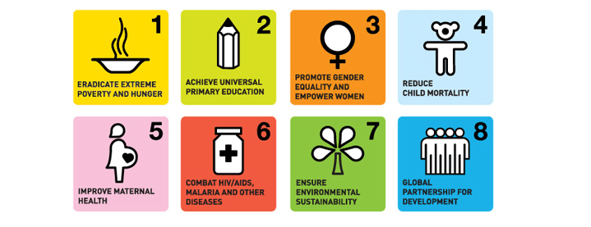
MDGs in Nepal: Overview
In general satisfactory:
For example;
Poverty reduced ( 42 % to 21.6%),
School enrolment and gender equality in school increased,
Child and maternal mortality decreased,
Prevalence of HIV/AIDS contained, and
Water and sanitation improved.
However,
From qualitative perspectives, achievements are not as satisfactory as they should have been, and
Most of the achievements, quantity or numeric, as such are averages meaning achievements remain unequal if seen from geographical and societal and community dimensions.

Slide 4
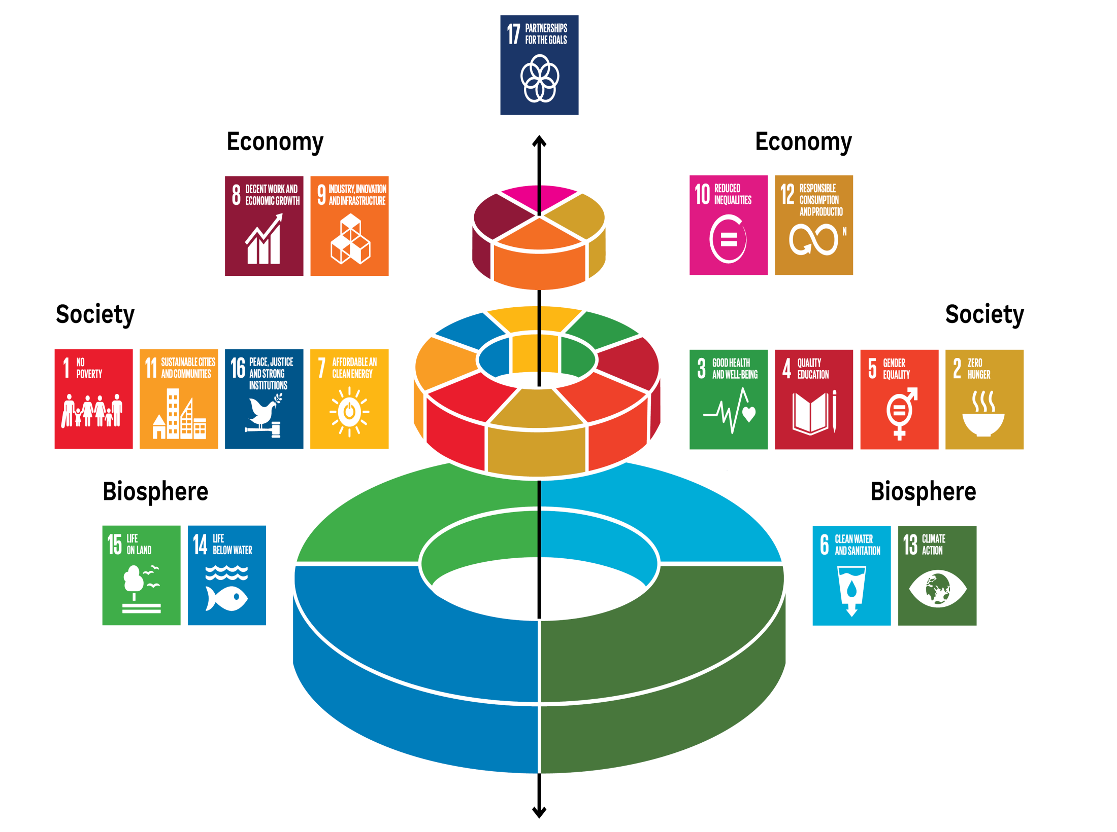

Slide 5
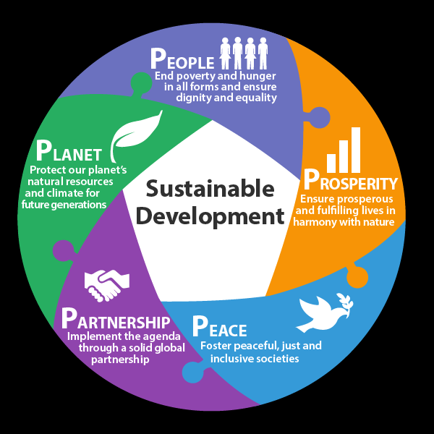
Sustainable Development Goals
Adopted by 193 countries in 2015
17 Goals, 169 Targets and 232 Indicators
They are interlinked each other
The Constitution of Nepal guided the three dimension of Nepal
Social transformation,
Economic growth,
Environment Protection

Slide 6
Mainstreaming SDGs in Planning and Budgeting

Slide 7
Mainstreaming SDGs in 14th Plan
Dimension of SDGs | Objectives and Strategies of 14th Plan
Economic | Poverty Reduction (1,2,10)
 | Production and Economic Growth (7,8,9)
 | Infrastructure Development(11)
Social | Social and Human Development (3,4,6)
Environmental | Cross Cutting Issues (Environment, gender, inclusion, Governance and Service Delivery) (5,12,13,14,15,17,16)

Slide 8
SDG Budget Coding in MTEF (NPR in billions)
S.N. | SDGs | Projection FY 2018/19 |  | Projection FY 2019/20 |  | Projection FY 2020/21
 |  | Budget. | % | Budget. | % | Budget. | %
1 | No poverty | 127.6 | 9.7 | 136.4 | 8.6 | 151 | 8.1
2 | Zero Hunger | 41.4 | 3.1 | 44.5 | 2.8 | 49 | 2.6
3 | Healthy life | 28.1 | 2.1 | 24.0 | 1.5 | 27 | 1.4
4 | Quality education | 48.3 | 3.7 | 49.2 | 3.1 | 49 | 2.6
5 | Gender equality | 4.6 | 0.4 | 5.1 | 0.3 | 6 | 0.3
6 | Water & sanitation | 24.3 | 1.8 | 23.6 | 1.5 | 24 | 1.3
7 | Clean energy | 86.9 | 6.6 | 109.8 | 7 | 123 | 6.6
8 | Decent work & Economic Growth | 7.4 | 0.6 | 8.7 | 0.6 | 9 | 0.5
9 | Industry & Infrastructure | 162.1 | 12.3 | 200.1 | 12.7 | 233 | 12.5

Slide 9
SDG Budget Coding in MTEF (NPR in billions)
S.N. | SDGs | Projection FY 2018/19 |  | Projection FY 2019/20 |  | Projection FY 2020/21
 |  | Budget. | % | Budget. | % | Budget. | %
10 | Reduced inequality | 2.4 | 0.2 | 2.6 | 0.2 | 3 | 0.2
11 | Sustainable Cities | 203.2 | 15.4 | 194.0 | 12.3 | 112 | 6
12 | Sus. Consumption/Production | 3.0 | 0.2 | 2.8 | 0.2 | 1 | 0.1
13 | Climate Action | 11.5 | 0.9 | 13.6 | 0.9 | 15 | 0.8
14 | Lives Below Water
15 | Lives on Land | 14.3 | 1.1 | 14.8 | 0.9 | 16 | 0.9
16 | Peace, justice & institutions | 130.3 | 9.9 | 137.4 | 8.7 | 151 | 8.1
17 | Partnership for sustainable development | 6.2 | 0.5 | 6.7 | 0.4 | 7 | 0.4
 | Not Coded | 413.6 | 31.4 | 604.4 | 38.3 | 889 | 47.7
 | Total | 1,315.2 | 100 | 1,577.7 | 100 | 1,865 | 100

Slide 10
SDGs Coding in ADP (2075/76)
S.N. | SDGs | Number of Projects | Budget
 |  |  | Amount | Percentage
1 | No Poverty | 21 | 223,118 | 3.7
2 | Zero Hunger | 61 | 358,563 | 6.1
3 | Healthy Life | 37 | 263,142 | 4.4
4 | Quality Education | 11 | 113,654 | 1.9
5 | Gender Equality | 9 | 44,395 | 0.8
6 | Water and Sanitation | 18 | 240,623 | 4
7 | Clean Energy | 36 | 864,768 | 14.6
8 | Decent Work and Economic Growth | 11 | 59,393 | 1
9 | Industry and Infrastructure | 74 | 1,548,293 | 26.1

Slide 11
SDGs Coding in ADP (2075/76)
S.N. | SDGs | Number of Projects | Budget
 |  |  | Amount | Percentage
10 | Reduced Inequality | 3 | 21,671 | 0.4
11 | Sustainable Cities | 30 | 1,769,040 | 29.8
12 | Responsible Consumption/ Production | 8 | 25,563 | 0.4
13 | Climate Action | 13 | 107,131 | 1.8
14 | Lives Below Water | _ | _ | _
15 | Lives on Land | 12 | 56,261 | 1
16 | Peaceful, Justice and Strong Institutions | 17 | 24,169 | 0.4
17 | Partnership for Sustainable Development | 2 | 10,084 | 0.2
 | Equalizing and Special Grants | 1 | 200,000 | 3.4
 | Total | 364 | 5,929,868 | 100

Slide 12
Nepal Vision-2100 BS
National Vision: Prosperous Nepal Happy Nepali
Target: 12500 $ Per capita in 2100 BS (25 year)
5 periodic Plan (2076- 2100)
15th Plan: Generating Prosperity
16th and 17th Plan: Accelerating Prosperity
18th and 19th Plan: Sustaining Prosperity
Main Drivers: Tourism, Hydro, Modern Infrastructure, Urbanization, Productivity enhancement, Human resource and federalism
Enablers: Natural resource, energy, ICT, Cultural and social capital, Demographic dividend etc

Slide 13
15th Plan (2076/77- 2081/82 BS)
Base Plan for generating prosperity and happiness
Objectives: Construction of Modern Infrastructure, Decent Job creation, Inclusive growth, Poverty reduction, Quality heath and education, Good governance, Social justice, Balanced environment, Enhance Connectivity etc.
Alignment of 15th Plan with SDGs
Finalized after the boarder consultation with stakeholders including development partners

Slide 14
Policy Documents Prepared
Preliminary SDGs report, 2015;
Sustainable Development Goals: Status and Roadmap 2016-2030, 2017;
National Review of Sustainable Development Goals, 2017;
UN Development Assistance Framework (UNDAF) for 2018-22;
SDG Based Monitoring and Evaluation Guidelines (National and Provincial);
SDG Based Local and Provincial Level Planning Guidelines;
SDG Need Assessment, Costing and Financing Strategy; 2019
Sectoral Policies in line with SDGs.

Slide 15
SDGs Status and Roadmap: 2016-2030
Goals |  | Global Targets | Indicators
 |  |  | Global | Local | All
1 | No poverty | 7 | 14 | 14 | 28
2 | Zero Hunger | 8 | 13 | 17 | 30
3 | Healthy life | 13 | 27 | 32 | 59
4 | Quality education | 10 | 11 | 35 | 46
5 | Gender equality | 9 | 14 | 22 | 36
6 | Water & sanitation | 8 | 11 | 14 | 25
7 | Clean energy | 5 | 6 | 9 | 15
8 | Decent work & Economic Growth | 12 | 17 | 14 | 31
9 | Industry & Infrastructure | 8 | 12 | 8 | 20
10 | Reduced inequality | 10 | 11 | 16 | 27
11 | Sustainable Cities | 10 | 15 | 15 | 30
12 | Responsible Consumption/Production | 11 | 13 | 10 | 23
13 | Climate Action | 5 | 8 | 11 | 19
14 | Lives Below Water | 10 | 10 | 0 | 10
15 | Lives on Land | 12 | 14 | 17 | 31
16 | Peaceful, justice & strong institutions | 12 | 23 | 8 | 31
17 | Partnership for sustainable development | 19 | 25 | 3 | 28
Total |  | 169 | 244 | 245 | 489
Excluding Goal 14 |  | 159 | 234 | 245 | 479

Slide 16
Annual Average Investment Requirement for SDGs (in Rs. Billion)
SDG areas | 2016-19 | 2020-22 | 2023-25 | 2026-30 | 2016-30
Poverty | 77.50 | 134.63 | 174.13 | 211.73 | 153.00
Labor and Tourism | 28.97 | 43.12 | 63.47 | 83.50 | 56.88
Agriculture | 82.77 | 107.12 | 125.27 | 148.01 | 117.88
Health | 56.33 | 91.35 | 137.56 | 220.01 | 134.14
Education | 139.08 | 207.24 | 316.14 | 493.46 | 306.25
Gender | 7.56 | 12.36 | 16.57 | 23.403 | 15.60
Water and Sanitation | 36.52 | 100.61 | 91.82 | 86.406 | 77.02
Energy | 69.40 | 132.46 | 239.13 | 502.715 | 260.40
Transport, Industry and ICT | 296.30 | 462.24 | 606.53 | 963.236 | 613.84
Urban Infrastructure | 170.23 | 161.78 | 154.32 | 184.982 | 170.27
Climate Change | 20.01 | 21.34 | 23.917 | 31.23 | 24.80
Forestry | 20.51 | 28.56 | 38.019 | 56.00 | 37.45
Governance | 50.01 | 56.17 | 59.502 | 64.67 | 58.02
Total SDG Investment Need | 1055 | 1559 | 2046 | 3070 | 2025
Total SDG Investment Need as % of GDP | 42.07 | 48.96 | 50.87 | 54.04 | 49.20

Slide 17
Share of Financing (in percentage)

Slide 18
Annual Average Financing Gap (in Billions)

Slide 19
Financing Strategy
Internal Resource Mobilization: Progressive tax, broadening tax base, PPP, private sector investment, improvement in resource administration, broadening revenue base, borrowing
Shifting resources to productive sector from unproductive one
Macroeconomic and sectoral policy reform
Space for Official Development Assistance (ODA)
Positive environment for Foreign Direct Investment
Reorient private and cooperatives investment towards SDGs

Slide 20
Institutional Mechanism
National Steering Committee
Implementation Coordination & Monitoring Committee
Thematic Working Committees
Economic Development
Social
Development
Energy Development and Climate Change
Coordination
Governance
Sustainable Production and Gender
Mainstreaming
Agriculture, Development and Drinking Water
Infrastructure
Development

Slide 21
High Level SDGs Committees
Steering Committee : Responsible to provide policy directives, works to create a conducive policy environment, and builds partnerships for achieving the SDGs;
Implementation and Coordination Committee : Responsible for guiding line ministries on mainstreaming the SDGs into national, provincial and local plans; arranging financial, human and technical resources by mobilizing internal and external resources, and coordinating between the public and private sectors, civil society and development partners;
Thematic Committees : Responsible for preparing SDG related plans, policies, programmes, budget implementation, and monitoring and evaluation. They have to also coordinate with sectoral government agencies, the private sector, civil society, international organizations and other partners...

Slide 22
Partnership
Public
Private
Cooperatives
Development Partners
Civil Society/ Communities

Slide 23
Localization of SDGS Sub-national level
SDGs Based Guidelines
Periodic planning, MTEF and Annual planning ( for provincial and local level)
Monitoring and Evaluation (for national and provincial)
Data Production:
Prepared SDGs Indicators for Province Level
National Data Profile (In the process)
Capacity Development
Organized training programme for provincial officials about SDGs based planning, budgeting, MTEF, M &E and Statistics

Slide 24
Challenges of SDGS Implementation
SDGs Localization: . As the country embarks on implementing a new federal structure of governance, a prominent challenge will be to quickly mainstream SDGs into the provincial and local level planning and budgeting systems.
Weak Data Base: Weak database and lack of availability of disaggregated data by sex, age, social groups, disability status, geography, income and sub - national level will hinder monitoring of progress.
Financial Gap: Financing challenges is major, particularly to trigger and sustain job - creating economic growth , enhance the quality of social service.
Coordination : Horizontal and vertical coordination among the Governments, coordination with Private, Cooperative, Civil Society and other stakeholders.
The challenges also include: access to technology, capacity development, and realignment of policies to implement SDGs, landlockedness as well as with vulnerabilities to climate change and natural disasters.

Slide 25
Way Forward
Dedicated and coordinated implementation of the SDGs is needed by federal, provincial and local governments. Therefore, governance needs to be strengthened at all levels.
Macroeconomic policy reforms are needed to achieve higher levels of economic growth and to distribute income and benefits to the poor and marginalized people.
Prioritize interventions based on financial, managerial, technological, institutional and capacity constraints.
Sectoral plans, long-term strategies and perspective plans need further aligning with the SDGs.
Data specially disaggregated data for national and sub-national level, by sex, age, social groups and disability is needed. The government of Nepal has started to conduct population census, labor force survey and preparing national data profile which will help to track the SDGs.

Slide 26
Thank You for Listening

