Slide 1

Learning Conference: Implementing the 2030 Agenda in the Asia-Pacific Region
Critical Role of Public Institutions in SDG Implementation -
Key Messages from UN DESA 2018 Regional Symposium
Mr. Heon-Jun Kim
Senior Programme Management Expert
United Nations Project Office on Governance (UNPOG)/DPIDG /UN DESA
23 January 2019

Slide 2
Contents
Introduction
Key Messages from the Regional Symposium
Country Demands for Capacity Building
International Partnership
Priority Work of UNPOG in 2019

Slide 3
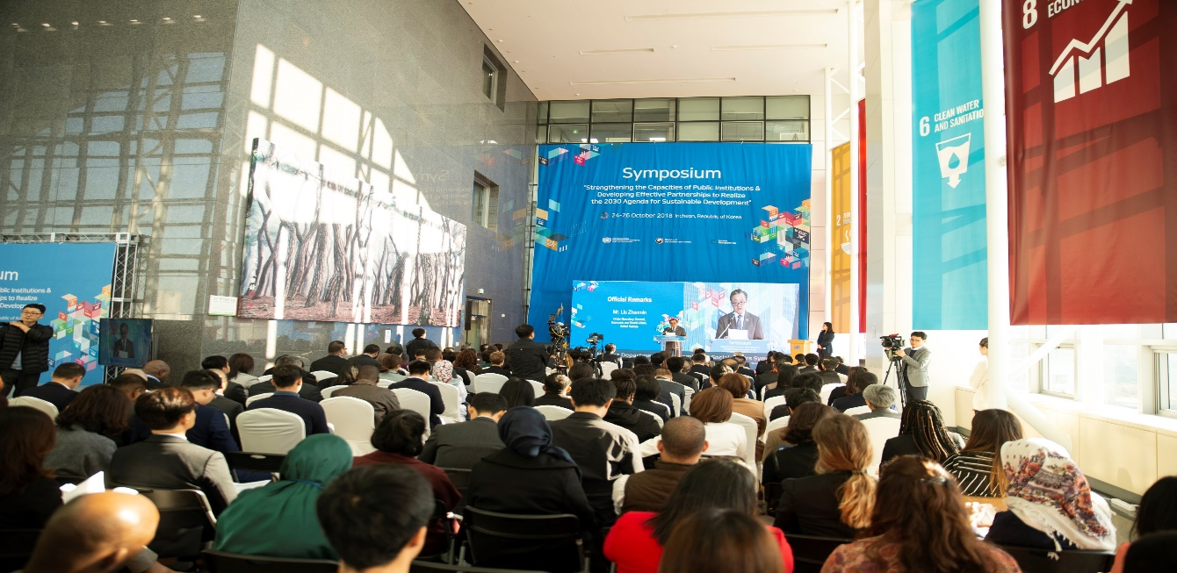
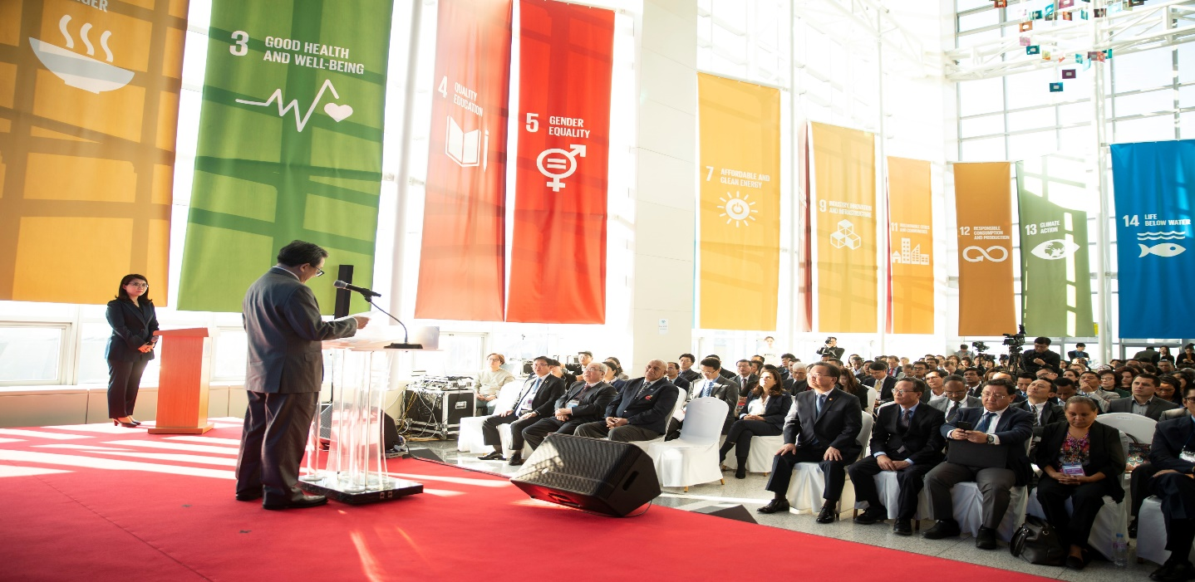
Introduction
Regional Symposium on “Strengthening the Capacities of Public Institutions and Developing Effective Partnerships to Realize the 2030 Agenda for Sustainable Development” (24-26 October 2018, Incheon, Republic of Korea)
Organized by DPIDG/UNDESA through UNPOG with support from Ministry of the Interior & Safety and Incheon Metropolitan City, Korea.
206 participants; 55 countries representing government agencies, international organizations such as UNESCAP, UNISDR and GCF, think tanks, AfDB, academia, CSOs and private sector.
High Level Representation
USG Liu Zhenmin delivered opening and closing remarks.
H.E. Mr. Kim Boo Kyum, Minister of the Interior and Safety, delivered the opening remarks.

Slide 4
2. Key Messages from the Regional Symposium
Plenary Session I
Taking Stock of the Implementation of SDG 16 on Effective, Accountable, and Inclusive Institutions in Asia and the Pacific
Key Messages:
Public institutions play cross-cutting roles in SDG implementation.
Policy coherence and coordination among public institutions is essential to fully exploit the benefits of synergistic actions and effectively manage unavoidable trade-offs across SDGs.
Mobilization of local governments is key for achieving the 2030 Agenda, yet we observe difficulties in cascading efforts down to subnational levels.
Localizing the SDGs need to strengthen sequencing and integration into national development plans.
Institutionalized engagement and participation are critical for achieving national visions for implementation of the 2030 Agenda.
Public institutions face challenges in reaching out to vulnerable groups as there is a lack of information and disaggregated data. It is thus important to build capacities for foresight and longer-term visioning and competencies of public servants.

Slide 5
2. Key Messages from the Regional Symposium
Plenary Session II
Effective Public Institutions and Digital Government for Advancing the SDGs
Key Messages:
Digital government and frontier technologies bring huge opportunities for SDG implementation while posing risks of further digital and development divide within countries and between developing and developed countries.
Digital government and frontier technologies can significantly improve public service delivery and citizen engagement.
Frontier technologies can be applied to wellbeing of human kind such as healthcare, social protection, security and public surveillance.
Frontier technologies are transforming the traditional governance models and can create security and trust related issues.
Capacity development for local government officials, i.e. Mayors and Local Administrators is highly required for maximizing the positive impact of frontier technologies on SDG implementation.
It is imperative to institute national AI policy, framework, guidelines and potentially laws to ensure AI use is ethical and is not violating any rights of citizens and government sector.
AI could accelerate the digital divide by placing a premium on high-skilled workers.
The 4th Industrial Revolution is retransforming the partnership between countries.

Slide 6
2. Key Messages from the Regional Symposium
Plenary Session III
Inclusive Institutions for SDG Implementation: Ensuring Inclusion and Participation in Decision Making of the Poorest and Most Vulnerable Groups
Key Messages:
Ensuring inclusion and participation in decision making of the poorest and most vulnerable groups is the core component of SDG 16.
Different countries may have varied categories of vulnerable groups despite some commonalities of vulnerabilities.
Youth, women, older persons and migrants are important social groups that call for special policies for engagement.
Governments have to work with the private sector and civil society organizations to address the special needs of vulnerable groups.
Digital government and social media are important channels for inclusion and participation in decision making by vulnerable groups.
Political will and intensive grassroots communication are necessary to engage vulnerable groups.

Slide 7
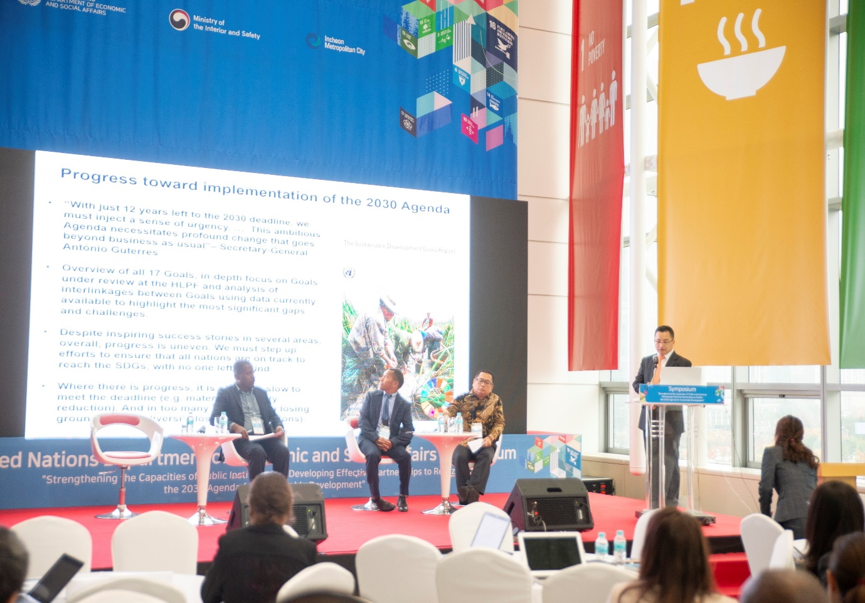

2. Key Messages from the Regional Symposium
Plenary Session IV
Accountable Institutions for SDG Implementation: Data, Statistics and Analytics for Monitoring, Review and Follow-Up
Key Messages:
The achievement of the SDGs have to synchronize with the national goals including cross cutting issues and sub national authorities.
Data mapping exercise is a very important step to mainstream the SDGs in national development strategies.

Slide 8
2. Key Messages from the Regional Symposium
Plenary Session V
Public Governance Innovations to Strengthen Resilience
Key Messages:
Small Island Developing States (SIDS) are particularly vulnerable to the effects of climate change and the increasing intensity and frequency of natural disasters.
Disaster Risk Reduction strategy should be set in synergy with climate change adaptation and mitigation to support sustainable development.
All development investment must be informed by disaster and climate risks.
Important to fully exploit innovative technology (Block chain) and remote sensing (Geographic Information System) for disaster resilience.
Building resilience should strengthen e-resilience to ensure the continuous functioning of key ICT infrastructure especially in times of emergencies.

Slide 9
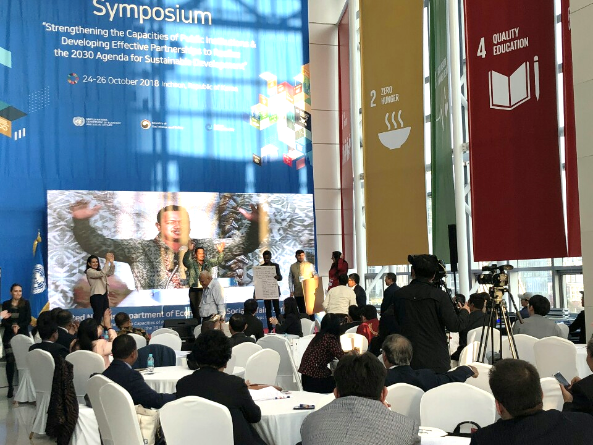
2. Key Messages from the Regional Symposium
Plenary Session VI
Partnership-Building Session
Key Messages:
Developing effective partnership including North-South, South-South and triangular cooperation is important for SDG implementation.
DPIDG of UN DESA needs to design the strategy for better supporting or facilitating the capacity development in countries in special situations through North-South, South-South and triangular cooperation.

Slide 10
3. Country Demands for Capacity Development
Others (5): Support countries’ participation in the HLPF, joint research projects and others

Slide 11



4. International Partnership
Country/Organization | Capacity Support & Commitments
Bangladesh | Offered to support and share their SDG tracker system– an open source software with others countries
The Asian Association for Public Administration (AAPA) | Offered to become a platform for networking and capacity building for teaching the SDGs
The Government of India and the government of Haryana | Could support other countries by sharing peer knowledge and systems on initiatives in the fields of financial inclusion, digital governance, citizen-centric administration and gender equality
UN ESCAP | Offered to provide support for stakeholder engagement across the Asia – Pacific region
Kazakhstan | Offered knowledge sharing opportunities in E-Government
Afghanistan | Offered joint research contribution on the 4th Industrial Revolution
China (Beijing Institute of Technology) | Offered hosting training workshops
Malaysia | Offered venue for meetings and conferences in Kuala Lumpur

Slide 12
5. Priority Work of UNPOG in 2019
Priorities Areas
Regional Symposium
Multi-Country Training Workshop on Institutional Arrangements Leadership and Innovative Capacity to Implement the SDGs
United Nations Public Service (UNPS) Forum Workshop on government innovation for social inclusion of vulnerable groups
Study Visit to Korea on E-Government
Peer-to-peer Learning Workshop for SIDS
High Level Political Forum (HLPF) side event on SDG 16

Slide 13

www.unpog.org
http://publicadministration.un.org
Notes:
13

