Slide 1

Institutional arrangements to facilitate coherence in sustainable development policies
Implementing the 2030 Agenda in the Asia- Pacific region, 23-24 January 2019, Shanghai
Veronique Verbruggen, Senior Inter-regional Adviser Governance and Public
Administration Institution Building, CDU
Division for Public Institutions and Digital Government (DPIDG)
United Nations Department of Economic and Social Affairs (UN DESA)

Slide 2
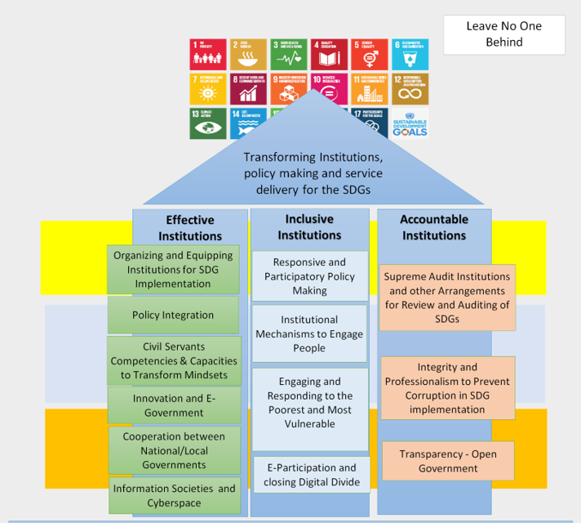
Transforming institutions and policy development
Notes:
The unit that I work for in DESA is a global initiative that provides support in capacity development to member states in the field of SDG 16 and more in specific in organizing and equipping institutions for SDG implementation, in equipping the civil servants with the right skills that are required for the implementation of the SDGs. As an illustration, regional schools of public administration are collaborating to reach an agreement on a skillset in which civil servants would need training. It also engages on capacity development in the field of innovations in public service delivery and digital government and focuses on strengthened accountability and transparency.
It also provides support in institutional coordination to enhance policy coherence.

Slide 3
Policy coherence refers to:
(1) systematically identify relevant linkages
across the SDGs and consider those linkages in
design of policies;
(2) are consistent across scales (from local to
national) of implementation;
(3) involve relevant stakeholders in design,
implementation, monitoring and evaluation;
(4) provide adequate resources for
implementation at all levels and at all scales.

Slide 4
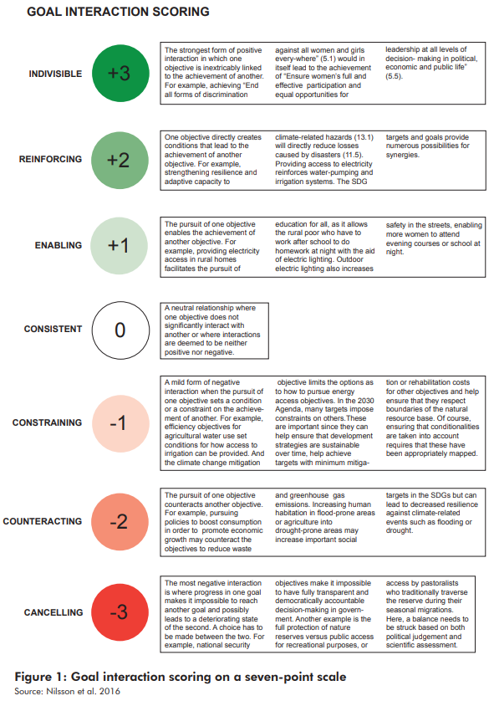

Slide 5
Policy coherence from an institutional perspective
a shift towards institutional coordination
strengthened institutional capacity
clarity in roles & responsibilities among institutions
More active participation of multiple stakeholders
Coordination in sectoral development plans
Joint decision-making
Budget availability/ joint budgets
Involvement of Statistics’ offices for access & quality to data/
Local level involvement: 13/17 SDGs are related to service
delivered at local level; 40% SDGs achieved if services are
delivered at local level.

Slide 6
Understanding of system dynamics required,
connecting the dots between immediate impact of
policy interventions and possible longer term effects
Increase the synergies & reduce the trade-offs across sectors, programmes and institutions
Manage conflicts

Slide 7
Illustration
Energy policy aimed at reducing fossil fuel subsidies
to foster a shift towards renewable sources
to have a positive impact on public health by reducing air, soil & water pollution
to increase job creation
to limit the risk of resource-based inflationary pressure
- to reduce income inequality, poverty & food insecurity
to manage water and land demands from some renewable
energy sources, which can compete with agriculture
development & threaten food security.

Slide 8
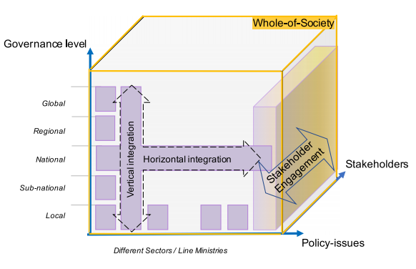
Horizontal and vertical integration
Notes:
Policy integration from an institutional perspective involves integration across sectors and institutions (horizontal integration), actions that are aligned across national and local government and result in coherent outcomes (vertical integration), and engages all stakeholders in the realization of shared objectives (broad stakeholders participation). Other concepts like “whole of government” approach is also used- reflecting the above principles and referring to ministries, public administrations, agencies at different government level that collaborate to achieve a common solution to a problem or a “whole of society” approach referring to the engagement of non-state actors in achieving common solutions to a problem.

Slide 9
Two levels of policy coherence
Institutional arrangements to ensure
implementation of the SDG agenda as a
whole
Institutional settings that promote
integrated arrangements in specific
sectors

Slide 10
Horizontal policy coherence
Institutional coordination mechanisms to develop a
comprehensive national sustainable development
strategy
Cross-sector coordination mechanisms to lead and coordinate SDG implementation
Alignment of budgetary processes with SDG
strategies in case of cross-sectoral priorities
Institutional/ staff incentives to work across sectors
Monitoring, evaluation & review SDG processes
Parliaments and Supreme Audit Institutions

Slide 11
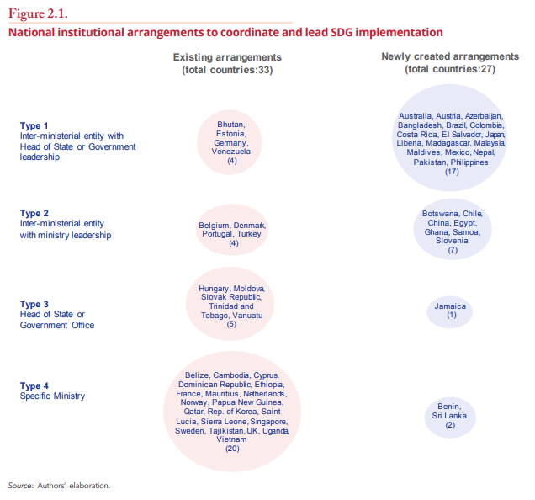

Slide 12
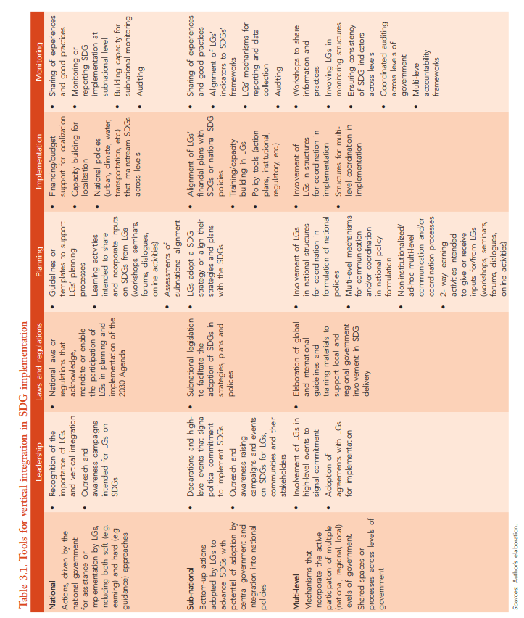

Slide 13
Lessons learned
Institutions can impede coherence in implementation
Need for contextualization, hence “best practices”
elusive as a concept
Inter-ministerial arrangements do not guarantee more engagement
More engagement does not necessarily lead to more
coherence
Power & resource imbalances among stakeholders
Real-world policymaking comprises negotiations
around competing goals and interests

Slide 14
Thank you
verbruggen2@un.org
http://publicadministration.un.org

